Slide 1
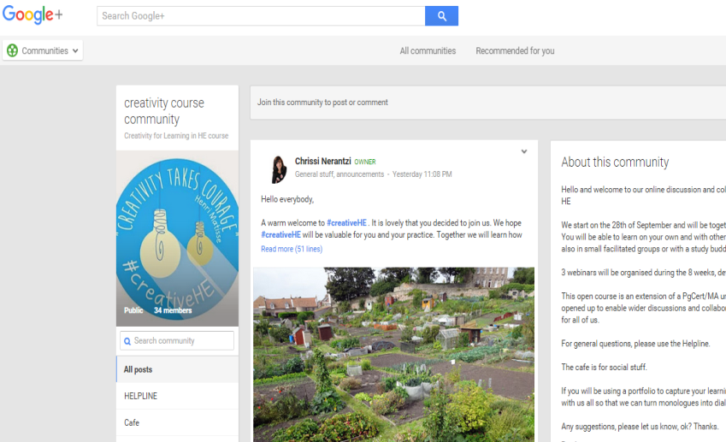
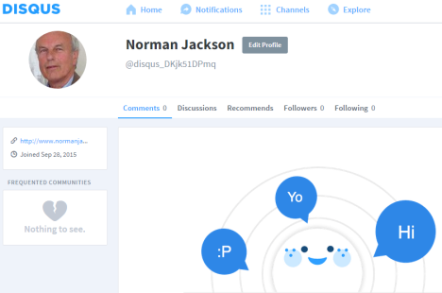
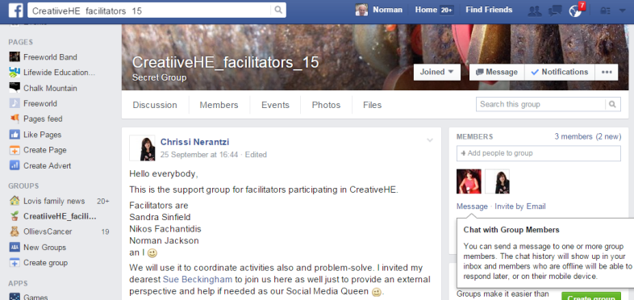
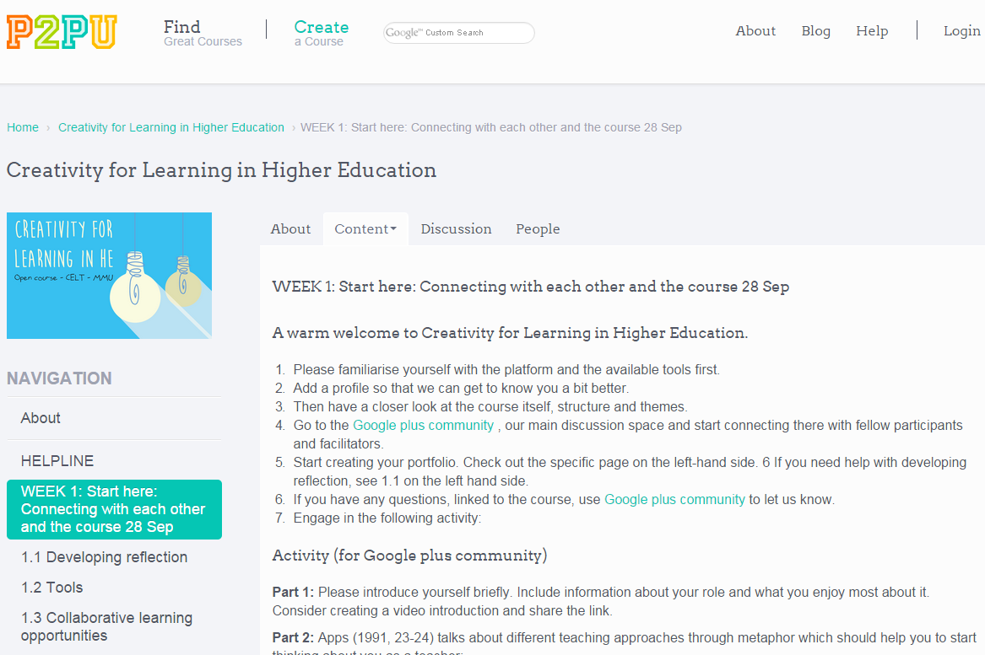
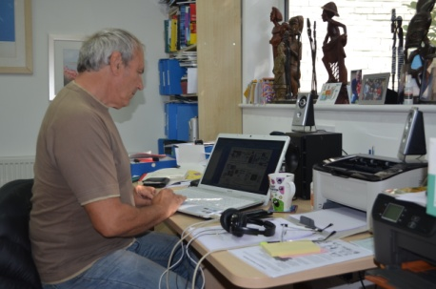
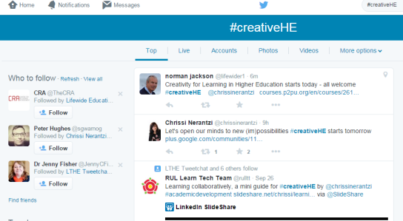
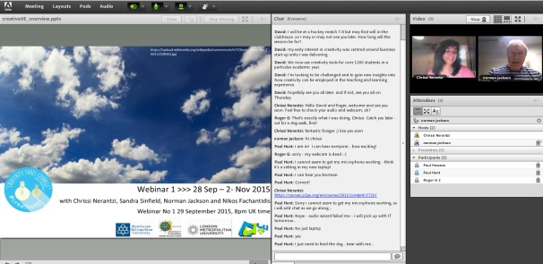
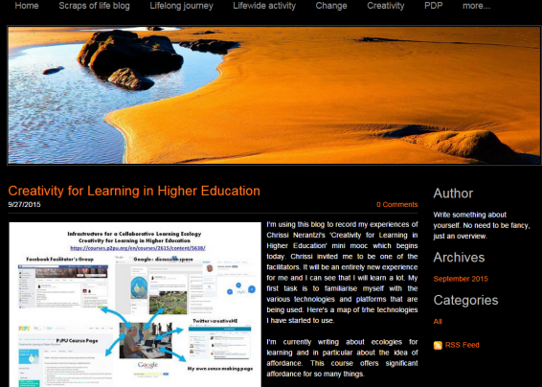
Creativity for Learning in Higher Education
TECHNOLOGY INFRASTRUCTURE FOR A COLLABORATIVE LEARNING ECOLOGY
https://courses.p2pu.org/en/courses/2615/content/5638/
Google+ community space
DISQUS discussion space
Facebook facilitator’s space
Twitter #creativeHE
P2PU Course Information & Resources
My own sense making page
Adobeconnect – f2fconversations

