Slide 1
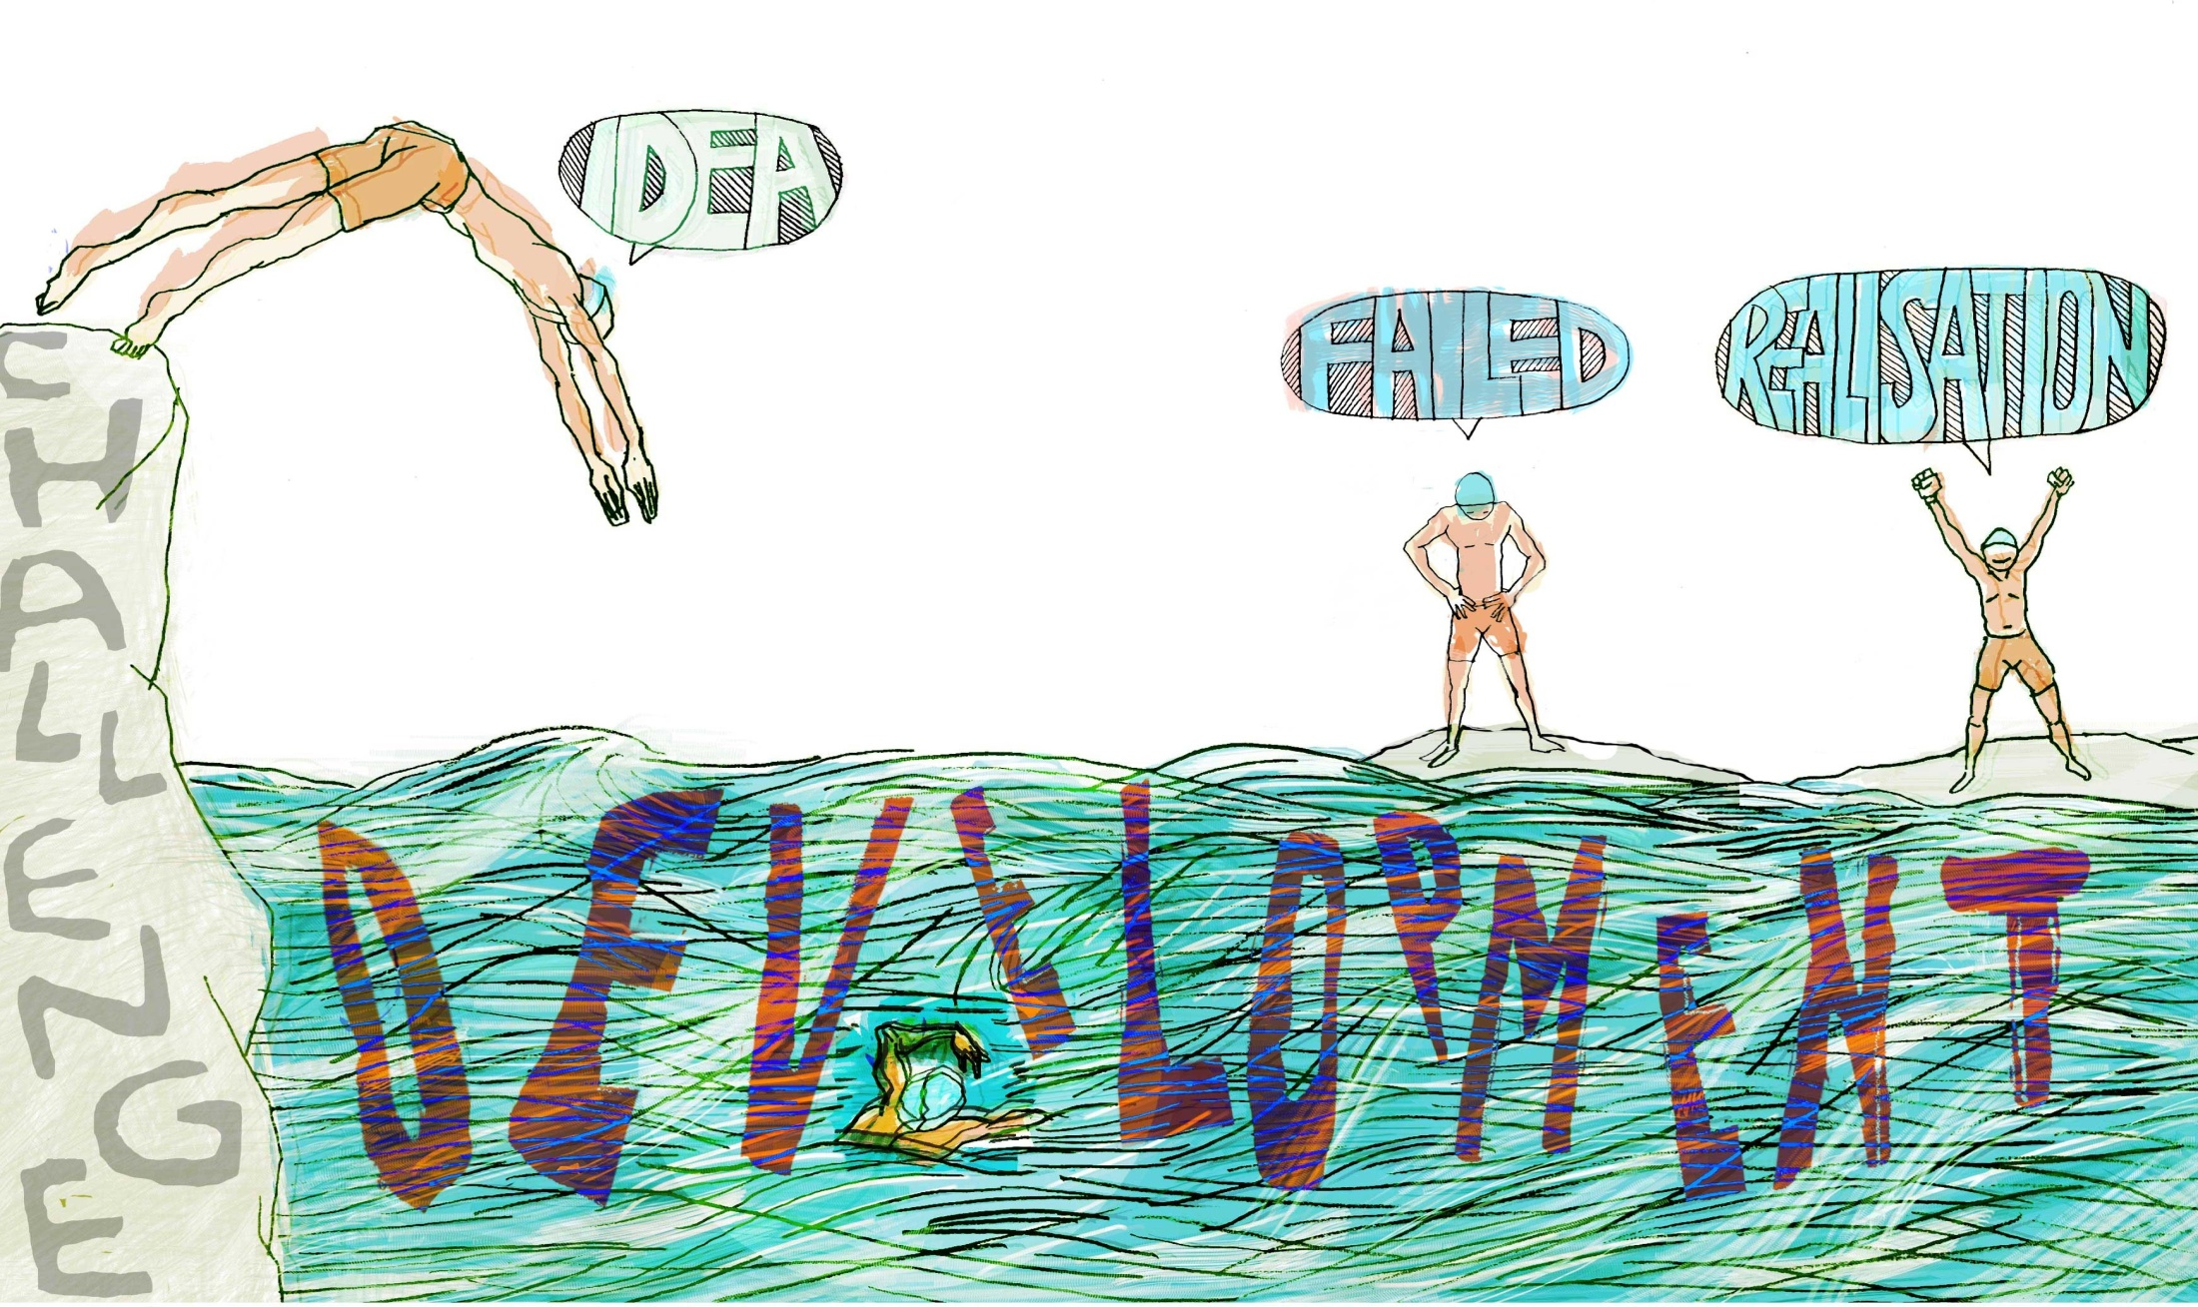
Creativity in Educational Development
Norman Jackson, Lifewide Education
Copies of slides and background studies
http://www.normanjackson.co.uk/seda.html
IDEA
FAILED
REALISED
Notes:
The wicked problem¹ facing all universities, is fundamentally a developmental challenge focused on the question of 'how we prepare learners for the challenges they will face in their future lives'. Nested in this challenge is the developmental problem of how teachers and other professionals directly involved in student development develop themselves so that they can support and enable students to develop themselves so that they can act effectively in the future worlds they will inhabit. For institutional leaders the developmental challenge is concerned with the continual process of change so that the people who work in the organisation are able to engage effectively with this challenge. People who work in a developmental role fulfil a unique role in enabling the institution to meet this challenge. Fundamentally this is a story of development - at personal, professional, curriculum, infrastructure and whole institution levels and what I will try and do is reveal the ways in which creativity contributes to this process.

Slide 2
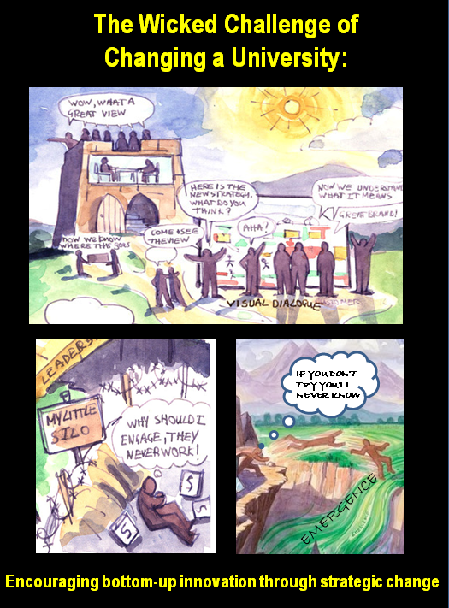
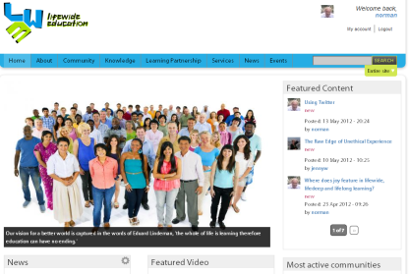
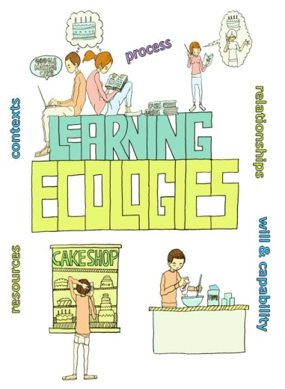
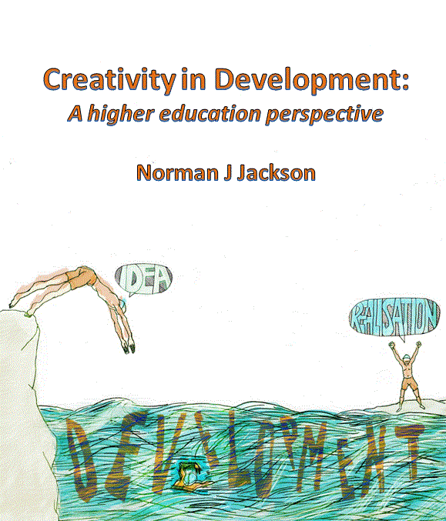
My developmental narrative - creativity in higher ed.
University of Surrey
Lifewide Education
Policy/Regulation Research Development & Innovation
Study of ‘how a
university changed’
Personal Development
Planning Community
Imaginative Curriculum
Network
SCEPTrE CETL
Lifewide Education
Community
Current study
1999-2000
2000-05
2006-13
2011-13
Notes:
We all have histories of involvement and this is part of my history of involvement in creativity in higher ed. It’s a story of personal development, and my attempts develop thinking about a higher education.

Slide 3
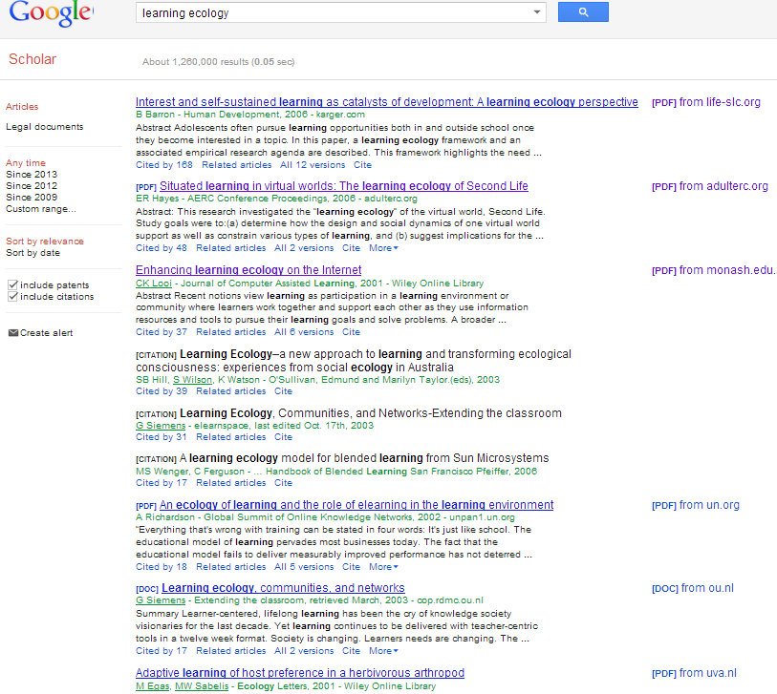
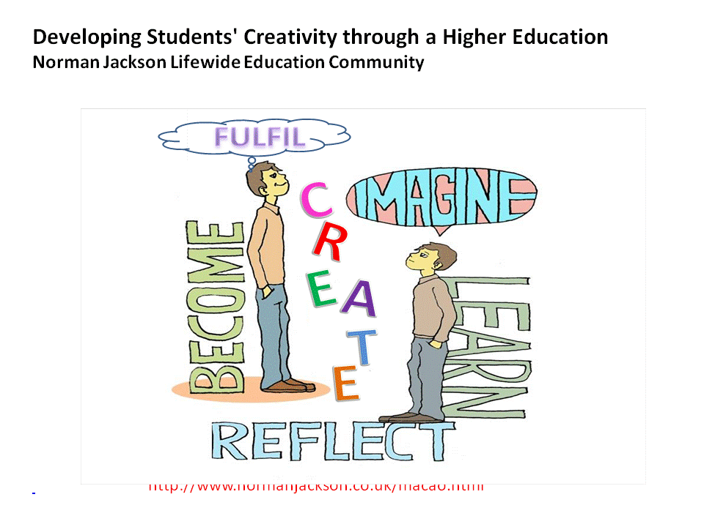
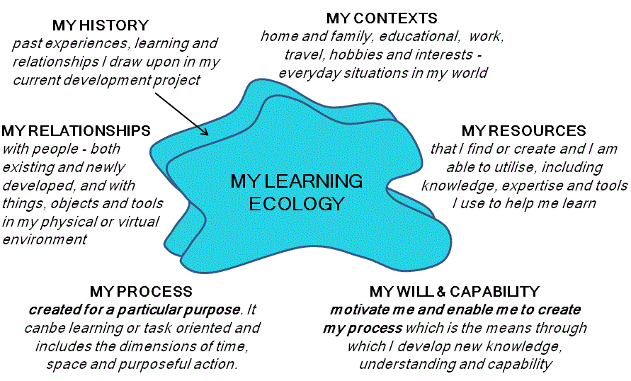
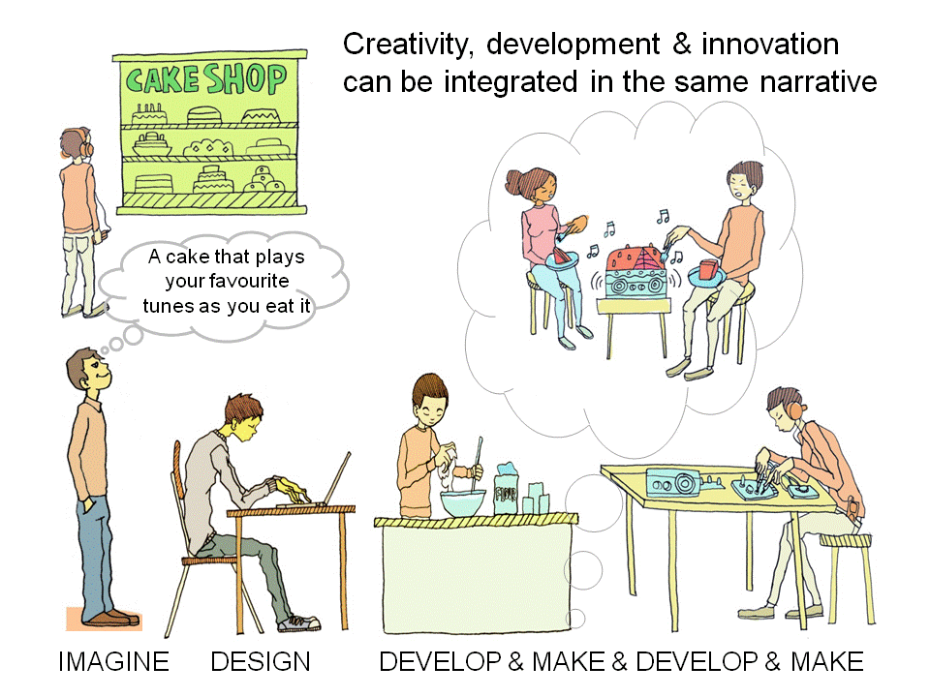
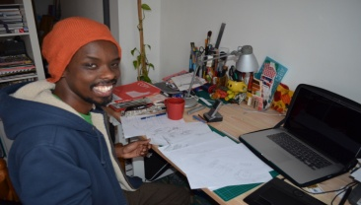
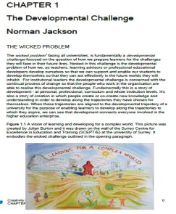
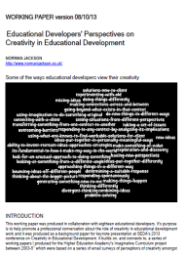
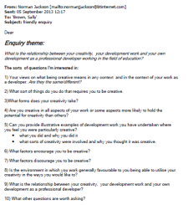
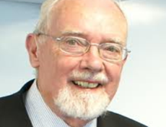
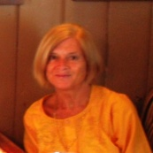
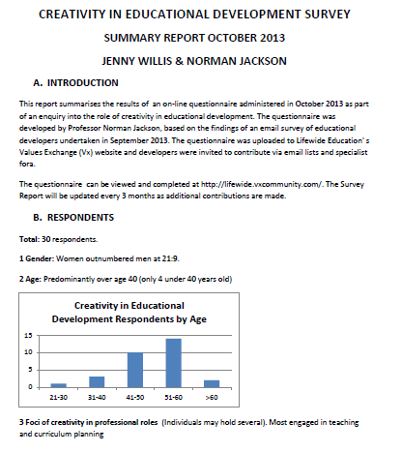
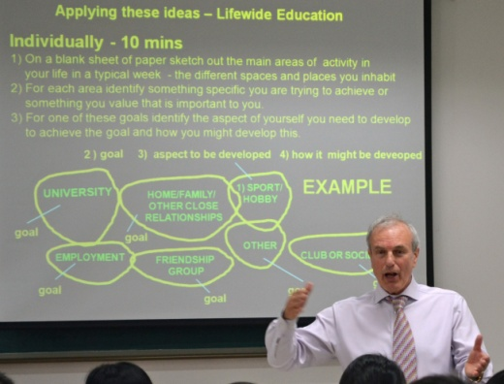
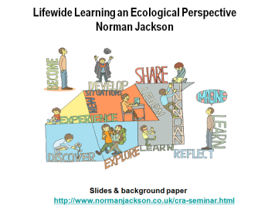
CREATING AN ECOLOGY FOR LEARNING
2 previous work
3 Creating my own narrative of my process for the purpose of identifying own creativity
1 google
7 Interactions with illustrator to create narrative imagery to communicate ideas
4 Email survey 21 developers – products, relationships, conversations. Several developers gave me extensive feedback on the working paper providing me with the encouragement and courage to go further
8 Peer reviews of
thinking/writing
Gave me valuable
feedback to
challenge my
assertions and
improve my
writing
5 Created questionnaire which JW posted on-line
and processed results
9 Created and performed presentation
10 E-book
SEDA event
6 Promoted survey using mailists/fora and 30 developers
contributed – product more detailed knowledge
WHERE NEXT???
Notes:
When we think about creativity we often overlook the most fundamental thing. The process we create to learn and achieve through which we develop.

Slide 4
CREATING AN ECOLOGY FOR LEARNING
EXISTING
2 previous work
3 Creating my own narrative of my process for the purpose of identifying own creativity
1 google
7 Interactions with illustrator to create narrative imagery to communicate ideas
NEW
process
NEW – visual aids
4 Email survey 21 developers – products, relationships, conversations. Several developers gave me extensive feedback on the working paper providing me with the encouragement and courage to go further
NEW synthesis
8 Peer reviews of
thinking/writing
Gave me valuable
feedback to
challenge my
assertions and
improve my
writing
NEW - collaboration
5 Created questionnaire which JW posted on-line
and processed results
NEW - knowledge
9 Created and performed presentation
10 E-book
NEW - collaboration
SEDA event
6 Promoted survey using mailists/fora and 30 developers
contributed – product more detailed knowledge
NEW
WHERE NEXT???
Notes:
The very act of bringing such processes into existence is an act of creativity.
'the emergence in action of a novel relational proocess growing out of the uniqueness of the individual on the one hand, and the materials, events, people, or circumstances of his life'
Carl Rogers (1960)

Slide 5
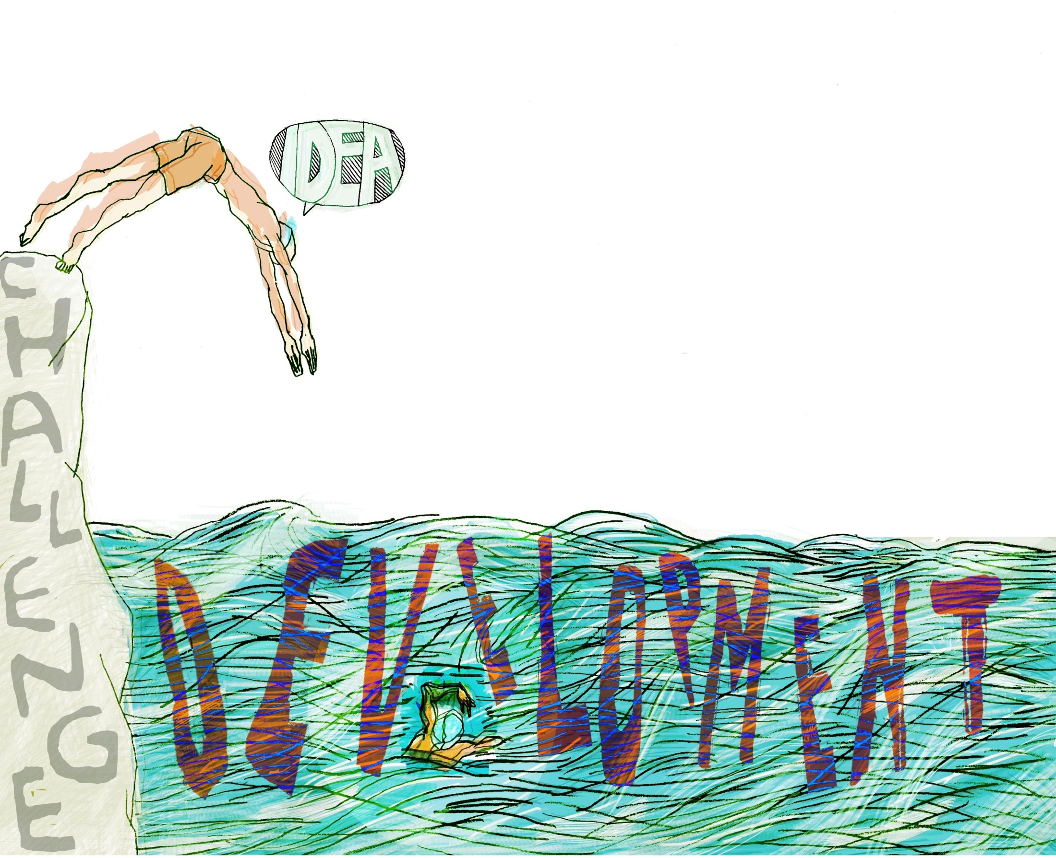
Development is intentional movement towards something different that has
potential to be better than what currently exists or to add value to what exists
NEWNESS
structures, tools, frameworks, processes, procedures
- behaviour and practice
- thinking, knowledge and understanding
MAKING SOMETHING DIFFERENT
Modifying/adapting something that already exists
REPLACING SOMETHING
BECOMING DIFFERENT
STOPPING SOMETHING

Slide 6
Developmental Spectrum
INCREMENTAL
Doing the right things
Doing things right
Doing things better
Stopping doing things
NON-INCREMENTAL
Doing new things that someone else is doing
Appropriating what someone else is doing
Doing things that no one else is doing
Trying to do things that can’t be done
INNOVATION
An educational innovation is
'a novel solution to an educational problem,
opportunity or challenge, that is more effective, efficient, sustainable, or just than existing solutions’
(adapted from Phills et al 2008)

Slide 7
Creativity is the concept we use when we talk about bringing ideas,
material or virtual objects, processes, performances and practices
into existence
Creativity is the production of novel and useful ideas in any domain....
But the product or idea cannot be merely different for difference sake; it must also be appropriate to the goal at hand, correct, valuable, or expressive of meaning (Amabile 1996)

Slide 8
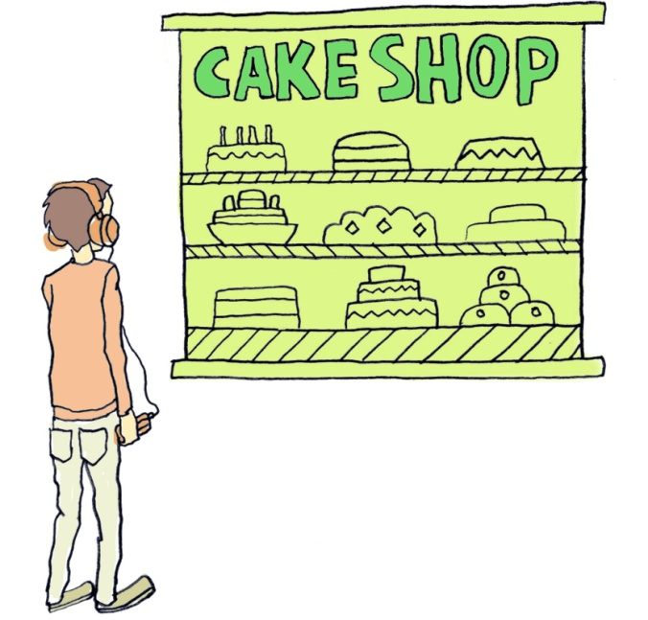
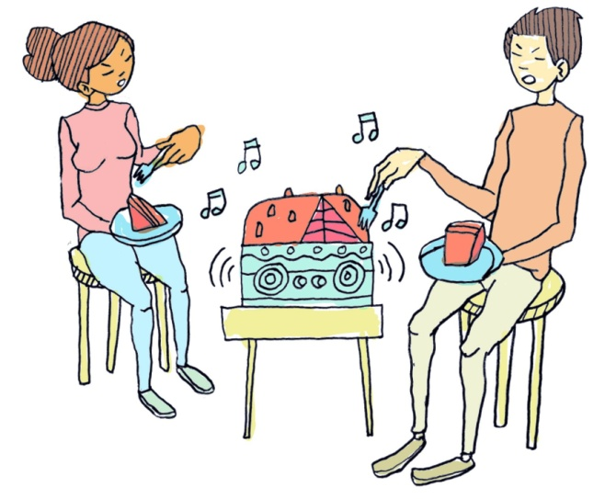
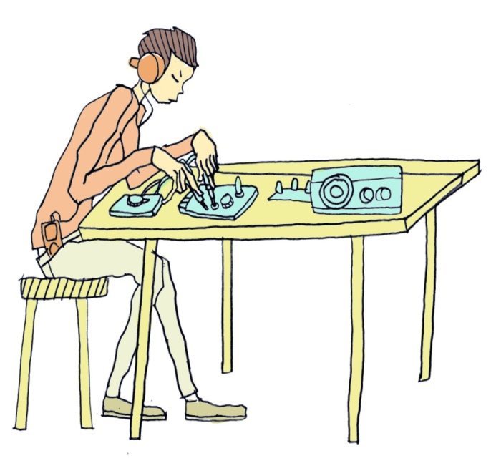
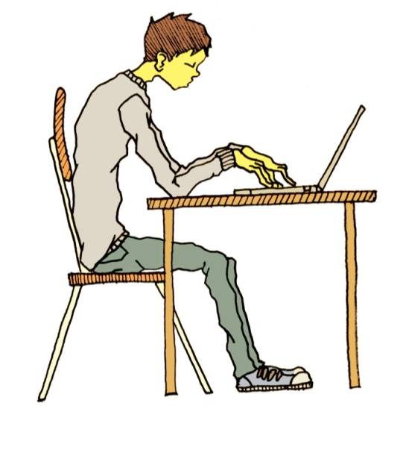
Integrating creativity, development
& innovation in the same narrative
A cake that plays your favourite tunes as you eat it
IMAGINE DEVELOP & MAKE & DEVELOP & MAKE & PRODUCE

Slide 9
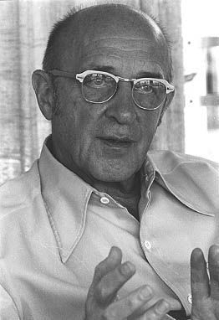
A definition of creativity
that explains the narrative
Personal creativity is
'the emergence in action of a novel relational product growing out of the uniqueness of the individual on the one hand, and the materials, events, people, or circumstances of his life'
Carl Rogers (1960)
product = ideas, material or virtual objects,
practices and performances and processes
PRODUCT RESULTS FROM PROCESS!
Notes:
What learners need is reassurance that they are creative. They need conceptions of creativity that they can readily relate to in their own lives.
Vygotsky, one of the great thought leaders in learning and development, 'any human act that gives rise to something new
is.... a creative act, regardless of whether what was created is a physical object or some mental or emotional construct that lives within
the person who created it and is known only to him’ Lev Vygotsky
view provides a powerful way of embedding our creativity in our own mental and emotional lives. If we accept his conception then we are all creative and all more or less continuously creating. It is a fundamentally human characteristic.
Rogers provides a useful definition of personal creativity that we can all relate to and which can explain our creative acts.

Slide 10
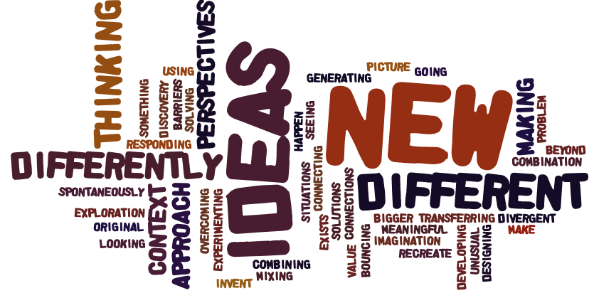
Beliefs of developers in education
What does being creative mean in the
context of educational development?

Slide 11
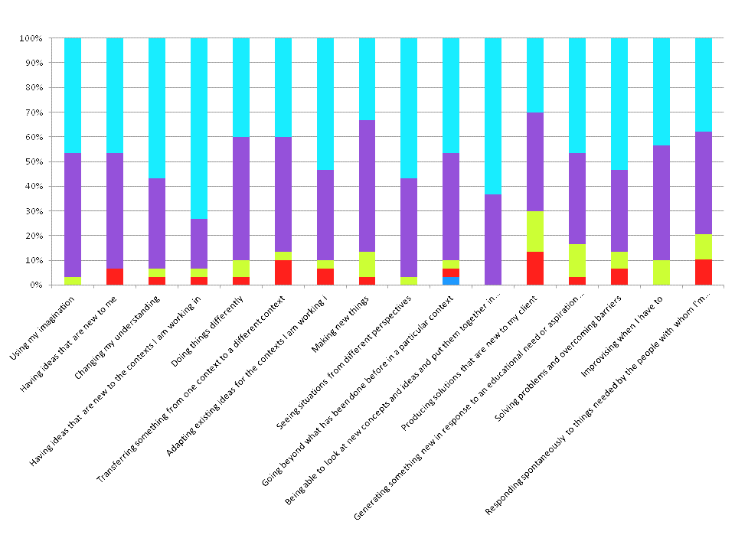
Beliefs of developers in education
What does being creative mean in the
context of educational development? n-=30
Strongly
Disagree
Strongly
Agree
Using imagination
Having ideas new to me
Changing my understanding
Having ideas new to the contexts I’m working in
Seeing situations from different perspectives
Able to combine new ideas in interesting/meaningful ways
Notes:
All are relevant at the 70% agree/strongly agree level. All but one at 80% level.
Eight perceptions are relevant at the 90% agree/strongly agree level.

Slide 12
Personal creativity in the service of others
[My] creativity is about generating something new to me which brings me
some satisfaction because I’ve done something innovative. As a developer,
it’s in accordance with that - but in response to an educational need or
aspiration which matters to me Educational Developer H
In my development work, creativity is often required in order to connect
with a given 'client' in order to 'bring alive' relevant personal meaning for
them of the values and actions that I am wishing to foster.
Educational Developer F

Slide 13
Beliefs of developers in education
Creativity is a rare gift which only a few people have
responses of university teachers University of Ulster Teaching & Learning Conference (n=58)
responses of educational developers to on-line survey (n=29)

Slide 14
Beliefs of developers in education
Most people can develop their creativity if they are given the opportunity to do so
responses of educational developers to on-line survey (n=30)
responses of university teachers University of Ulster Teaching & Learning Conference (n=58)

Slide 15
Beliefs of developers in education
Effective use of creativity is dependent on many factors such as personal agency, attitudes, challenge, hard work, capability and context relevant knowledge
responses of educational developers to on-line survey (n=30)
responses of university teachers University of Ulster Teaching & Learning Conference (n=58)

Slide 16
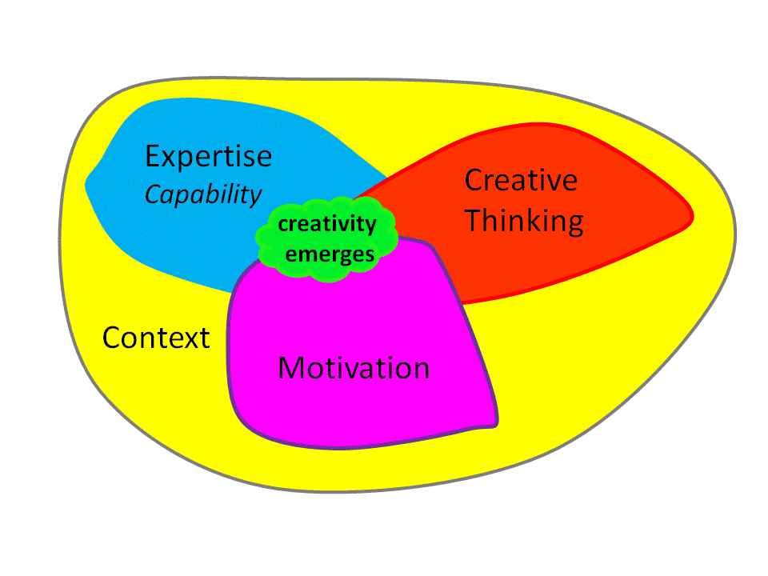
Visualising creativity
Teresa Amabile (1983)
Qualities &
Dispositions
'the emergence in action of a novel relational product, process or performance growing out of the uniqueness of the individual on the one hand, and the materials, events, people, or circumstances of his life on the other.'
‘We hardly ever pay attention to intrinsic motivation, which is the driving force that actually makes creativity happen’
Notes:
By combining Rogers definition or creativity with Teressa Amabile’s model and adding context because creative responses are context dependent – we can create a useful tool to help students understand their creativity.

Slide 17
Beliefs of developers in education
Some people are naturally more creative than others

Slide 18
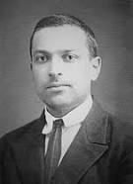
Significance
'any human act that gives rise to something new is.... a creative act regardless of whether what was created is a physical object or some mental or emotional construct that lives within the person who created it and is known only to him’
Lev Vygotsky
Notes:
What learners need is reassurance that they are creative. They need conceptions of creativity that they can readily relate to in their own lives.
Vygotsky, one of the great thought leaders in learning and development, 'any human act that gives rise to something new
is.... a creative act, regardless of whether what was created is a physical object or some mental or emotional construct that lives within
the person who created it and is known only to him’ Lev Vygotsky
view provides a powerful way of embedding our creativity in our own mental and emotional lives. If we accept his conception then we are all creative and all more or less continuously creating. It is a fundamentally human characteristic.
Rogers provides a useful definition of personal creativity that we can all relate to and which can explain our creative acts.

Slide 19
Four-C model of creativity Kaufman and Berghetto (2009)
mini-c
little-c
Pro-c
Big-C
eminent
creativity of
exceptional
people
creative acts of experts/experienced
people & teams within an organisation, community
or domain
new ideas and their implementation
everyday creative
thoughts and actions in every aspect of our lives
impact on
culture, society,
the world
impact on an organisation, field, system of practice,
or market
changes in our understandings
impact on
individuals and their
zone of influence
individuals’
significance and impact of a development/ innovation (1-3)

Slide 20
Beliefs of developers in education
Being creative is an essential part of my professional identity
responses of educational developers to on-line survey (n=30)
responses of university teachers University of Ulster Teaching & Learning Conference (n=58)

Slide 21
Beliefs of developers in education
The role of educational developer involves considerable creativity
I don`t have much opportunity
to be creative in my work as an educational developer
responses of educational developers to on-line survey (n=30)
Notes:
To summarise – faculty value their own creativity, they share similar understandings of what it means, they believe it can be developed, its not something that can be separated from context, capability and motivation, their role is not to define it for students but to encourage learners to understand their own creativity and communicate their understandings.

Slide 22
Beliefs of developers in education
I am at my most creative when
I am working collaboratively
and productively with others
I am at my most creative when I am working by myself on something
I care deeply about
responses of educational developers to on-line survey (n=30)
Notes:
To summarise – faculty value their own creativity, they share similar understandings of what it means, they believe it can be developed, its not something that can be separated from context, capability and motivation, their role is not to define it for students but to encourage learners to understand their own creativity and communicate their understandings.

Slide 23
Beliefs of developers in education
I develop myself through the professional development
work I do and this includes my creative development
responses of educational developers to on-line survey (n=30)

Slide 24
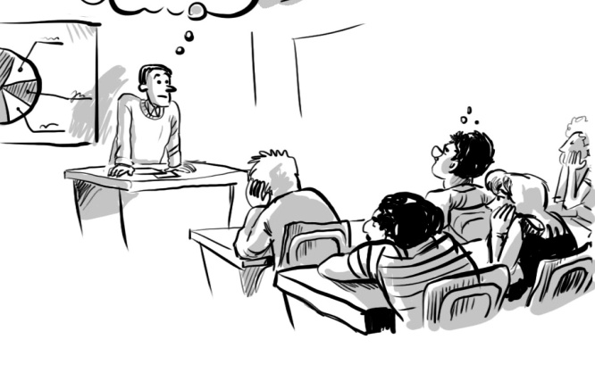
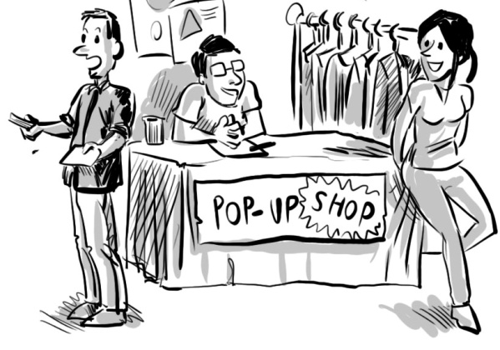
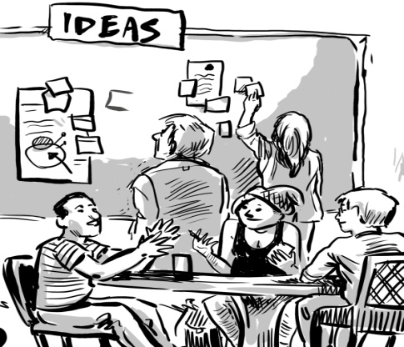
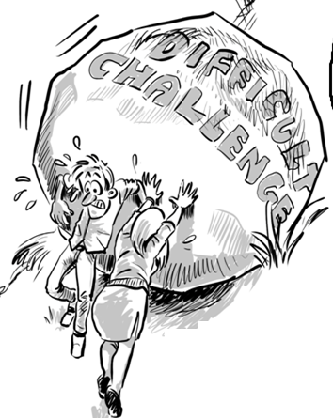
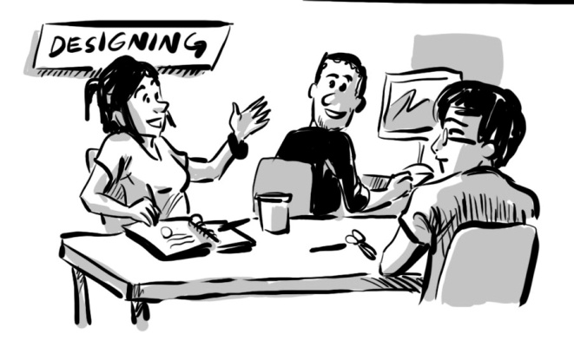
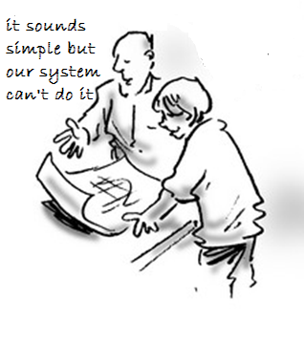
What are the most important personal
qualities, skills, capabilities, attitudes
and values that enable you to be
creative in your work as an
educational developer?
THERE MUST BE
A BETTER WAY?
WHAT A GREAT
WAY TO LEARN
WHAT A GREAT IDEA
IT WILL ALL BE
WORTH IT IN THE END
WHAT IF WE ?...
SORRY YOU
CAN’T DO THAT!

Slide 25
What sort of things do you do that requires you to be creative?
imagining
communicating in engaging ways
developing collaborative relationships
resolving issues /conflicts
designing and implementing processes
playing and experimenting
conducting research
performing and improvising
teaching and facilitating learning
inspiring others and leading thinking
empowering others
‘Approaches ie to organisation of resources, structures; strategic – creating
strategy, new approaches; presentations – keynotes, presenting my
research and experiences; teaching. Pretty much everything.’ Ed. Dev. P
Notes:
Ways and means to accomplish
Creativity is embedded and embodied in the ways and means developers have for accomplishing what they value and what their institution or clients need them to do.
Managing attention, using resources, getting grim messages
across, dealing with dilemmas, putting things into a palatable
form so that people who are turned off by text can engage
with ideas at a higher level Educational Developer R

Slide 26
Developmental Spectrum
INCREMENTAL
Doing the right things
Doing things right
Doing things better
Stopping doing things
NON-INCREMENTAL
Doing new things that someone else is doing
Appropriating what someone else is doing
Doing things that no one else is doing
Trying to do things that can’t be done

Slide 27
Opportunities for being creative in the incremental
parts of the developmental spectrum (n=30)
Doing the right things
favourable
Doing things right
Doing things better
most favourable
Stopping doing things

Slide 28
Opportunities for being creative in the innovation parts of the developmental spectrum (n=30)
Doing new things
that someone else
is already doing
good for some
good for some
Appropriating what
someone else is doing
most favourable
Doing things no
one else is doing
good for some
Trying to do things
that can’t be done

Slide 29
CONTEXTUALISING CREATIVITY IN DEVELOPMENT
Think of a significant educational development project you have been involved in and try to match it to one of these types of situation
Adaptive - being inventive with
someone else’s ideas or practices.
Recreation - adapting things that
have been done before in another
context. Doing things that have
been done before but differently.
Original - your own ideas,
inventing new practices.
Doing things that no one
has done before to the best
of your knowledge
Incremental - building on what already exists in your own context perhaps drawing on ideas and practices from elsewhere
Combinational - mainly adapted from ideas and practices elsewhere but
containing some original features developed in your own context

Slide 30
Distribution of creative effort within a
specific educational development project

Slide 31
Creative effort in educational development
finding & managing
resources
visioning
selling
ideas
design
research/enquiry
managing others
turning ideas into new practices
helping others
forming new relationships
evaluating
sharing / disseminating results
performing
working collaboratively

Slide 32
Factors that encourage creativity in development
Amabile’s model of creativity
Process
Personal
Organisational/managerial/
cultural/environmental
Notes:
Factors that encourage creativity in development
Personal
Ability to think and act creatively
Having the capability to undertake the work or the belief that the necessary knowledge and capability can be developed
Having particular attitudes or orientations – like being open to new ideas, willing to take risks and to persevere when faced with obstacles
Having the ability to persuade others
Being motivated from within intrinsic motivations might be triggered by:
a problem or issue needing resolution
exposure to an exiting idea or practice
feelings of boredom and staleness
Process factors relate to
the dynamics of engagement and interaction – belief that good things will emerge from good work processes
the opportunities for communication in order to persuade or involve people
meaningful and productive working relationships with colleagues/clients
having the freedom, time and space to develop something in a particular way
Organisational / cultural / environmental factors that encourage include
managerial regimes that trusts and empowers developers and appreciates and values their efforts
being part of a supportive and productive team
a culture/community which values and cares about people
having sufficient resources. Limited resources do not necessarily stifle creativity as it is can be an incentive for resourcefulness.
Employment conditions or situations that provide the developer with the freedom/ autonomy/ flexibility/independence they need to fulfil their role.

Slide 33
Factors that discourage creativity in development
Relational /
interpersonal
Amabile’s model of creativity
Personal
Organisational/managerial/
cultural/environmental
Notes:
Personal factors like
perceived shortcomings like lacking certain knowledge or skill
lack of new ideas
lack of motivation, feeling tired or stressed and states of mind that affect ‘the will to be creative’ such as the impact of negative responses work, and not feeling supported or valued
fear of ridicule
lack of autonomy and feelings of disempowerment
excessive involvement in trivial tasks
Interpersonal factors like
other people with different priorities
resistance to new ideas and general apathy
having to persuade a whole team before we start
having the credit for my idea hijacked
myopic/ instrumental/ intransigent senior staff
other developers who dismiss anything that is different and challenges the status-quo
academic staff who assert that more creative approaches are inappropriate and not academic
people who just don't get it.
Organisational/managerial/cultural/environmental factors like
intimidating management styles - managers who don’t understand what academic
development is and don’t value or encourage more risky and creative approaches
academic or managerial bureaucracy : KPIs applied to development
accountability regimes which make people/managers risk averse
inherent conservatism
lack of clarity and agreement on “the big picture”

Slide 34
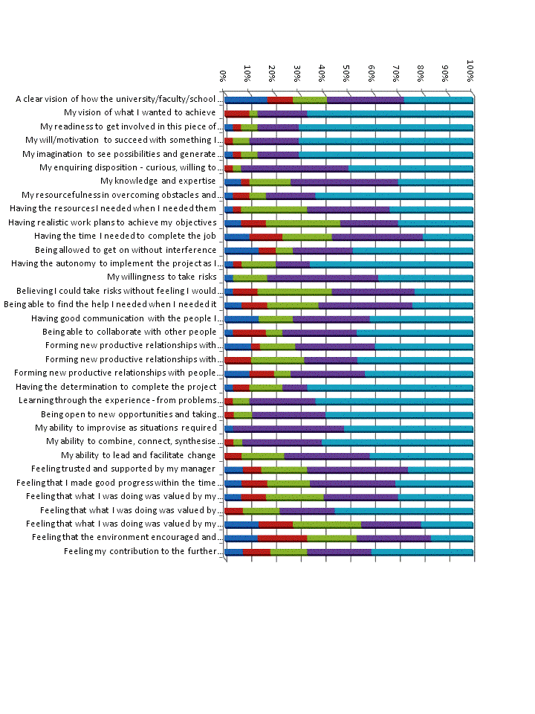
With reference to your development project, please rate the extent to which each
factor was relevant to your creativity and ability to be creative
least relevance greatest relevance

Slide 35
Most important influences on developers’ creativity and ability to be creative (top two categories >90%)
1 My ability to improvise as situations required
2 My ability to combine, connect, synthesise information, ideas, situations to
create new possibilities
3 My enquiring disposition - curious, willing to explore and experiment
4 My will/motivation to succeed with something I cared about
5 Learning through the experience - from problems as well as success
6 Being open to new opportunities and taking advantage of new situations as
they emerged

Slide 36
Least important influences on developers’ creativity and ability to be creative (top two categories >90%)
1 Feeling that what I was doing was valued by my manager(s)
2 Feeling that the environment encouraged and supported me throughout the
process especially when things did not go as planned
3 Having explicit goals and realistic work plans to achieve my objective
4 Having the time I needed to complete the job
4 Believing I could take risks without feeling I would be unduly criticised if I
wasn't completely successful
5 A clear vision of how the university/faculty/school saw its future and how my
developmental project contributed to that vision

Slide 37
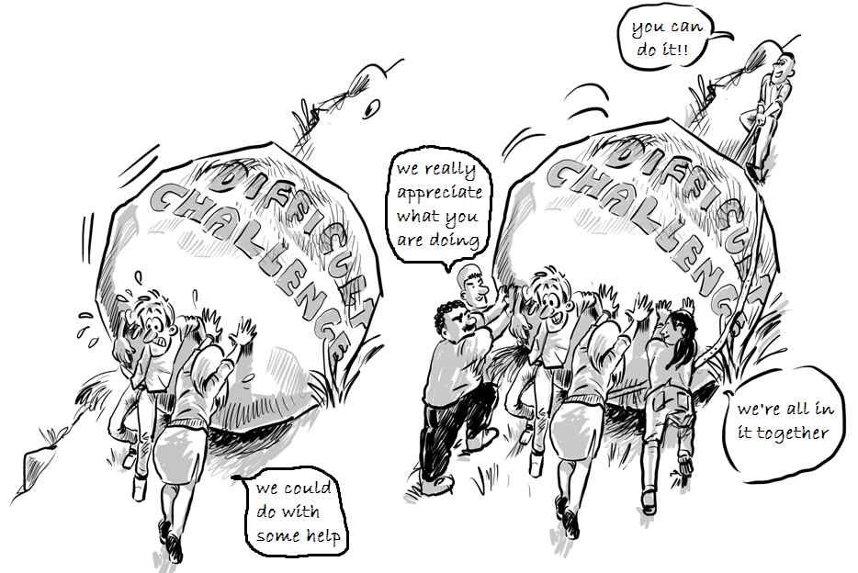
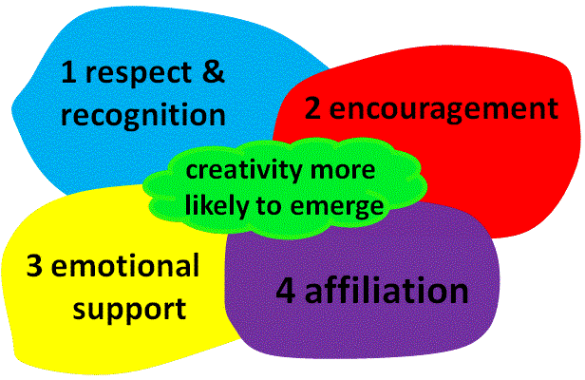
The Progress Principle - Amabile and Kramer (2012)
‘Catalysts’ that facilitate progress
and encourage creativity
Setting clear goals
Allowing autonomy
Providing resources
Having enough time
Offering help with the work
Learning how to succeed
Allowing ideas to flow
‘the single most important factor in igniting creativity, joy, trust, and productivity in workplace situations is simply a sense of making progress on meaningful work’
Environmental nourishers
Notes:
The importance of significant others in creating an ‘inner life’ conducive to personal creativity
Our ability to be creative is often constrained or enabled through the social environment we inhabit. Some aspects of our life, like work or education, involve social situations in which we interact, communicate with and engage in activity with other people to learn, accomplish things, provide services or produce things that we, and perhaps others, value.
In such environments personal creativity may be a co-creative process in which we engage in collaborative activity to achieve shared goals. Recent research (Amabile and Kramer 2012) indicates that the single most important factor in igniting creativity, joy, trust, and productivity in workplace situations is simply a sense of making progress on meaningful work.
But creating an environment that fosters progress, and which promotes intrinsic motivation and attitudes that are more likely to engage people in creative activity requires effort. Using a diary-based method Amabile and Kramer collected and analysed confidential, personal stories from over 200 employees at seven companies in a variety of industries (over 12,000 daily diaries in total) looking for commonalities that influenced "inner work life," which the book defines as "the confluence of perceptions, emotions, and motivations that individuals experience as they react to and make sense of the events of their workday." Tangible incentives—salaries and bonuses—barely registered in the diaries. But the subject of progress, or lack of it featured prominently. Diary entries that reported work progress often showed an inner work life surge, which, in turn, increased the likelihood of creative productivity.
In addition to studying the effect of progress, the researchers analysed the workday diaries to determine the factors that facilitated progress: catalysts (events that helped a project move forward) and "nourishers" (interpersonal interactions that lifted people's spirits). They also analysed the negative forms: inhibitors (events that induced setbacks) and toxins (interpersonal interactions that served to undermine employees' spirits.) Using analyses of stories in the diaries, the book outlines seven major catalysts for progress:
Setting clear goals: it's important that the goals be reachable in a realistic time frame- achieving small wins is important to maintaining a sense of progress.
Allowing autonomy: people have to have autonomy in order to get there
Providing resources: that are sufficient and timely to accomplish whatever is being attempted
Having enough time—but not too much—to complete a project : extreme time pressure is bad for creative productivity, but low-to-moderate time pressure is good
Offering help with the work
Learning from both problems and successes : an environment in which you are not punished or ridiculed if you do not succeed
Allowing ideas to flow
The research identified four nourishers necessary for a healthy inner work life: respect and recognition, encouragement, emotional support, and, finally, affiliation—any action that serves to develop mutual trust, appreciation, and even affection among co-workers. People are more likely to engage in creative activity when they encounter such environments. Perhaps there is something here we can learn from in the design and delivery of higher education experiences!

Slide 38
Factors & Conditions that Encourage/Facilitate Strategic Development, Bottom-up Innovation & Creativity
Leadership, management & facilitation of strategic development & bottom up innovation
1 Leadership is shared and distributed throughout the organisation
2 A strategic vision that inspires people to create their own visions for change that they can embody
3 A strategy for both planned and emergent change
A strategy that involves the whole social-cultural environment
Involvement of brokers to facilitate change across and between organisational
structures, hierarchies and boundaries
6 An effective but flexible approach to managing and accounting for resources
Environmental /cultural factors that support, encourage and enable strategic development, bottom-up innovation and creativity
An environment/culture that :
promotes effective, honest and meaningful communication
recognises and supports resolution of local contentious practice and facilitates rather than inhibits progress
encourages/facilitates new relationships and collaborations to foster change
provides emotional support and celebrates what has been achieved
values learning and encourages and enables people to share what has been learnt so that it can be used and adapted to other contexts
encourages people to take risks, to put themselves into unfamiliar situations where they need to
harness their creativity to realise their ideas and actualise themselves
Notes:
The study of strategic change demonstrated the value and importance of bottom-up innovation within a comprehensive and sustained strategic change project. While top down initiatives, like the introduction of new business systems and processes are essential to enabling a university to be more effective, responsive and adaptive in its educational work, it is the innovators who provide the key resource to enact and embody the significant educational changes a university is trying to make. The study reveals that innovators thrive in an organisational culture where leaders and managers are encouraging, supporting and enabling. Where they have the resources - especially time to make change happen. Where the institution's systems and procedures enable rather than hinder progress. Where they have the respect, emotional support and encouragement of managers and colleagues and where they can find help when they need it and where they feel their efforts have been valued and have made a positive difference.
It stands to reason that for organisational change to be successful the conditions and situations embodied in the factors that innovators consider to be important in accomplishing significant change have to be supported and realised. Twelve factors grouped under 1) leadership, management & facilitation or 2) environment/culture provide an overarching framework within which bottom-up innovation is more likely to be encouraged, supported and facilitated within a process of strategic change.

Slide 39
What is the relationship between your creativity, your educational development work and your own development as a professional?
‘My creativity enables me to come up with interesting ideas and to persuade others that the ideas have value. But it's in the implementation of these ideas that I have to exercise my will, use my expertise and develop new knowledge and capability in the process. So it might be argued that imagination leads to creative ideas which drive motivation to implement them but it's learning through and after the experience of trying to implement an idea that leads to my continued development as the type of professional I want to be. So they are connected in a way that enables me to be me.’ Contributor to Creativity in Educational Development Survey

Slide 40
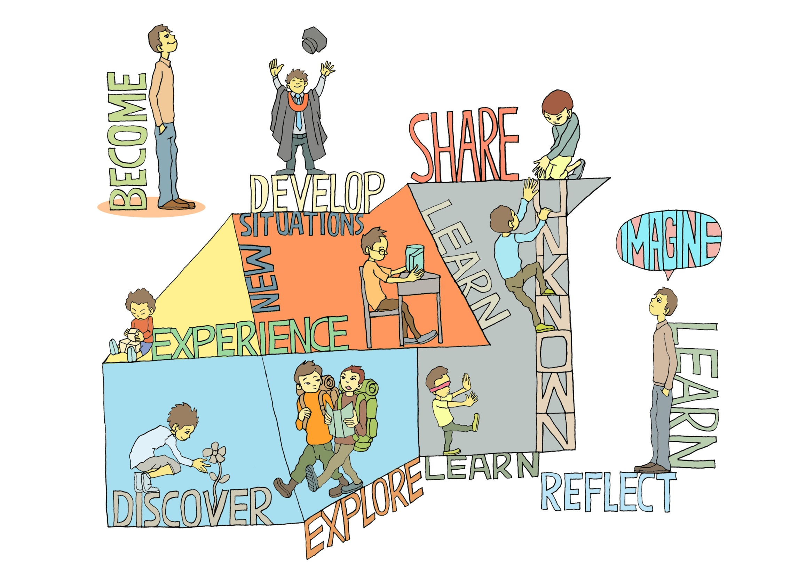
C
R
E
A
T
E
Copies of slides and working papers
can be downloaded from
http://www.normanjackson.co.uk/seda-conference.html
New E-Book to be published December 2013
http://www.lifewideeducation.com/
Notes:
WE ARE ALL CREATIVE TO VARYING DEGREES AND IN VARYING WAYS. The pathway to becoming who we want to become is a something we create for ourselves – in fact the idea of an ecology for learning and development is probably a better metaphor and it is one of the fundamental ways in which we utilise creativity Ultimately it is the way we engage with the experiences we create or encounter that determines the development we gain.

Slide 41
If you would like to add your views to the Creativity in Educational Development Survey
Visit http://lifewide.vxcommunity.com/

