Slide 4
LEARNING FOR LIFE IS
CONCERNED WITH THE FORMATION OF A WHOLE PERSON AS THEY INTERACT WITH, ADAPT TO & CHANGE THEIR WORLD

Slide 12
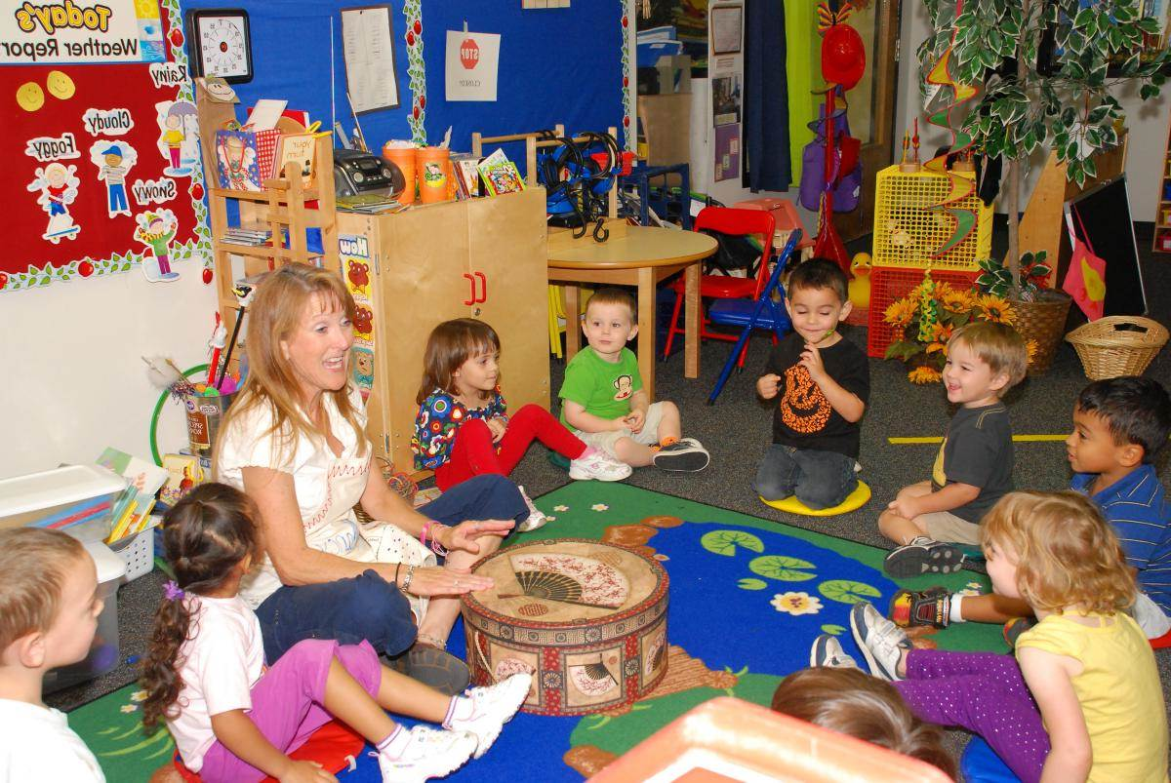
‘
Learning for life: a teachers ecology of practice
4 PLACES
The classroom is the place for situational learning through the experience of doing & co-creating meaning
3 RESOURCES teacher’s pedagogical knowledge & skill, her knowledge of each child and the world, the children’s own experiences, learning aids, posters/ pictures, musical instruments, writing materials, pupils’ work, internet and more
2 AFFORDANCE FOR LEARNING
Teacher’s ability to read
situation & respond
The classroom environment/objects
The children’s responses
PAST
PRESENT
FUTURE
5 SPACES
Physical, Social, Emotional
Intellectual, Imaginative, Playful, Liminal
1 CONTEXT(S)
State educational policies. The school ethos & culture. Planned curriculum. Teacher’s intentions, values, beliefs, motivations…
6 RELATIONSHIPS
Teacher – children,
Between children
Teacher – parents,
Parents- children
Relationships with subject, environment, materials,
tools & activities
The teacher is interacting effectively with her environment. She skilfully weaves together aspects of herself, the students & the environment. Through interaction, she senses the effects of her actions and adjusts them : learning & meaning emerge and all participants undergo through the experience.
7 ACTIVITIES which create EXPERIENCES for learning e.g. discussing, listening, showing, sharing stories, singing, dancing, reading, painting and much more

Slide 20
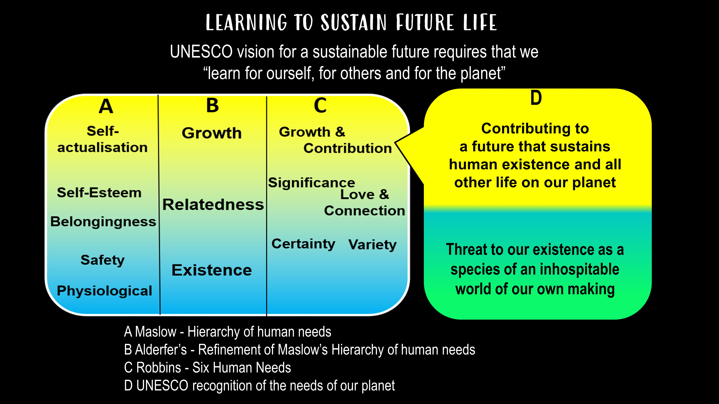

Slide 23
