Slide 1
Ecology of Creativity:
A Tale of Emergence in Practice
Norman Jackson
SLIDES & NARRATIVE http://www.normanjackson.co.uk/luminate.html

Slide 2
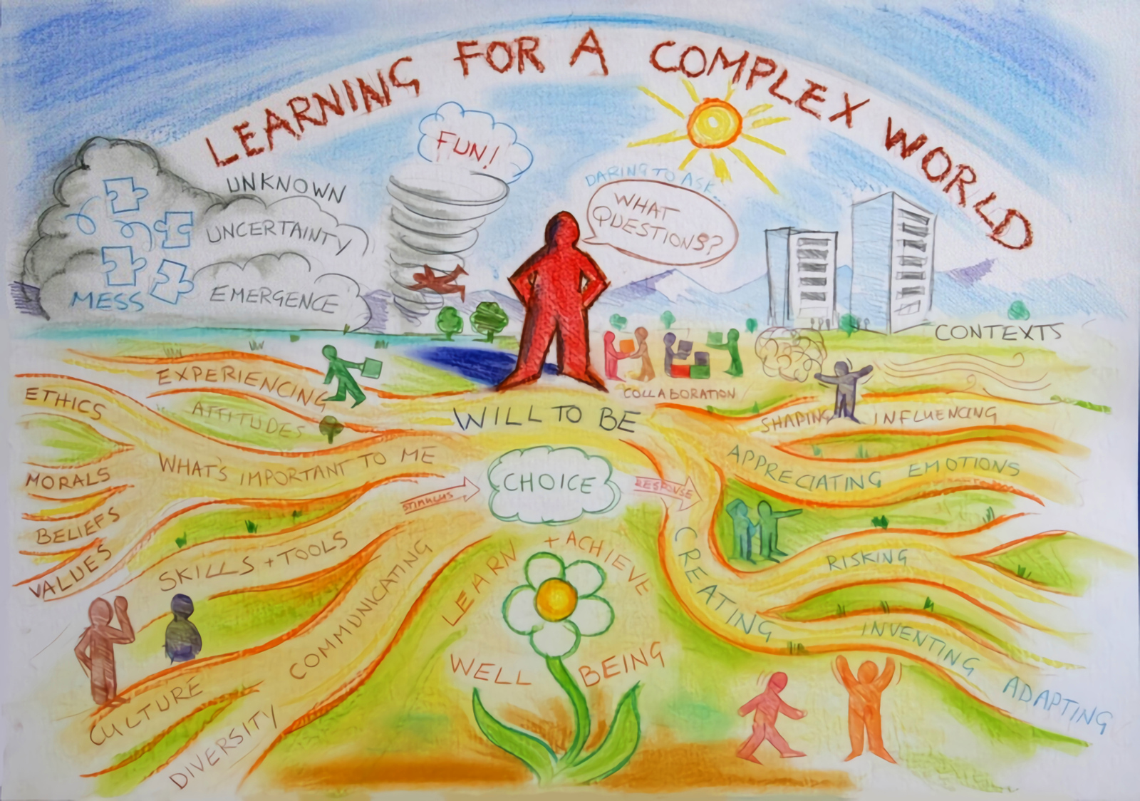

Slide 3
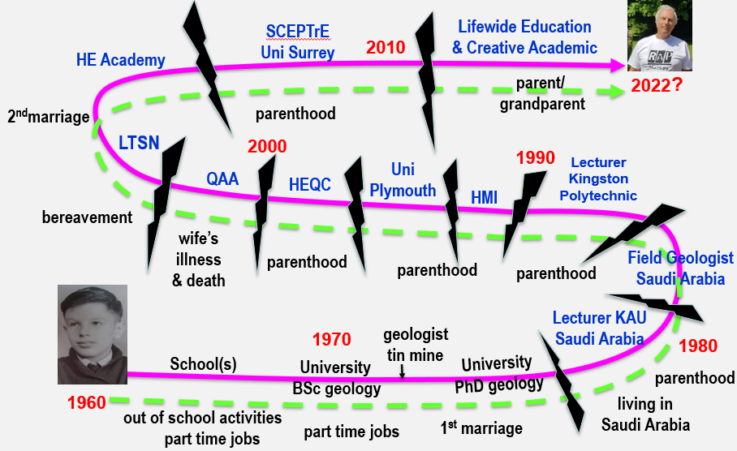
lifelong dimension of participating & developing
What is our potential?

Slide 4
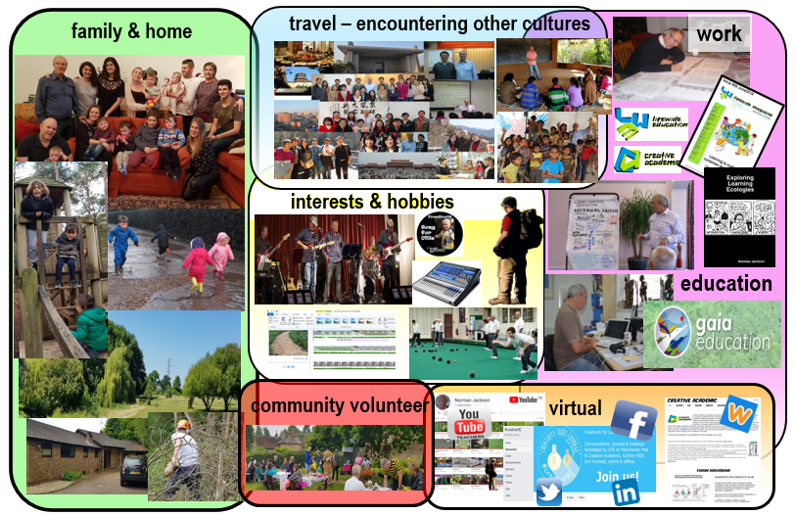
Lifewide dimension of participating & developing
What is our potential?

Slide 5
NEEDS THAT HAVE TO BE SATISFIED & MOTIVATIONAL
FORCES THAT DRIVE LIFEWIDE PARTICIPATION
Self-actualisation
Growth
Self-esteem
What is our potential?
Relatedness
Belongingness
Safety
Existence
Physiological
Abraham Maslow (1943) Clayton Alderfer (1969)

Slide 6
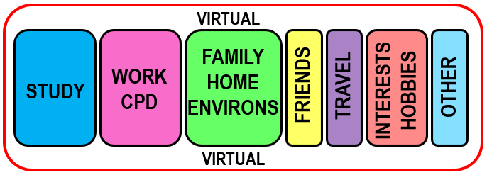
Lifewide sites for developing & realising potential
COMMUNITY
LIFELONG LEARNING Our Ontological Journey
LEARNING & DEVELOPING FOR PRESENT & FOUNDATION FOR FUTURE
Formal / non-formal
Individual
Intended
Task-focused
Need
Directed
Planned
Extrinsic motivation
Cognitive
Informal
Social
Unanticipated
Incidental
Interest
Self-directed
Emergent
Intrinsic motivation
Emotional
WE INTEGRATE
learning & development from every part of life
& opportunities for creativity emerge

Slide 7
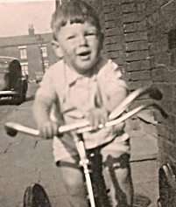
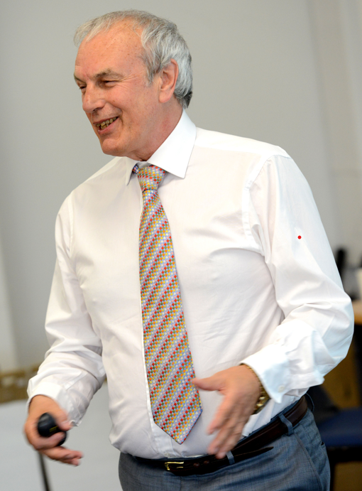
developing & realising our potential is a lifelong-lifewide practice
education
Lifewide learning
Lifelong learning - education, work & other aspects of life are
woven together by individuals in ways that have meaning to them
“The whole of life is learning therefore education can have no ending”
Eduard Lindeman (1926)
but we need to make the lifewide dimension of lifelong learning
explicit in order to see and appreciate this.

Slide 8
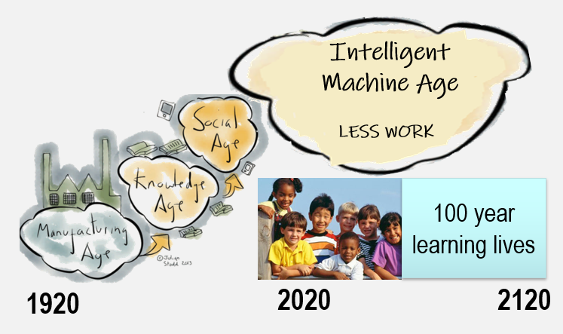
A world in formation-
work

Slide 9
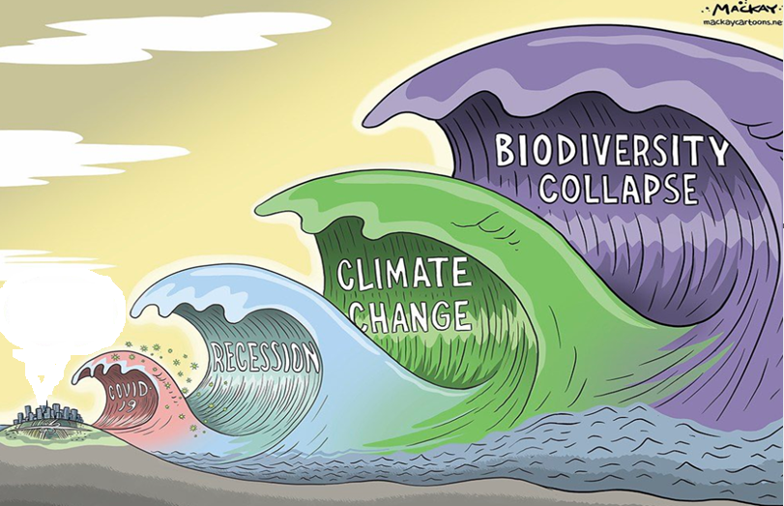
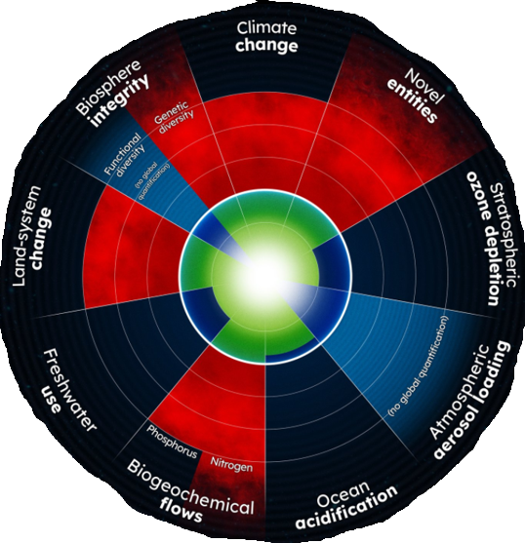
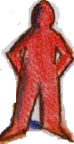
A WORLD IN FORMATION –
SUSTAINING OUR FUTURE
SOCIAL &
ENVORONMENTAL INJUSTICE
War
recession
famine
Covid
PLANETARY
BOUNDARIES
Notes:
Image credit Graeme MacKay https://mackaycartoons.net/2020/03/18/wednesday-march-11-2020/

Slide 10
GLOBAL GOALS & EDUCATION TO SUSTAIN A FRAGILE WORLD
Creativity is at the heart of sustainability. Creativity is rooted in sustainable social, economic, environmental and cultural practices. It can mean anything from humanity’s ability to transform itself to tackling specific problems.
Hans d’Orville (2019) Special Advisor
to Director-General of UNESCO

Slide 11
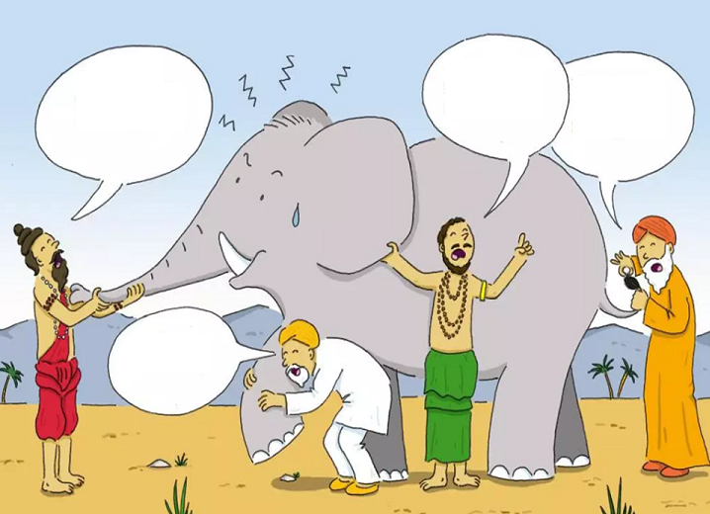
CREATIVITY
I think
Its a fan
It’s definitely
a snake
FEELS LIKE
A FURRY MOUSE
WHAT IS IT?
No Its a
tree stump

Slide 12
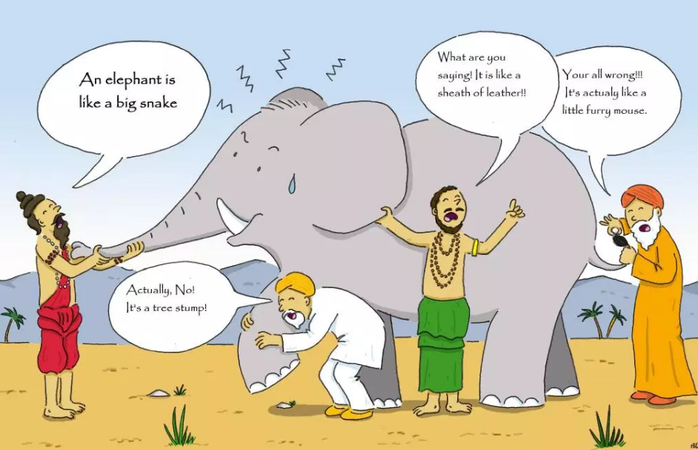
Doing
New things
Solving problems
Connecting
Combining
Inventing
Making
Performing
Communicating
Attitudes
Motivated
Enthusiastic
Curious/inquisitive
Willing to try
Willing to take risks
Determined
Obsessive
Ways of thinking
Using imagination
Thinking differently
Having new ideas
Having an open mind
Inquiring
Having ahaa moments
What does
being creative
mean?
Effects
New ideas
New things
Changes what exists
Changes you
Innovation
Transforming
Feelings
Feels personal
Satisfying
Exciting
Passion
Uncomfortable
Fulfilling

Slide 13
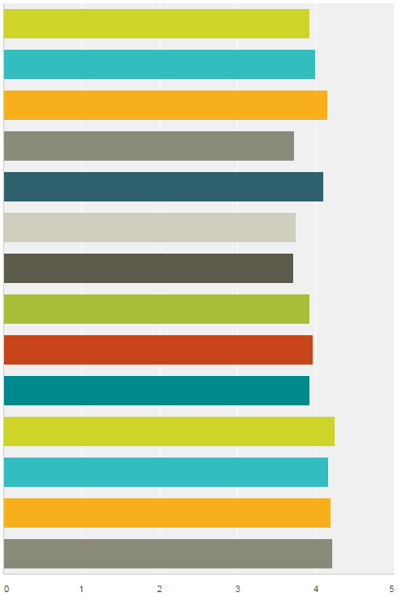
HE TEACHER BELIEFS ABOUT CREATIVITY
#lthechat n=40
In the context of your work what does being creative mean?
4.0 Agree
Having ideas that are new to the context
Being able to look at new concepts and put them
together in different but personally meaningful ways
INCREASING LEVEL OF AGREEMENT
Seeing situations from different perspectives
Solving problems and overcoming barriers
Going beyond what has been done before
Having ideas that are new to me
Generating something new in response
to an educational need
Adapting ideas to the context
Improvising when necessary
Changing my understanding
Making new things happen
Using my imagination
Doing things differently
Making new things
These ways of thinking & acting begin to reveal how creativity
is experienced in higher education teaching practices
Notes:
These ideas describe the phenomenon through which an individual’s creativity is more likely to happen.

Slide 14
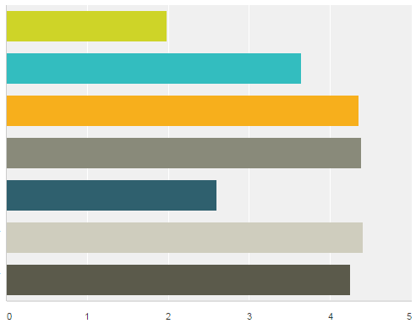
HE TEACHER BELIEFS ABOUT CREATIVITY
#lthechat n=40
Creativity is a rare gift that only a few people have
AGREE
Some people are naturally more creative than others
Most people can develop their creativity if given the opportunity to do so
Developing students' creativity should be integral to their development at university
University programmes are designed to encourage students' to use and develop their creativity
HE could do more to encourage & support students' creative development
HE should do more to encourage & support
students' creative development
STRONGLY DISAGREE

Slide 15
What does creativity mean in the academic disciplines?
Finding and solving complex problems
Being imaginative and original – able to think generatively & associatively
having new ideas and being able to adapt existing ideas.
Being curious having an enquiring disposition – being able to ‘see’
Being resourceful – finding and making use of what is available
Being able to think synthetically and relationally –
to connect things in novel ways and recognise patterns
Being able to think critically and analytically to evaluate ideas
Being able to communicate ideas to enable
people to understand and see things differently
Survey of 8 disciplines
(Jackson & Shaw 2006)
Notes:
Being original – is understood as creating something new and useful to the discipline. For most academics this is embodied in the processes and products of research many of whom are active contributors. The idea is also connected to invention and innovation. For example in history this could mean: new approaches to solving historical problems; new techniques to gather and analyse data; new approaches to validate evidence; new interpretations of evidence; new forms of history and new forms of communicating historical information.
Making use of imagination – is focused on the use of mental models in disciplinary thinking. It is a source of inspiration, stimulates curiosity and sustains motivation. It generates ideas for creative solutions and facilitates interpretation in situations which cannot be understood by facts or observations alone. Disciplinary problems and concerns provide an essential context for the use of imagination.
Finding and thinking about complex problems – the engine of academic creativity is intellectual curiosity – the desire to find out, understand, explain, prove or disprove something. Curiosity leads academics to find questions that are worth answering and problems that are worth solving.
Making sense of complexity, synthesising, connecting and seeing relationships – Because working with complex problems often involves working with multiple and incomplete data sets, the capacity to synthesise, make connections and see new patterns and relationships is important in sense-making (interpreting and creating new mental models) and working towards better understandings and possible solutions to difficult problems.
Communication - the communication of ideas, knowledge and deeper understandings are important dimensions of creativity in the discipline. The symbolic language and tools and vehicles for communicating are all part of the disciplinary heritage. Story telling is an important dimension of communication. Disciplinary cultures are largely based on writing using the conceptual and symbolic language and images that have been developed to communicate complex information. Story-telling and story-writing are important sites for academics’ creativity.
Resourcefulness – in the professional disciplines many roles involve solving difficult problems requiring ingenuity and resourcefulness. For example, a social worker or medic might need all their resourcefulness to access and acquire the resources to solve a client or patient’s problem.
Amabile⁶ reveals how these characteristics of disciplinary creativity might be integrated into her model of creativity (Figure 3) through the example of a bio-engineer utilising his expertise, creative thinking and motivations to find and solve problems (contexts) that motivate him. In this scenario we are dealing with the Pro-c versions of creativity recognised by Kaufman and Beghetto¹⁶
A bio-engineer's expertise includes his innate talent for imagining and thinking about complex scientific problems as well as sensing out the important problems in that domain, his factual knowledge of biochemistry and the techniques of genetic engineering, his familiarity with past and current work in the area, and the technical laboratory skill he has acquired. This component can be viewed as the set of cognitive pathways that may be followed for solving a given problem or doing a given task ^{6 p5}
Our bio-engineer's arsenal of creativity skills might include his ability to break out of a preconceived perception or expectation when observing experimental results, his tolerance for ambiguity in the process of deciding on the appropriate interpretation for puzzling data, his ability to suspend judgment as he considers different approaches, and his ability to break out of strict algorithms for attacking a problem^{6 p5}
Task motivation makes the difference between what our bio-engineer can do and what he will do. The former depends on his levels of domain-relevant skills and creativity-relevant skills. But it is his task motivation that determines the extent to which he will fully engage his domain-relevant skills and creativity-relevant skills in the service of creative performance.^{6p7}
For many people, simply having the intellectual challenge of a problem they care about is all they need to motivate themselves and increase their potential for creativity.

Slide 16
Creativity as originality
In psychology the “standard consensual definition” of creativity consists of “effectiveness and originality.” (Runco and Jaeger 2012).
[But there are] two ambiguities. Firstly, the definition leaves open the choice of the context and norms against which to measure originality and effectiveness. Secondly, it does not discuss the possible role of a subjective judge (Colin 2019).
Creativity is a phenomenon whereby something new and valuable is formed (Latin creō "to create, make").(Wikipedia).
The [something new] may be intangible (such as an idea, scientific theory, musical composition or joke) or a physical object (such as an invention, literary work or painting).

Slide 17
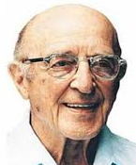
Creativity as transformation of what already exists
'the emergence in action of a novel relational product growing out of the uniqueness of the individual on the one hand, and the materials, events, people, or circumstances of [their] life’ Carl Rogers (1960)
product = ideas, material or virtual objects, practices, performances, relationships, processes, learning and more……
MEANINGS OF CREATIVITY ARE GENERATED IN SITU
situations provide contexts, cultural norms and subjective users & judges

Slide 18
Creativity as a process of
transformation & regeneration
“Creativity is the process through which we take elements of ourselves and the world around us and transform them into something new….In the process we transform the world and ourselves”
(Adapted from Bennick, 2009, TEDx Puget Sound).

Slide 19
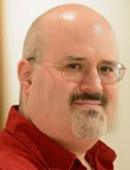
SIGNIFICANCE & SCALE OF CREATIVITY
4C Model of creativity
James Kaufman and Ron Beghetto
little-c creativity - everyday creativity found in most people,
Big-c eminent creativity which is reserved for the great.
mini-c creativity inherent in the learning process
Pro-c expertise in any domain
Kaufman, J.C. and Beghetto, R.A. (2009) Beyond Big and Little:
The Four C Model of Creativity. Review of General Psychology 13, 1, 1-12.
Notes:
One of the challenges for creativity in higher education is to develop useful conceptual tools that help us develop better shared understandings. One tool with good potential is the 4C model of creativity proposed by Kaufman and Behgetto in 2009
Kaufman, J.C. and Beghetto, R.A. (2009) Beyond Big and Little:
The Four C Model of Creativity. Review of General Psychology 13, 1, 1-12.

Slide 20
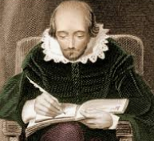
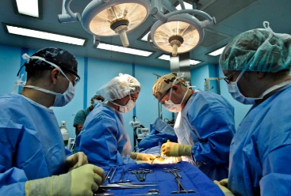
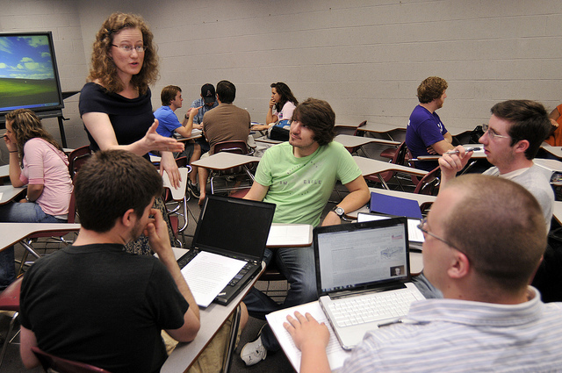
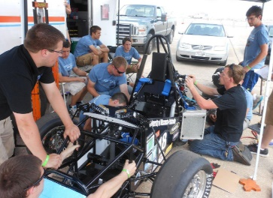
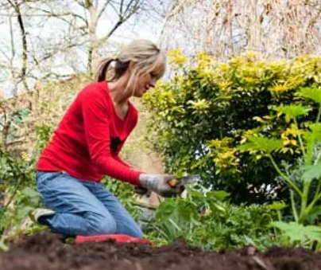
CREATIVITY CONTEXTS & NORMS
world
4C model of creativity
Kaufman & Beghetto (2009)
society
Big-C
field/domain
organisation/ community
mini-c creation of new meaning
CONTEXTS FOR CREATING
Situations within which creativity emerges
Pro-c
family/
group/team
little-c
individual
Where the results of creativity are recognised, judged & valued
NORMS FOR JUDGING & VALUING CREATIVITY
Notes:
This is our instrument.

Slide 21
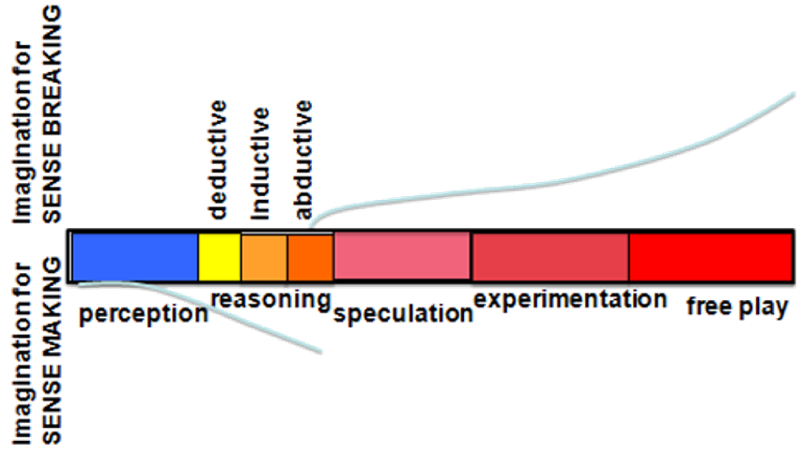
Thinking creatively
The cognitive continuum – ‘pragmatic imagination’
Pendleton-Julian and Brown (2016)

Slide 22
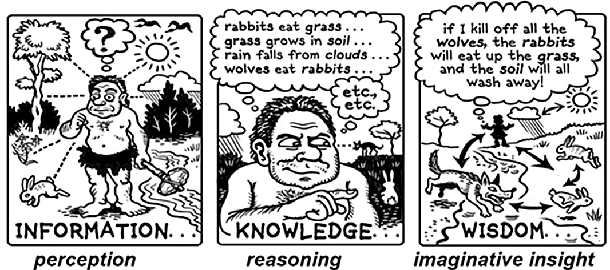
Thinking creatively
We interact with our environment, perceive and try to make sense of
information flows, create meaning and act upon these meanings.
In this way we change our understanding ‘mini-c’.

Slide 23
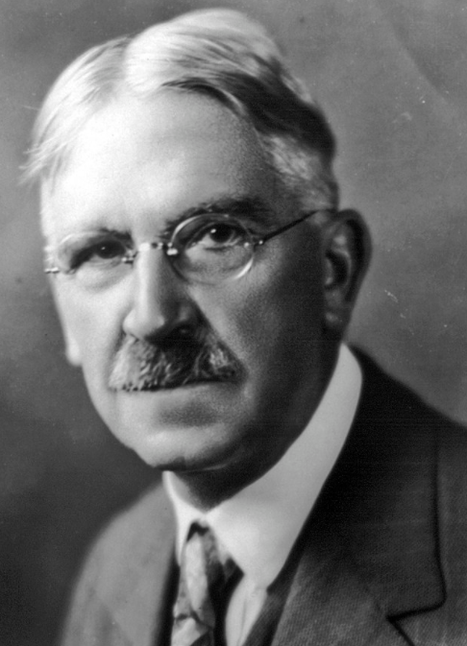
IN SEARCH OF AN ECOLOGICAL CONCEPT
FOR PRACTICE, LEARNING & CREATIVITY
“When we experience something we act upon it, we do something; then we suffer or undergo the consequences. We do something to the thing and then it does something to us in return” John Dewey
PERCEIVE
MOTIVATE
UNDERGOING
before doing
Self
Lifewide Environments
Work/professional life/practice
Family, friends, community
Home /garden / environs Hobbies/interests/leisure activities
Virtual / technological
Travel / other cultures Formal / informal study
And more…………………….
TRY TO DO
SOMETHING
D
O
I
N
G
IMAGINE
PLAN
FIND RESOURCES
ACT/PERFORM
REFLECT
MAKE SENSE
UNDERGOING
while doing
Achieve fully,
partially or
not at all
UNDERGOING
after doing

Slide 24
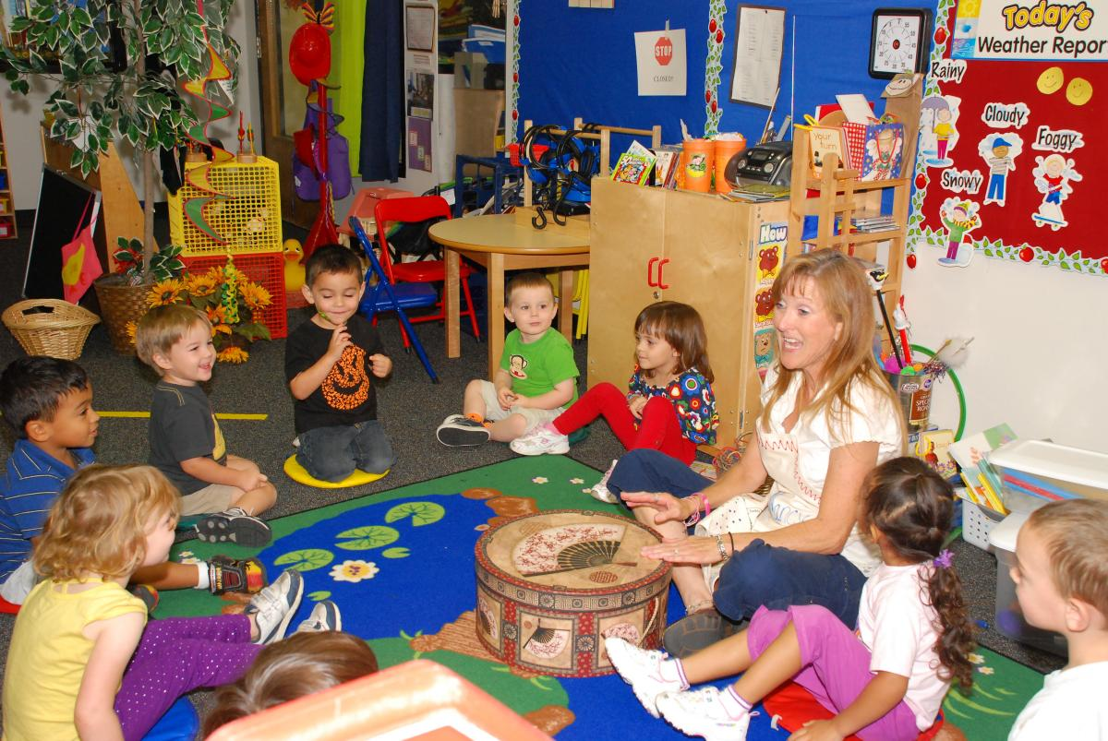
In search of an ecological theory of
practice in which learning is embedded
UNDERGOING
before doing
TEACHER
ENVIRONMENT
UNDERGOING
while doing
PERCEIVE
DECIDE WHAT TO DO
ACT WITH SKILL & PURPOSE
MONITOR & ADJUST ACTIONS
UNDERGOING
after doing
REFLECT ON / LEARN FROM
WHOLE EXPERIENCE
LEARNING, CREATIVITY & OTHER
ACHIEVEMENTS EMERGE

Slide 25
ecology of practice in which learning & creativity are embedded
4 SPACES
Physical –
classroom
Social, Emotional
Intellectual, Liminal,
Creative
3 RESOURCES (knowledge & information flows, tools, materials, technologies)
teacher’s pedagogical knowledge, her knowledge of each child, the children’s own experiences, learning aids, posters/ pictures, musical instruments, writing materials, pupils’ work, internet
Primary School Classroom
2 AFFORDANCE FOR LEARNING
In the teachers activities
The classroom environment
The children’s responses
PAST
Unfolding Present
5 PLACES
The classroom is the significant place for situational learning through the experience of doing
FUTURE
1 CONTEXT(S)
Moral purpose of education
Early years school ethos & culture
State educational policies
The teacher’s intentions
6 RELATIONSHIPS
Teacher – children,
Between children
Teacher – parents, Parents- children
And relationships with subject, environment, materials, tools & activities
The teacher consciously and skilfully weaves together elements of herself and the world around her and transforms them into something new….In the process she transforms herself and learners’ understanding.
7 PROCESSES/ACTIVITIES/EXPERIENCES
Eg talking, discussing, listening, showing,
telling stories, singing, dancing, reading,
painting and more

Slide 26
Ecology of practice heuristic
3 RESOURCES
information, knowledge, people, tools, technologies
& other artefacts (anything that can be used)
2 AFFORDANCES
possibilities for thinking and action that can be perceived or imagined
4 SPACES
physical, social, virtual, intellectual, psychological, liminal, ontological
WHOLE PERSON
with their mind and body, purposes motivations, knowledge and skills, seeking, sensing, perceiving, feeling, imagining, relating to and interacting with their environment, interpreting & making sense of their situations, weaving together the things that matter to accomplish their goals
ENVIRONMENT
1 CONTEXTS
situations, circumstances, culture, ourselves,
problems/opportunities -
PAST
5 PLACES
significance of place for situational learning through the experience of doing
FUTURE?
LEARNING, CREATIVITY
& OTHER ACHIEVEMENTS
EMERGE
6 RELATIONSHIPS
with people, communities, places, ideas, objects, work, hobbies, problems,
natural world - anything!
7 PROCESSES/ACTIVITIES/EXPERIENCES
eg study, work, making, research, inquiry,
problem solving and much more
Notes:
Summary of the components of a learning ecology
Learning ecologies (Jackson 2013a:14) 'the process(es) we create in a particular context for a particular purpose that provides us with opportunities, relationships and resources for learning, development and achievement'.
This definition represents the integration and interdependence of the elements of learning and achievement which include the contexts and spaces we inhabit, including our history, relationships and resources, (the most important being knowledge and tools to aid thinking), and our will and capability to create a learning process or learning ecology for a particular purpose.
Such actions may be directed explicitly to learning or mastering something but more likely they will be primarily concerned with performing a task, resolving an issue, solving a problem, or making the most of a new opportunity.
Learning ecologies have temporal dimensions as well as spatial and contextual dimensions: they have the capability to connect different spaces and contexts existing simultaneously across a person's life-course, as well as different spaces and contexts existing in different time periods throughout their life-course.
HYPOTHESIS : ECOLOGIES FOR ACHIEVING OUR PURPOSES
ARE OUR VEHICLES FOR DISCOVERING & CREATING MEANING
Our beliefs shape what we value and what we value shape our beliefs
Our beliefs & values shape our purposes – purposes emerge from the circumstances of our life and what we value they give our life meaning
Purposes create intentions (will/desire/ambition) to act on purpose (to reinforce the meaning that is our life) eg the desire to make a positive contribution/to make a difference to create a better version of oneself and to create new value in the world we are attending
Intentions cause us to search our life/world (contexts) for affordance (perceptions of possibility for action – eg to make a difference)
Affordance enables us to formulate goals to drive specific actions and behaviours in the particular contexts and situations of our life/world
These actions and behaviours result in an ‘ecology for achieving our goals’. Our ecology is the way we interpret, relate to, connect and interact with our world of which we are a part not a separate entity. Our ecology involves relationships, activities, experiences, use of resources (knowledge/tools and other artefacts) through which we learn and develop in order to accomplish something we value and create new and deeper meanings in the process.
New meaning grows from the experiences and reflections on experience grown through our ecology when it is integrated with our previous understandings, values and beliefs. Our unfolding experiences contain things which are currently meaningful and also things that do not make sense to us. It is in striving to make sense or better sense of such things that new meaning grows in relation to all of the above. Its an ecological process.

Slide 27
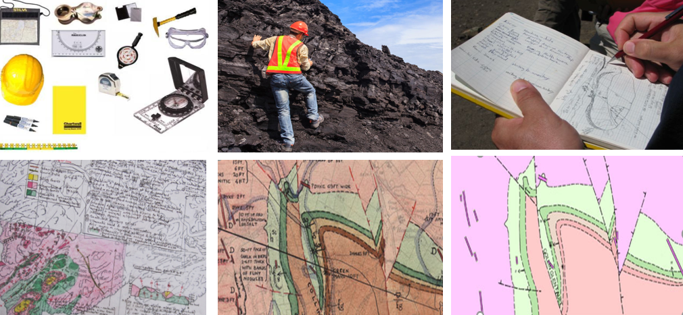
GEOLOGIST’S ECOLOGY OF PRACTICE: LEARNING & CREATIVITY EMERGE
information
KNOWLEDGE & PRODUCT
information
TOOLS
KNOWLEDGE & PRODUCT
KNOWLEDGE & PRODUCT
KNOWLEDGE & PRODUCT

Slide 28
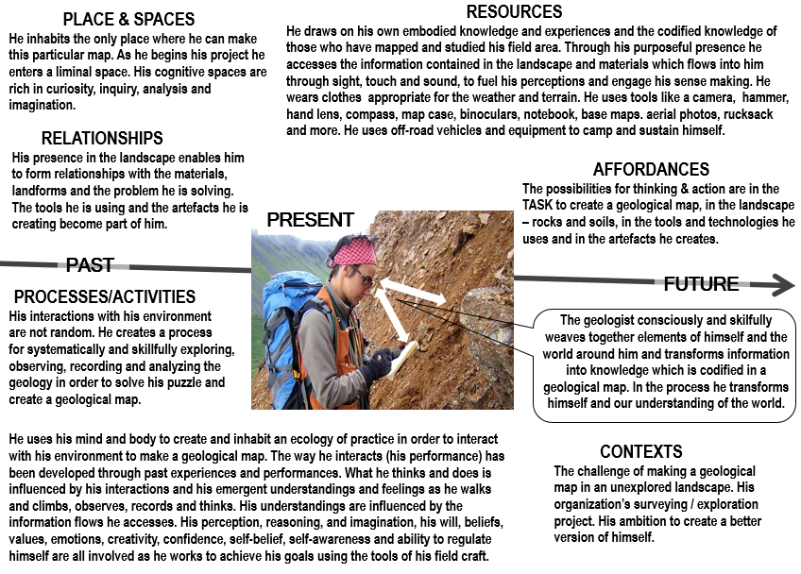
GEOLOGIST’S ECOLOGY OF PRACTICE: LEARNING & CREATIVITY EMERGE

Slide 29
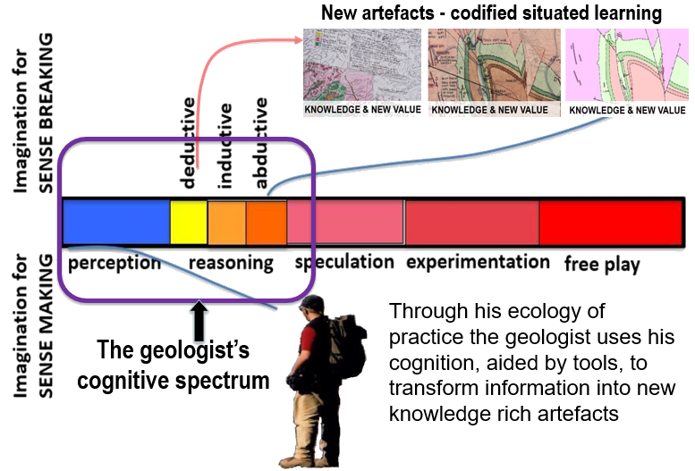
Situated cognition, learning & creativity

Slide 30
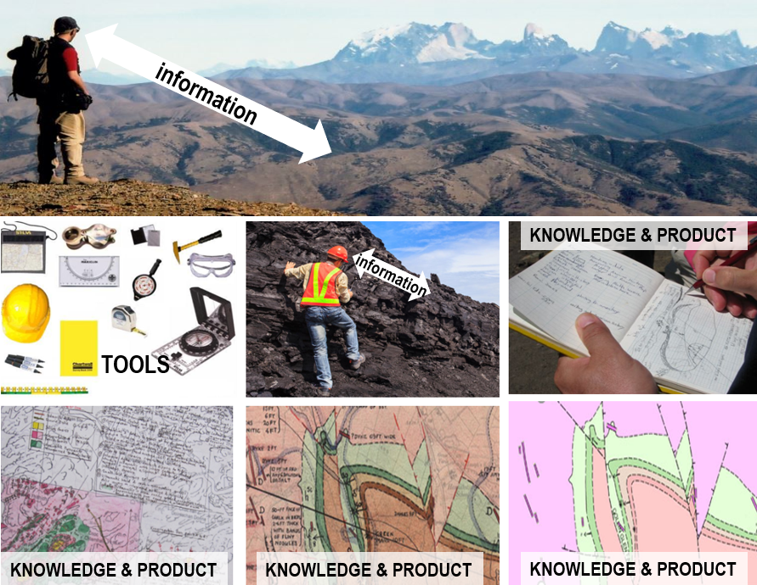
Pro-c - creativity involving expertise
The creative outputs are field
specific knowledge artefacts
and new understanding
CONTEXTS FOR CREATING & USING
GEOLOGIST MAKING A GEOLOGICAL MAP
FIELD/
DOMAIN
INDIVIDUAL
TEAM
ORGANISATION
NORMS FOR JUDGING & VALUING CREATIVITY
AS THE PRODUCTS ARE USED
Notes:
This is our instrument.

Slide 31
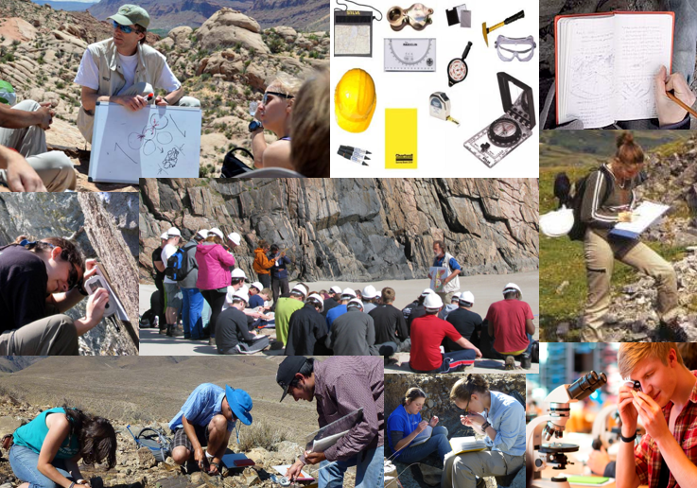
How do we learn how to create an ecology for
practice within which creativity is embedded?

Slide 32
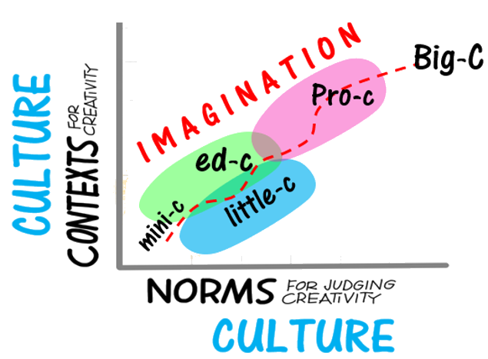
The argument for an educational domain
5C Model of Creativity (Jackson & Lassig 2020) developed
from the 4C model (Kaufman & Beghetto 2008)

Slide 33
enable learners to create own ecologies for
Practice in which creativity is embedded
Determined by learner
Partly to significantly determined
by learners
D Completely
determined
by learners
B
D
LEARNING ENVIRONMENT
OUTSIDE
INSTITUTION
LEARNING ECOLOGY
INSTITUTION
A
C
Partly to
significantly
determined
by learners
Completely determined
by teachers
Determined by institution or other body
e.g. work placement or volunteering
Learning ecology includes contexts, goals/problems, affordances, processes,
spaces, relationships, resources (knowledge, tools, technologies, artefacts)

Slide 34
Pedagogical practices that encourage students’creativity
Many of these approaches can form the basis for an ecology for practice
IMPORTANT FEATURES OF CREATIVITY IN DISCIPLINES
* Using imagination
Being original - new ideas /
perspectives / things /solutions * Being curious / inquiring /
find solutions * Being resourceful * Being able to combine,
connect, synthesise etc * Being able to think critically,
analyse, evaluate * Being able to think reflectively /
empathically
*Being able to represent ideas
and communicate meaning to
others & form / tell stories
GAMES
SIMULATIONS
CASE STUDIES
ROLE PLAY
INQUIRY- BASED
PROBLEM-BASED
LEARNING
PROJECT- BASED
LEARNING
MAKING
SOMETHING
FIELD STUDIES
MAKING
SOMETHING HAPPEN
‘ENTERPRISE’
DESIGN
THINKING
VISUALISATION
TECHNIQUES
STORY &
REFLECTIVE NARRATIVE

Slide 35
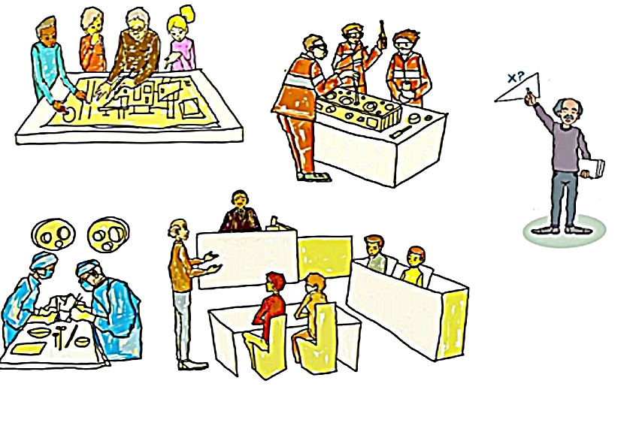
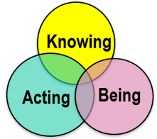
Signature pedagogies & signature learning experiences
Learning to practice and be creative as an architect, engineer, surgeon, lawyer….

Slide 36
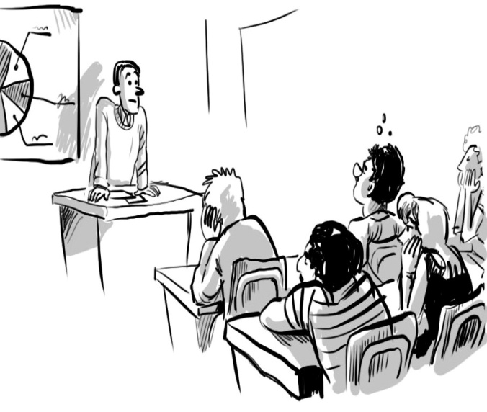
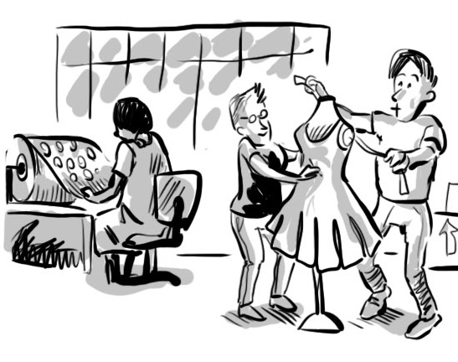
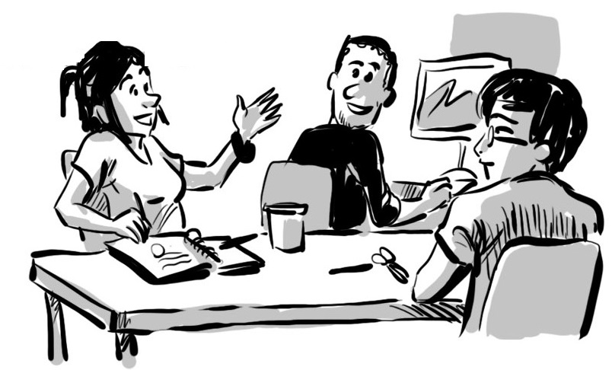
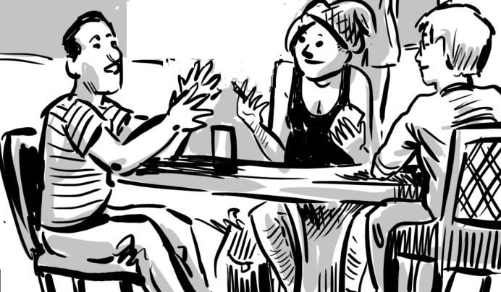
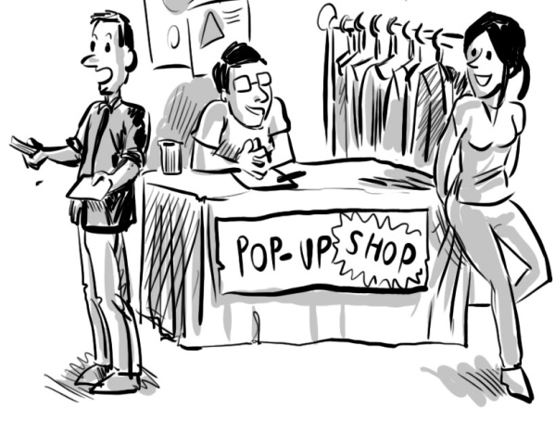
enabling learners to create their own ecologies for practice
FROM LECTURES
TO PRACTICE
DESIGN
MANUFACTURE
MARKET
SELL
REFLECT ON/LEARN FROM EXPERIENCE

Slide 37
Embracing the lifewide dimension of learning in Higher Education
The whole of life is learning therefore education can have no endings
Eduard Lindeman
Academic
curriculum
UNIVERSITY
ECOSYSTEM
Extra-curriculum
Part-time work
and internships
Managing own life
Study
programme
/modules
Co-curriculum
Organised
learning
outside
formal
curriculum
Caring for others
Running own
business
Work-related curriculum
Placement Internship
Apprenticeship
Participating in Sport
Volunteering &
social enterprise
May include fieldwork,
projects in
real world,
study abroad, community projects
Travel
Mentoring
Creative activity
Student Representation
& Societies
Study abroad
AN MORE!!!
World of infinite possibilities for learning

Slide 38
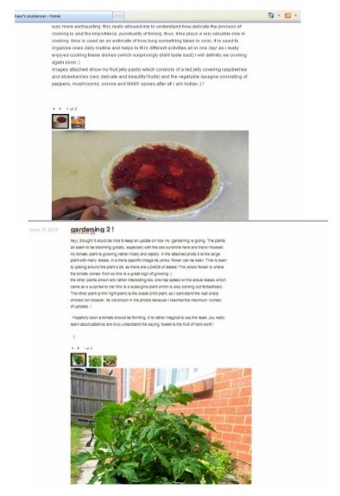
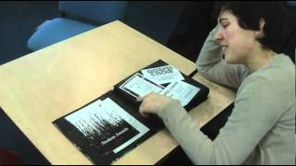
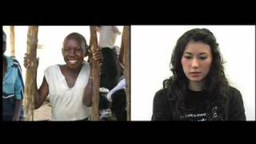
LIFE AS CURRICULUM – THE NARRATIVE OF PERPETUAL BECOMING
ONTOLOGICAL JOURNEYS
Narratives of becoming within which ecologies for practice, learning and creativity reside
CATCHING STORIES
Shoe box
Blog
Scrapbook
E-portfolio
Video diary
Digital story
Movie
Slide show
Using life as curriculum enables students to reflect on their own ontological journey to reach self-awareness – the sense of authoring their life and how they construct themselves. Pharr Sharrah

Slide 40
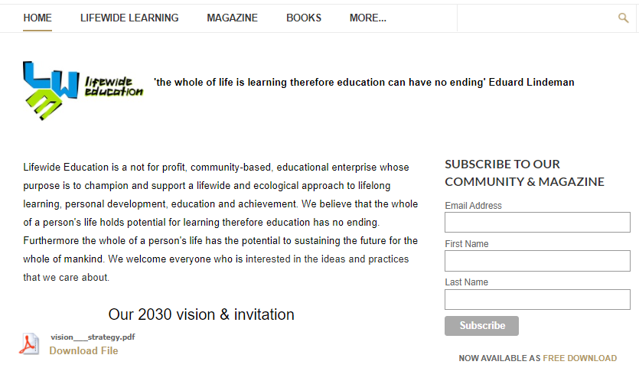
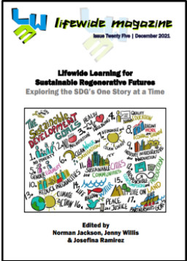
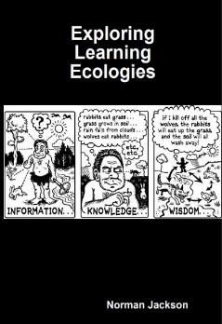
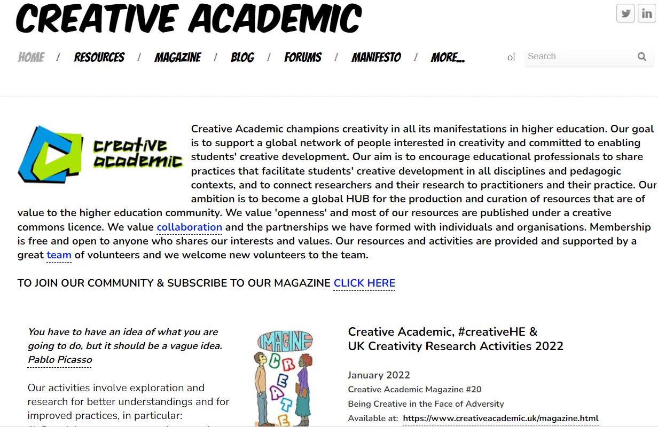
THANK YOU
SLIDES & NARRATIVE
http://www.normanjackson.co.uk/luminate.html
Free resources available
https://www.lifewideeducation.uk/
https://www.creativeacademic.uk/
Vibrant communities
https://www.linkedin.com/groups/4667550/
https://www.facebook.com/groups/creativeHE

