Slide 1
The Wicked Challenge of Changing a University:
Encouraging Bottom-up Innovation
through Strategic Change
Norman Jackson
Founder Lifewide Education Community
illustrations by Julian Burton and Andres Ayerbe
Background paper & slides at:
http://www.normanjackson.co.uk/ifiut.html
Notes:
This talk was given at the International Forum of Innovators in University Teaching held in Riyadh in February 2013. The talk was supported with a background paper which describes the research on which this talk is based. The paper entitled 'The Wicked Challenge of Changing a University' : Tales of Bottom-up Innovation Supporting or Encouraging Strategic Change, can be downloaded from my website http://www.normanjackson.co.uk/ifiut.html
I am very grateful to the conference organisers and to AI Imam Muhammad Ibn Saud Islamic University for the opportunity to share my research and to listen to the experiences of other delegates.
Introduction
I want to frame the idea of accomplishing significant self-determined change in a university as a 'wicked problem' (Rittel and Webber 1973). By that I mean accomplishing significant change is an ill-defined, ambiguous, socially grounded and often contested problem associated with strong moral, political and professional issues and values (Richie 2011). As far as changing an organisation is concerned - changing is the last thing that most people in the organisation want to do and engaging in change - moving from the known, the tried and tested ways of doing things into unknown and unproven territory is a risk that creates a big problem for most people. In other words the act of trying to engage a university in significant change creates a new wicked problem (Camillus 2008). The term ‘wicked’ in the context being used here, is not about being evil, rather it describes an issue that is hard to understand and define, and highly resistant to resolution.
My presentation is based on a study I have been doing of a university that has been engaged in a significant programme of change over about four years in which it has attempted to stimulate innovation from the bottom I wanted to know what factors and conditions supported bottom-up innovation within a strategic change process.
Some characteristics of wicked problems (Rittel & Webber 1973) Dilemmas in a General Theory of Planning. Policy Sciences, Vol. 4, 155-169
No proper definition or structure
No stopping rule.
Solutions are not true‐or‐false, but better or worse
Every solution is a "one‐shot operation" and counts significantly.
No pre‐determined solutions nor well‐described resolving actions.
Have multiple root causes and are nested in other problems
Solutions are likely to generate unintended consequences
Many social problems/challenges in a society are wicked problems
References
Camillus, J.C. (2008) Strategy as a Wicked Problem, Harvard Business Review. Available at: http://hbr.org/2008/05/strategy-as-a-wicked-problem/ar/1
Ritchie, T. (2011) Wicked Problems: Structuring Social Messes with Morphological Analysis Swedish Morphological Society. Available at: http://www.swemorph.com/pdf/wp.pdf
Rittel. H, & Webber, M.(1973) Dilemmas in a General Theory of Planning. Policy Sciences, Vol. 4, 155-169

Slide 2
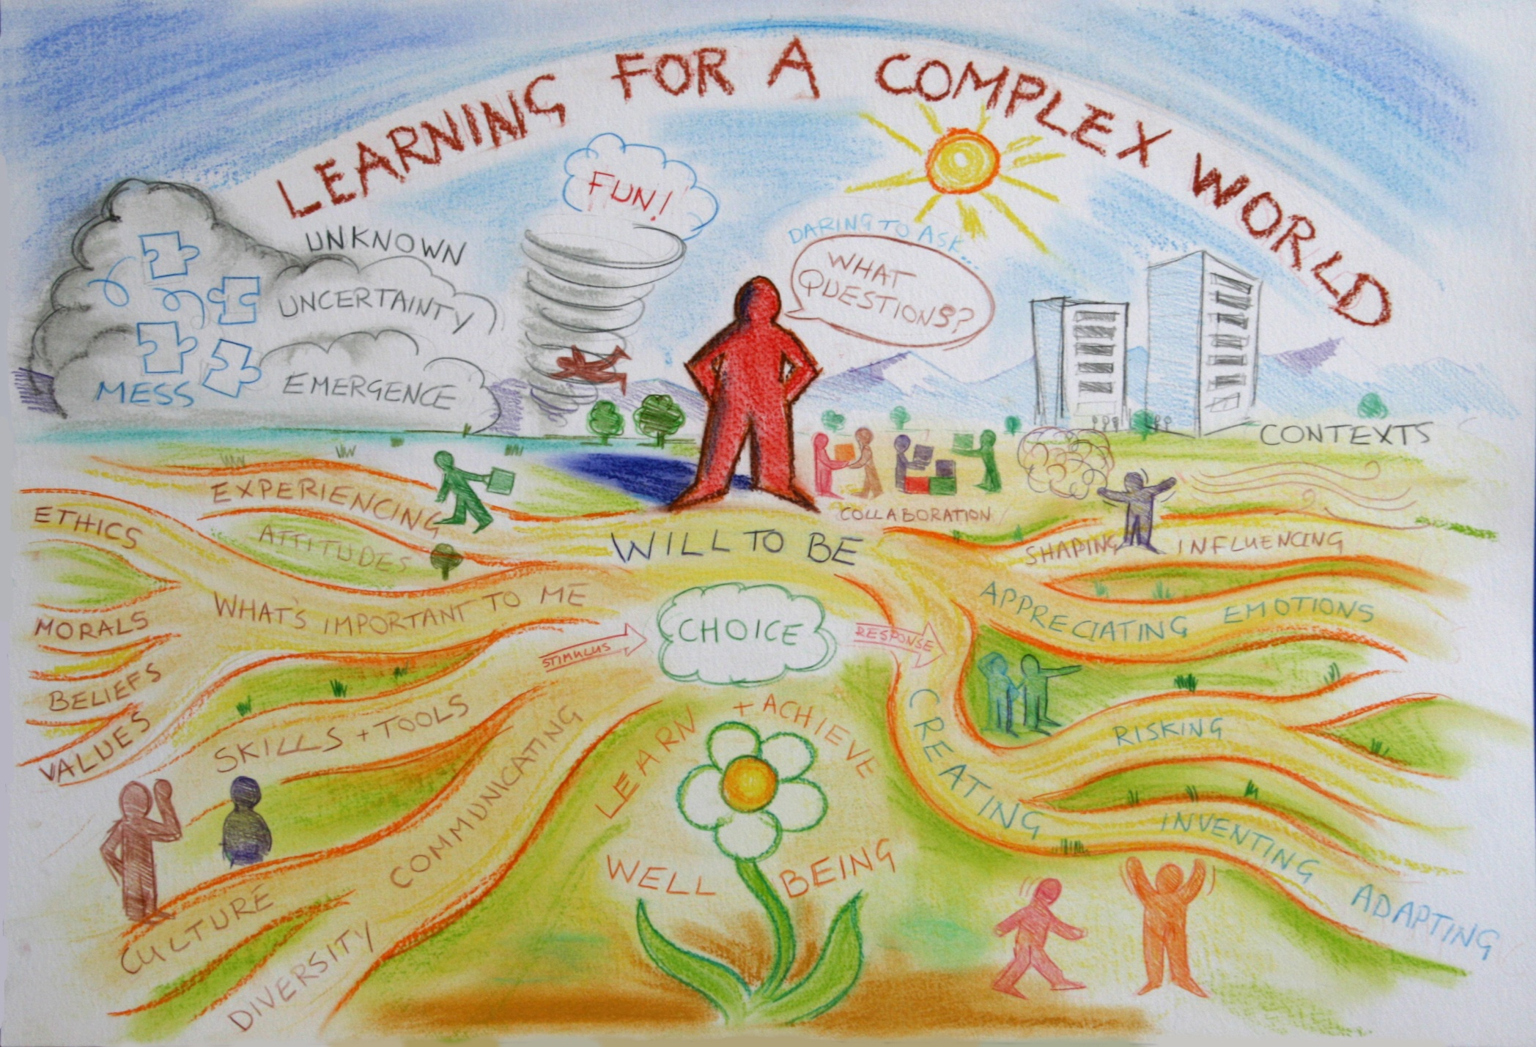
The learner’s & educator’s wicked challenge
me 1978
Notes:
People working and studying in higher education are confronted every day by two big challenges..
The first challenge for teachers is associated with a question like ‘ how do we prepare people for an ever more complex world?’… I don’t just mean preparing students for their first job when they leave university I mean how do we prepare them so that they can face and adapt to the challenges they will encounter over a lifetime of working and learning.
From the students’ perspective the same challenge is expressed in the question ‘ How do I prepare myself for the rest of my life?’… what sorts of things do I need to learn, what sorts of skills, qualities, dispositions and values do I need to develop, and what sorts of experiences do I need to have.. Personal and professional development needs to be so much more than simply studying and learning an academic curriculum.
This picture, which we drew on the wall of our Centre at the University of Surrey, symbolically represents some of the complexity embedded in this wicked problem – which is a problem that is very difficult to define, is nested in other problems and has many perspectives on it, has no right or wrong answers, and no clear resolving actions.

Slide 3
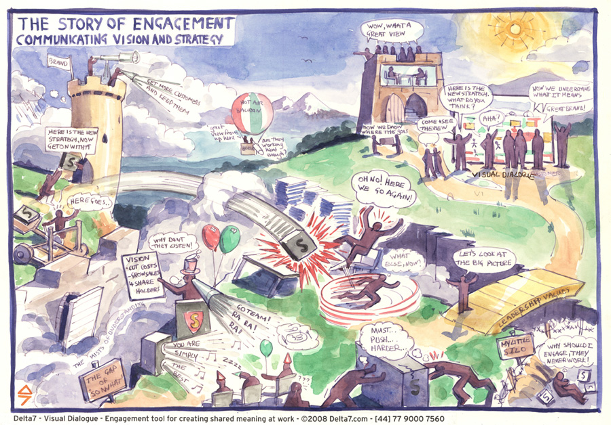
The organisational leaders’ wicked challenge
Notes:
The second challenge facing people who work in higher education can be described by the question ‘ How do we change our university so that it is better able to meet the challenge of preparing learners for a very complex, uncertain and ever changing world?’. How do we move from what is still a predominantly industrial provider-designed and directed model of higher education to a more ecological learner-designed and managed model of learning which is more appropriate for a modern world.
Many faculty would say that there is no problem.. and therein lies the problem….the challenge is to persuade people that believe there is no need to change something that has worked perfectly well for them in the past. Multiply that by the number of faculty and administrators working in a university and you can see how difficult it is to bring about change across a university.
University structures are hard to work cross, procedures are often non negotiable and require compliance, traditions and habits are deeply embedded in practices, and individual academics (at least in the UK) have significant levels of autonomy that means they have to be persuaded rather than be made to change. Bringing about significant change in a university is a complex and often messy process.
For people on the ground it often feels that change is imposed on them and this picture drawn by Julian Burton sums up what many people feel about change inside a university.. Consequently there is often much resistance to change that is passed down from the top.

Slide 4
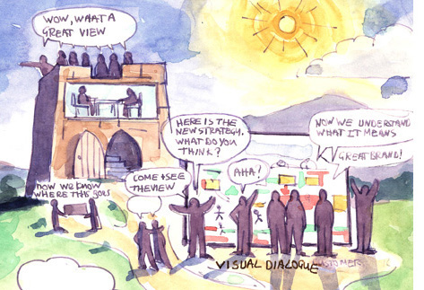
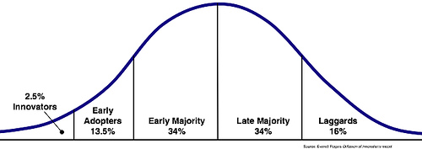
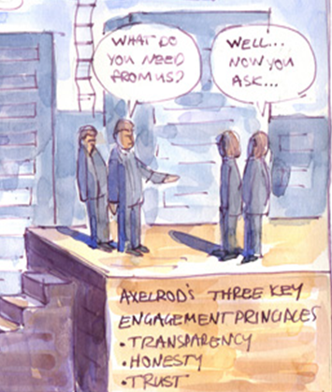
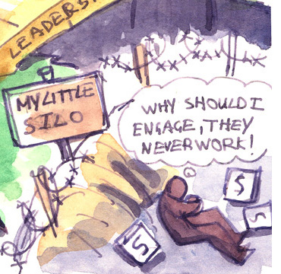
Rogers (1995) Innovation/diffusion curve
IF YOU DON’T
TRY YOU’LL
NEVER KNOW
EMERGENCE
Notes:
When a university decides it wants to significantly change institutional leaders have to create a vision of what the future will look like and sell that vision to the people working in the university. We know from the work of Rogers on the way innovations are diffused that the attitudes of the members of the university are likely to follow a pattern like the one shown by this distribution curve.
A small percentage of the population will embrace change and step forward to lead change.. They are the enthusiasts, innovators and early adopters.
At the other end of the spectrum a small proportion of staff will resist change….. These are the laggards, the people who hang back, who have no intention of changing if they can help it..
The bulk of the population, the early and late majority, will change if they can see why it is important to do so and if they can see the benefits in a very concrete way. They can also be encouraged to change if new systems or procedures are introduced that require them to change their behaviour.
I became interested in the factors and conditions that encourage change in a university when I tried to lead an educational innovation at the University of Surrey. I appreciate that every university is different because of its history, its leaders and its people but I wanted to know whether there are a set of factors and conditions that facilitate the process of accomplishing significant change, and particularly which enable bottom-up innovation to flourish.

Slide 5
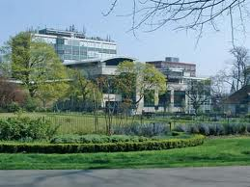
Southampton Solent University
New university (2005)
17,500 students
Teaching-led
Strong vocational tradition
Good student employability
Recognised excellence in education for
Creative Industries & Maritime education
HEFCE
approval
SDP
team
SDP Options
Appraisal
Bid
SDP YEAR 1
SDP YEAR 2
SDP YEAR 3
Strategic Development Programme (SDP)
£7.4m over 3Y educational innovation, organisational devt & infrastructure
New
V-C
New
Strategic Plan
July 2007
July 2008
July 2009
July 2010
July 2011
July 2012
Notes:
In 2011 I was fortunate to be invited to undertake a research study into how one university tried to accomplish strategic change over a three year period between 2009-2012 and I want to share the results of that study which will soon be published in a book.
Southampton Solent University is located on the south coast of England in Southampton, a major sea port and busy city of about 240,000 people. The university has about 19,000 students is located on three sites. It is teaching-led rather than research intensive, with a strong tradition in vocational education, good student employability statistics, and recognised excellence in maritime education and education for the creative industries.
In 2007 a new Vice Chancellor was appointed and this coincided with the development of a new 5 year strategic plan. The new university recognised that it had to adapt to what was a fast changing HE system in the UK. It bid for additional funding to help it change and in 2009 was awarded just over £7million over three years. Half as a direct grant and half as the full economic cost – which funded the development of new business systems.
This process of change became known as the Strategic Development Programme or SDP…

Slide 6
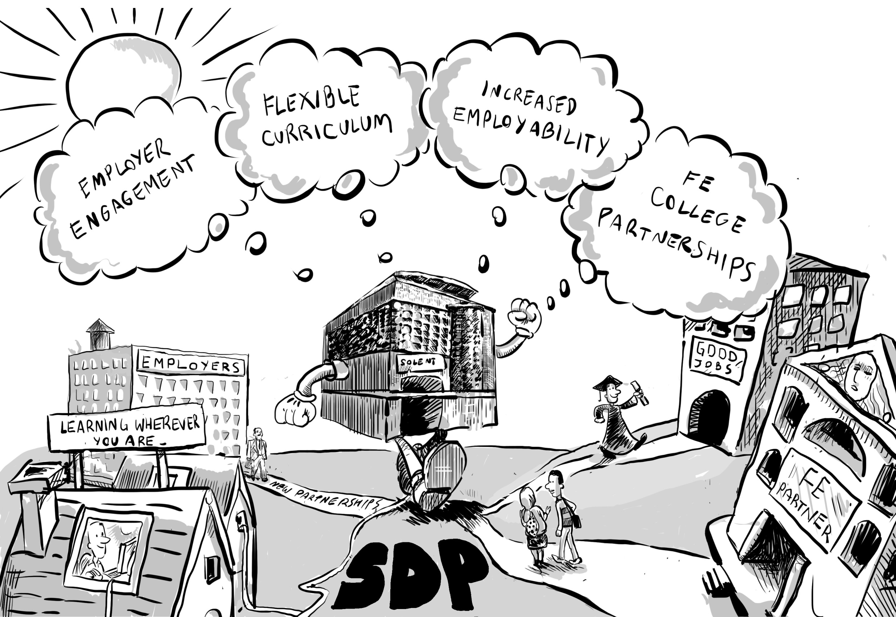
Mission The pursuit of inclusive & flexible forms of Higher Education that meet the needs
of employers and prepare students to succeed in a fast-changing competitive world.
Notes:
The rhetoric of change was on the university becoming more agile, capable of responding and adapting quickly to changes in the external environment.
It saw its future in meeting the needs of employers – local, regional and national by providing curricula that were more in tune with the education and training nees of employers and of providing education that was relevant to students gaining employment.
Its strategy focused on four objectives..
1) Improved relationships with a wider range of employers such that they were more involved in the design and delivery of the curriculum and were more involved in funding their workforce to participate in such programmes.
2) A more flexible curriculum in which learners could study anywhere and at any time… e-learning and new support systems
3) Learning experiences that improved the employability prospects of students – making higher education more relevant to the career choices of learners
4) New forms of partnership with the schools and colleges that were close to the university

Slide 7
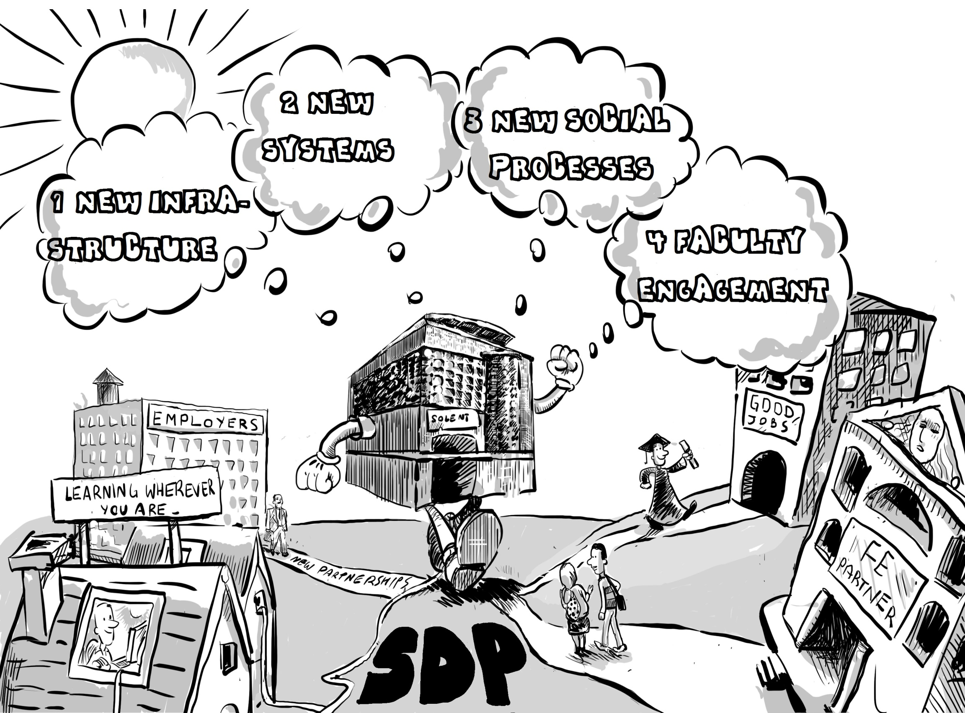
Notes:
This strategy led to four main types of activity..
1 ) Creation of new infrastructures to support desired change… SDP Project Team, flexible delivery team, partnerships team, employer engagement specialist, programme development manager…
Design of new systems for example a new Solent e-learning platform, finance, human resources, customer management, room management
3) New social process – new improvement-focused process for administrators, then mixed administrator/academic teams..
4) Faculty engagement – invitations to faculty to innovate and financial support to help them innovate… events/conferences, coaching, and support from central expert teams the university had established.. A range of educational and service-based innovations were made.

Slide 8
What factors and conditions encourage and facilitate
bottom-up innovation within a strategic change
process in a university?
60 semi-structured interviews
Senior and middle managers
Strategic project managers
Innovators
Significant others
Notes:
The study began in October 2011 with a small scale interview-based study in the School of Design involving 9 members of staff 12 staff. The study was expanded between March-July 2012 when another 50 people were interviewed. About 60 people were interviewed altogether including managers, innovators, systems managers, administrators and other people involved in the change process.
The core of the study was a series of case studies which were the stories of how innovators accomplished the changes they were trying to make.
These stories were used to identify factors and conditions that seemed to encourage and facilitate bottom-up innovation within a process of strategic change..

Slide 9
What’s important to the innovator ? 21 ratings Max 5.0
1 Having a clear vision of how the university saw its future and how SDP contributed to that vision | 3.7
2 My readiness and willingness to get involved in the SDP opportunity | 4.7
3 My vision of what I wanted to achieve | 4.5
4 My will/motivation to succeed | 4.7
5 Having explicit goals and realistic work plans | 4.4
6 Having the autonomy to implement the project as I wanted to | 4.3
7 Having the opportunity to use my personal creativity | 4.1
8 Believing I could take risks without feeling I would be criticised if I wasn't completely successful | 4.3
9 Having the financial resources I needed when I needed them | 4.3
10 Having the time I needed to complete the job | 4.4
11 Being able to find the help I needed when I needed it | 4.3
12 Having good communication with the people I needed to talk to | 4.5
13 The active involvement of others - teamwork | 4.7
14 Learning through the experience (learning from problems as well as successes) | 4.3
15 Feeling trusted and being allowed to get on with it without interference | 4.7
16 Feeling that I made good progress within the time available | 4.5
17 Feeling that what I was doing was valued by my colleagues | 4.5
18 Feeling that what I was doing was valued by Head of School/Service/ Dean | 4.4
19 Forming new productive relationships with colleagues in my school or university | 4.2
20 Forming new productive relationships with people outside the university | 4.3
21 Feeling that the environment encouraged and supported me throughout the process especially when things did not go as planned | 4.3
22 Feeling my contribution has been recognised and appreciated | 4.3
Notes:
A questionnaire was developed from a pilot study within the larger SDP study which identified factors that seemed to be important in enabling change to happen. Innovators were invited to rate the importance of each factor when trying to accomplish significant change on a five point scale.
The most striking conclusion is that all these factors are important to people when they are undertaking significant change. 21 of the 22 factors scored an average of 4 or more, and 19 factors scored 4.3 or more (max 5.0). The only factor to score less than 4 was (1) 'Having a clear vision of how the university saw its future and how SDP contributed to that vision.' However, most innovators had a clear vision of what they wanted to accomplish. Their vision is clearly more important to them than the strategic vision of the institution.
Personal characteristics (my will, my vision, my readiness) feature prominently in what is important, together with the way people wanted to be trusted and feel that their contributions would be valued. High value is also placed on communication, the social dimension of work and the need to make progress. The large number of factors innovators believe are involved in enabling innovation to be accomplished is striking and accounts for much of the complexity involved in innovating.

Slide 10
Eight factors had significantly lower average scores for realisation
compared to the average scores for what was believed to be important
1 Having a clear vision of how the university saw its future and how SDP contributed to that vision
2 My readiness and willingness to get involved in the SDP opportunity
3 My vision of what I wanted to achieve
4 My will/motivation to succeed
5 Having explicit goals and realistic work plans
6 Having the autonomy to implement the project as I wanted to
7 Having the opportunity to use my personal creativity
8 Believing I could take risks without feeling I would be criticised if I wasn't completely successful
9 Having the financial resources I needed when I needed them
10 Having the time I needed to complete the job
11 Being able to find the help I needed when I needed it
12 Having good communication with the people I needed to talk to
13 The active involvement of others - teamwork
14 Learning through the experience (learning from problems as well as successes)
15 Feeling trusted and being allowed to get on with it without interference
16 Feeling that I made good progress within the time available
17 Feeling that what I was doing was valued by my colleagues
18 Feeling that what I was doing was valued by Head of School/Service/ Dean
19 Forming new productive relationships with colleagues in my school or university
20 Forming new productive relationships with people outside the university
21 Feeling that the environment encouraged and supported me throughout the process especially when things did not go as planned
22 Feeling my contribution has been recognised and appreciated
Notes:
Eight factors had significantly lower average scores for realisation compared to the average scores for what was believed to be important, namely -
5 Having explicit goals and realistic work plans to achieve my objective (3.1 versus 4.4)
9 Having the financial resources I needed when I needed them (3.6 versus 4.3)
10 Having the time I needed to complete the job (3.3 compared to 4.5)
11 Being able to find the help I needed when I needed it (3.0 versus 4.4)
12 Having good communication with the people I needed to talk to (3.6 versus 4.5)
13 The active involvement of others - good teamwork (4.0 versus 4.7)
18 Feeling that what I was doing was valued by the Head of School/Service or Dean (3.7 versus 4.4)
21 Feeling that the environment encouraged and supported me throughout the process especially when things did not go as planned (3.2 versus 4.3)
These factors boil down to a combination of having the resources to complete the task of innovating, and innovating in an environment that supports and values the efforts of the innovator. In other words there was a consistent pattern of responses that suggests that there is a gap between the type of environment innovators believe is important to bring about innovation successfully and the environment that they experienced while they were innovating. Closing this gap would go a long way to creating an organisational culture that was as supportive of innovation as the innovators would like it to be.

Slide 11
Twelve Factors & Conditions that Encourage/Facilitate
Strategic Change and Bottom-up Innovation
Leadership, management & facilitation of strategic change & bottom up innovation
1 Leadership is shared and distributed throughout the organisation
2 A strategic vision that inspires people to create their own visions for change that
they will embody
3 A strategy for both planned and emergent change
4 A strategy that involves the whole socio-cultural environment
Involvement of brokers to facilitate change across and between organisational
structures, hierarchies and boundaries
6 An effective but flexible approach to managing and accounting for resources
Environmental /cultural factors that support, encourage and enable strategic change and bottom-up innovation
An environment/culture that :
promotes effective, honest and meaningful communication
recognises and supports resolution of local contentious practice and facilitates rather than inhibits progress
encourages/facilitates new relationships and collaborations to foster change
provides emotional support and celebrates what has been achieved
values learning and encourages and enables people to share what has been learnt so that it can be used and adapted to other contexts
encourages people to take risks to put themselves into unfamiliar situations where they need to
harness their creativity to realise their ideas and actualise themselves
Notes:
The study of strategic change demonstrated the value and importance of bottom-up innovation within a comprehensive and sustained strategic change project. While top down initiatives, like the introduction of new business systems and processes are essential to enabling a university to be more effective, responsive and adaptive in its educational work, it is the innovators who provide the key resource to enact and embody the significant educational changes a university is trying to make. The study reveals that innovators thrive in an organisational culture where leaders and managers are encouraging, supporting and enabling. Where they have the resources - especially time to make change happen. Where the institution's systems and procedures enable rather than hinder progress. Where they have the respect, emotional support and encouragement of managers and colleagues and where they can find help when they need it and where they feel their efforts have been valued and have made a positive difference.
It stands to reason that for organisational change to be successful the conditions and situations embodied in the factors that innovators consider to be important in accomplishing significant change have to be supported and realised. Twelve factors grouped under 1) leadership, management & facilitation or 2) environment/culture provide an overarching framework within which bottom-up innovation is more likely to be encouraged, supported and facilitated within a process of strategic change.

Slide 12
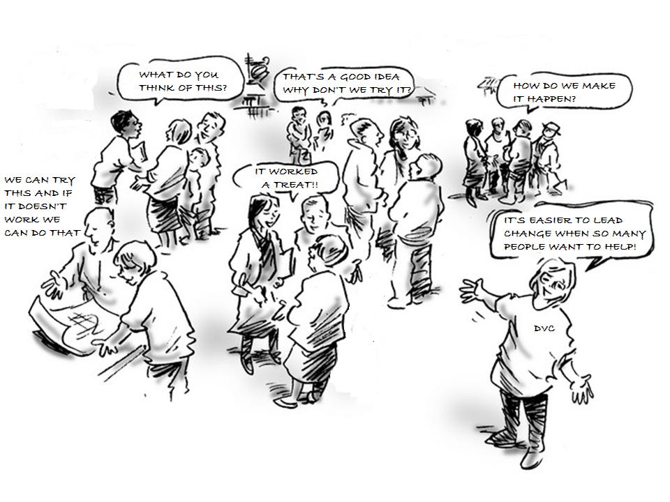
1 Leadership is shared and distributed throughout the organisation
Notes:
Whole organisation change is led from the top, middle and bottom. Leadership is shared and distributed throughout the organisation and innovators must be viewed as leaders of strategic change.
Leading from the top involves visualising the future and creating the conditions that motivates people to move the organisation in the direction of that future. It requires an integrating style able to hold the vision and deliver on commitments, but which is also open, flexible and trusting to allow ideas to emerge from the middle and bottom, and enable people to take ownership and exercise their autonomy to create and implement change. It involves trusting people to create the change once the direction has been set and encouraging and supporting the right sort of changes as they emerge.
Leading from the middle requires managers to accept responsibility for involving their Department, School, Faculty or Service in the strategic change and creating the conditions that encourage and enable their staff to participate in change. Leading from the middle involves translating organisational objectives into objectives that are meaningful in the local socio-cultural practice environment. Leading from the middle does not mean 'go and do it' it means 'we will do it together.'
Leading from the bottom involves individuals accepting responsibility to make change happen by adapting existing or inventing new practice that is consistent with the change the institution is seeking to make. The innovators are people who lead change by involving themselves in it and showing others how to accomplish it.
There is one secret to leading organisational change. The leaders at the top and in the middle have to create the conditions in which people at the bottom feel empowered and are enabled to change themselves and their own practices in order to make strategic change happen. This is a shared concept of leadership in which leadership is broadly distributed, such that people within a team and organization lead each other. It is a social, non-hierarchical concept and contrasts with more traditional notions where leadership roles are vested in individuals appointed by management.

Slide 13
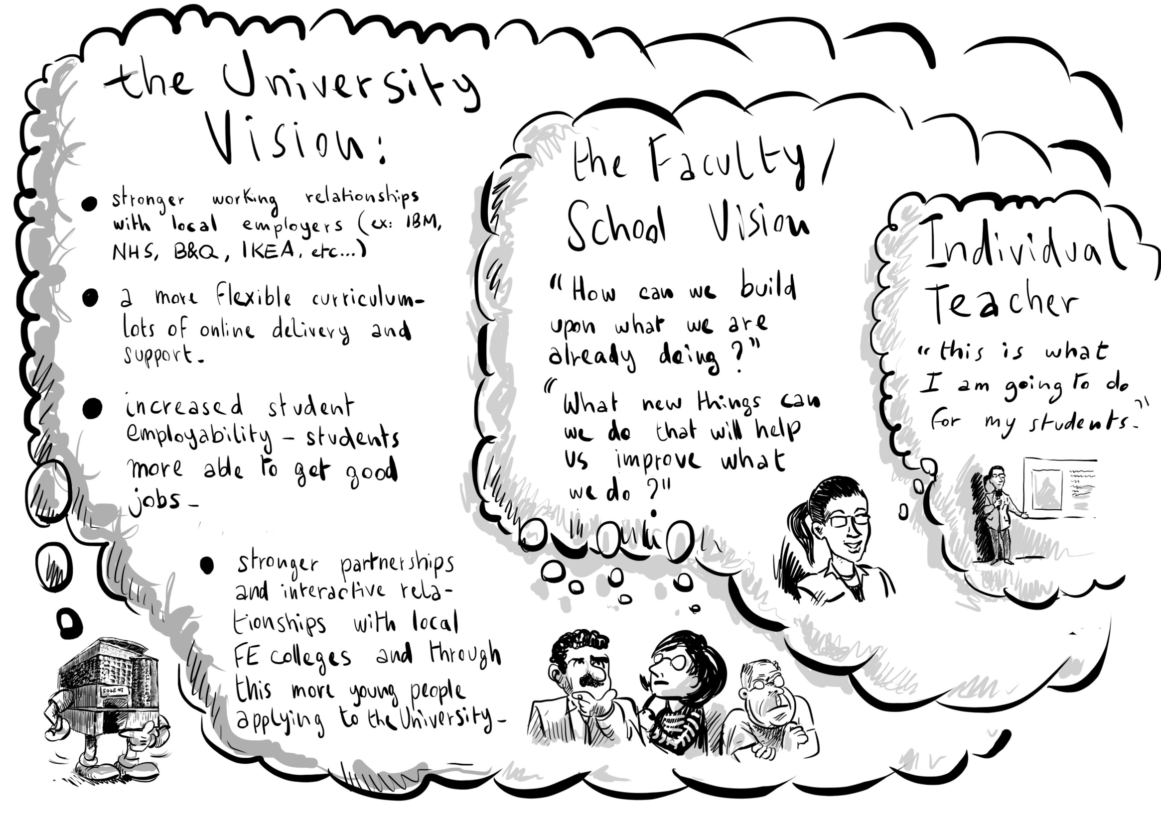
2 A vision that inspires people to create their own visions
Notes:
Organisational change involves someone with the power and authority to see the direction in which the organisation needs to travel and communicate that through a vision for a different
and better world. An organisational vision for strategic change, must encourage and enable people to see things in a different way and inspire them to create their own visions through which they can enact and embody change that they own. A vision at the top is of little value if people at the bottom cannot understand and relate it to their world of everyday practice. Middle managers have an important role in translating high level ideas and engaging staff in new conversations about the implications of such ideas.
From an institutional leaders perspective the most important vision is the one they hold about the future of their university. From an innovators perspective this is far less important than the vision they hold of the new practices and experiences they want to create. As long as the two visions are aligned strategic change will progress.

Slide 14
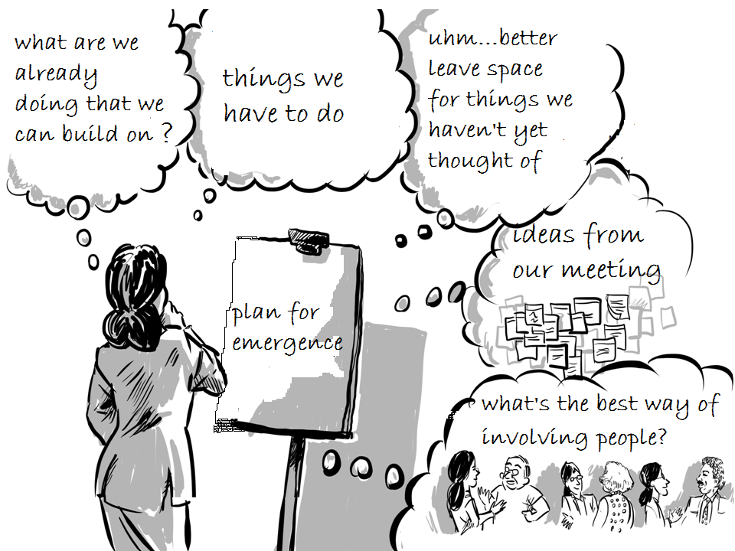
2 A strategy for both planned and emergent change
Notes:
For a strategy to be successful it needs to involve deliberate planned actions to achieve tangible objectives and goals but also contain the space and intention to improvise as new and better ideas emerge. It needs to encourage, stimulate and support activity that will lead to change and provide sufficient resources to enable change to happen and ensure that people involved in change have the necessary resources when they need them. This process of connecting top, middle and bottom in this way is more likely to create ownership and responsibility for ideas and actions so that the change that emerges is owned at all levels of the organisation. It is this connectivity that creates the sense of affiliation that is so important in change – we are all in it together.
Emergence cannot be controlled, predicted or managed but the leaders, managers and facilitators of organisational change can create conditions that are more likely to lead to changes of a certain type (Richard Seel's ten conditions for emergence are highly relevant here - Seel 2006).The successful management of change combines and integrates managed, purposeful and focused change through planned activities that enable and encourage people to improvise and discover the best ways forward for themselves.

Slide 15
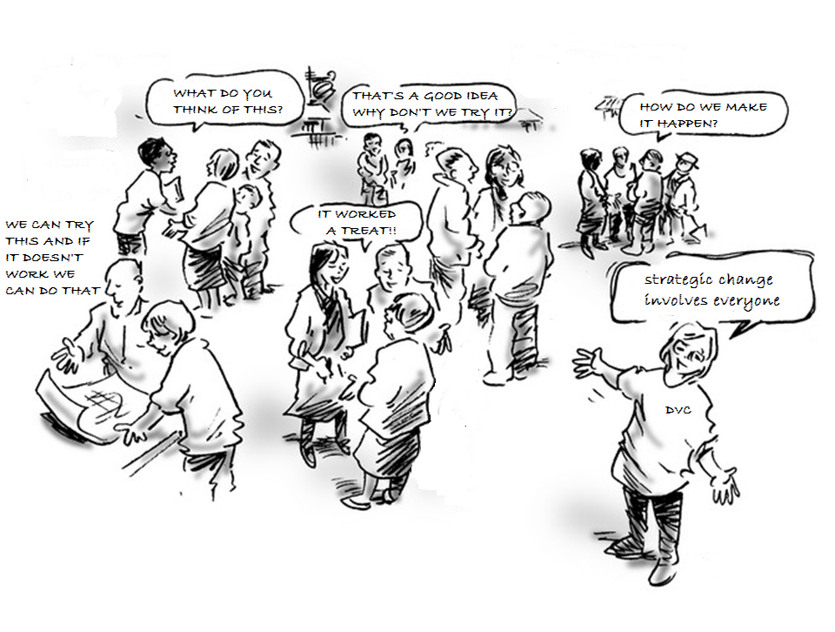
4 A strategy that involves the whole socio-cultural environment
Notes:
Change will only happen if people actually do new things ie they get involved in change by actively doing things rather than only thinking and talking about it. The strategy must involve most of the people in the organisation doing new things only then will change at the level of the whole organisation occur. This is why engagement is so important in creating a sense of whole organisation participation in the enterprise of strategic change.
The SDP sought to involve the academic (faculty) teaching community in all the Faculties and Schools through the funding of innovation through Faculties, Schools and individuals. It engaged Faculty and Service Administrative teams through the Service Plus project that sought to involve administrators in creating solutions to problems and challenges relating to the strategic agenda. Furthermore, by changing a number of business systems that were central to many of the university's operations it involved all staff in fundamentally new practices that were more in tune with the strategic changes the university was seeking. The feeling that everyone was involved, and change was not just targeted at a specific group of people was an important factor in accomplishing change at the organisational scale. By offering incentives to stimulate change and innovation within academic Faculties and Schools the university was seeking to work within the disciplinary cultural grain.
People are more likely to commit themselves to significant change if their will to be involved is driven by their own intrinsic motivations rather than extrinsic forces. Giving people the choice or freedom to chose to be involved seemed to be crucial for involving self-motivated innovators -

Slide 16
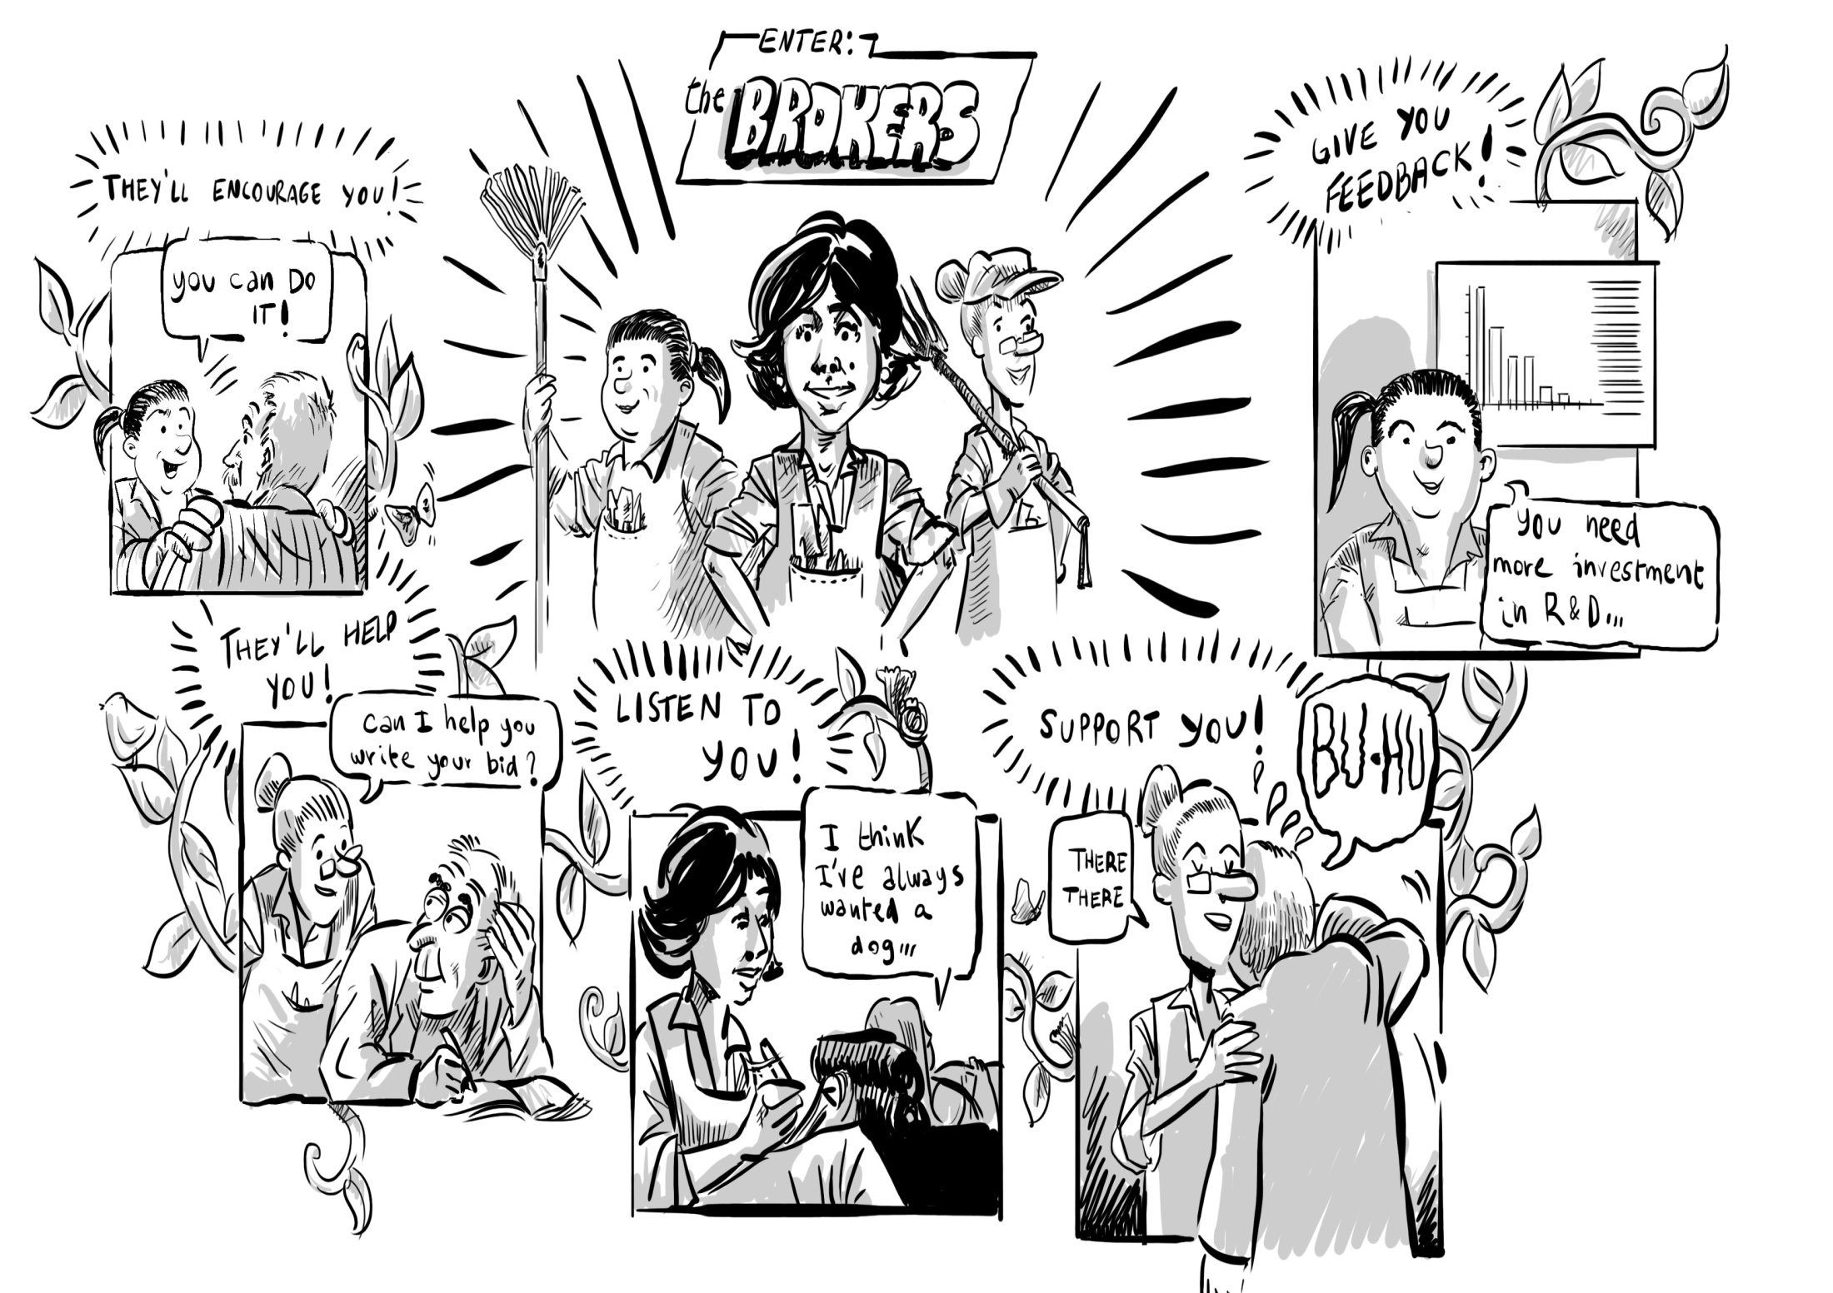
5 Involvement of brokers to facilitate organisational change
Notes:
Brokers play a key role in organisational change they facilitate communication, networking and working between and across the constituent parts of the organisation and help overcome impediments to progress
Organisational brokers work in collaborative and creative ways with people, ideas, knowledge and resources to enable things to happen that otherwise would not happen. They are a kind of multi-skilled anthropologist who can get inside and comprehend not just needs and desires, but the language, politics, positioning and outlook of the different parties.
The small (3 member) SDP Project Team acted as organisational brokers. They likened their role to the metaphor of gardeners cultivating the conditions for SDP projects and innovators to flourish and enable people with new ideas and practices to grow through the process of enacting change. They provided encouragement and resources to enable people to take on an innovation project, practical help in getting started, and emotional support when things got tough. They also monitored what was happening on the ground and provided feedback to senior managers on progress. Where appropriate they brought in new people to support and facilitate the process of change.

Slide 17
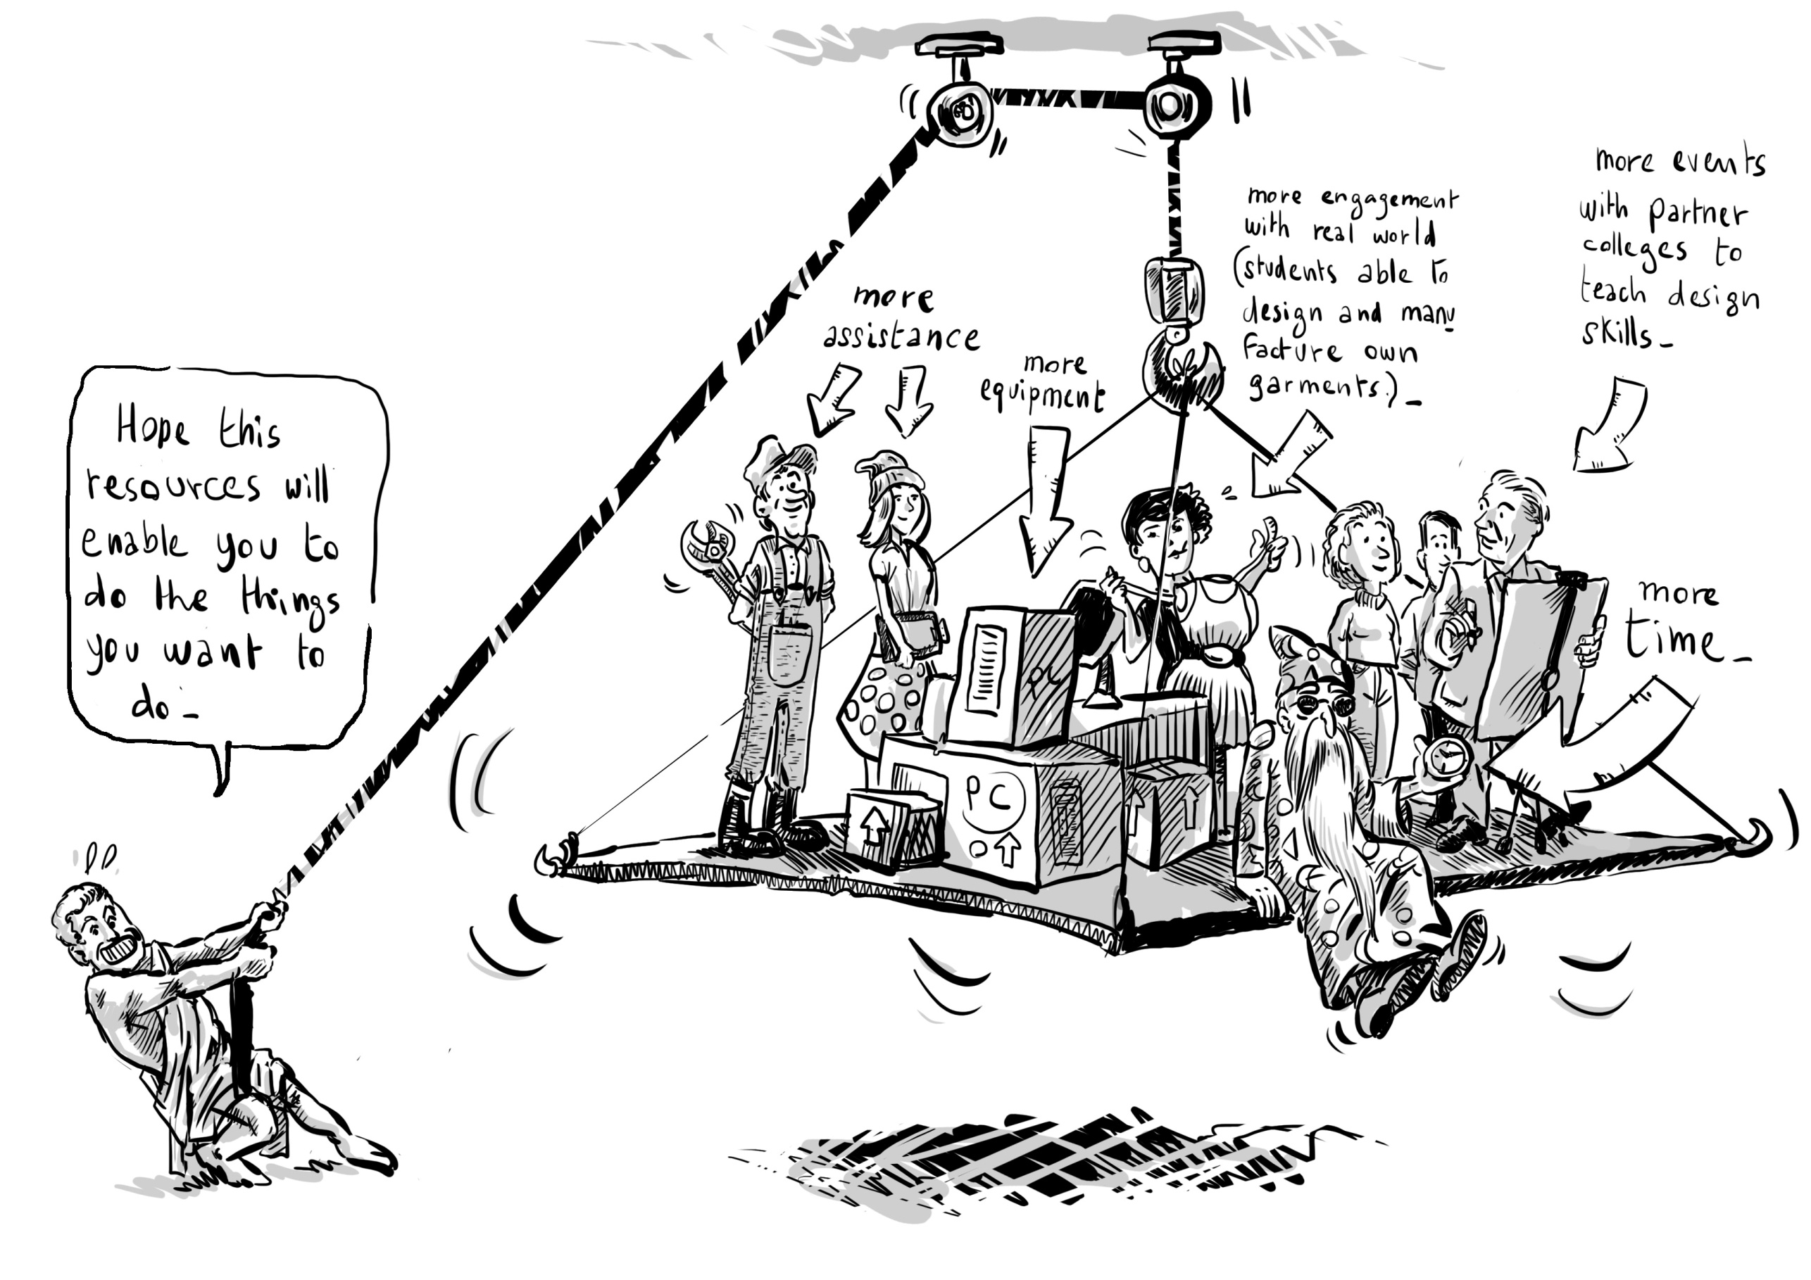
6 Effective but flexible approach to managing
and accounting for resources
Notes:
Large scale organisational change requires the distribution of significant new resources. Regardless of whether the funding is externally or internally sourced there need to be effective mechanisms for assigning and distributing resources, monitoring and accounting for their use. The Solent strategic change programme used a combination of SDP Team procedures and decision making, and the University's Management Board to approve the distribution of resources and account for their use.
People who were directly involved in change discussed resources in terms of their time and workload, and their ability to manage their time for development work alongside existing teaching and administrative commitments. Being able to manage and juggle time for development and existing commitments is an essential capability for all those involved in change. For academics the additional complication involves managing time within a fairly rigid academic calendar and weekly timetabling of teaching activities.
SDP resources provided additional capacity to employ knowledgeable consultants, or administrative or technical assistance from people within and outside the School. People also talked about resources in terms of funding and physical resources like equipment, the manufacturing of products created through an educational process, and social activity like hosting events and exhibitions for students from local 6th Form Colleges. The Strategic Development Fund was able to help with all these things.

Slide 18
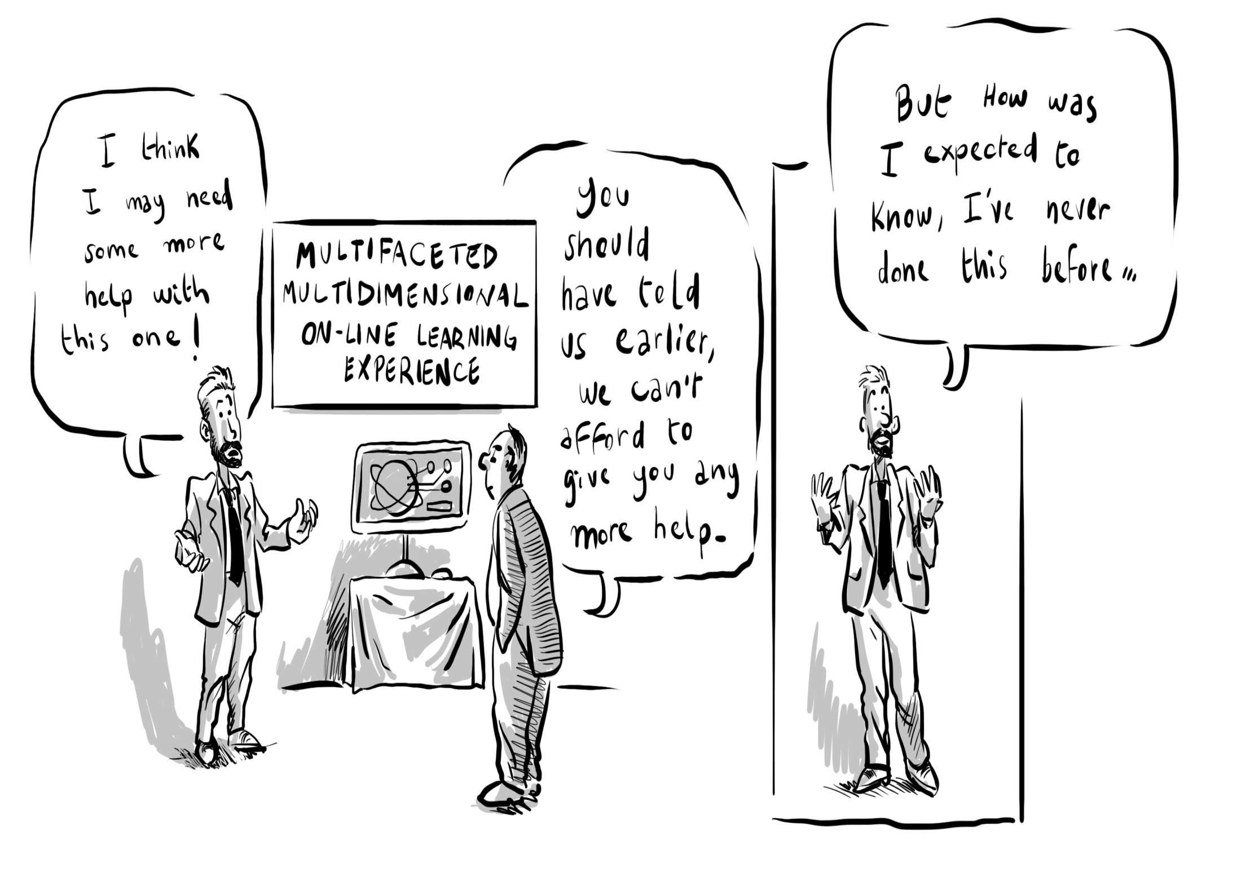
But the amount of resource is difficult to predict at the start
Notes:
While it is a straightforward matter to distribute and account for resources in a system that is operating in a business as usual mode, it is not so easy when the business is change and much of that change appears in an emergent form. The case studies reveal that from the innovators' perspective resourcing mechanisms were not always responsive to the emergent nature of the change process. Designers of strategic change and innovation projects need to design in a significant contingency to deal with the unexpected or develop mechanisms for gaining additional funds as a change process unfolds.

Slide 19
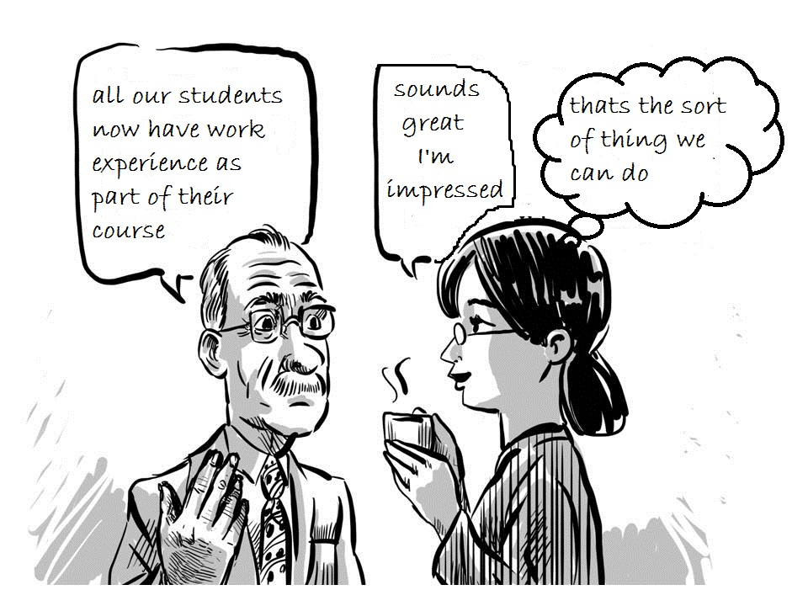
7 A culture that promotes effective, honest and meaningful communication
Notes:
Change involves creating new meanings and communication that is meaningful to those receiving it, pervades innovators' stories of change. If visions, ideas and invitations to contribute are not communicated in a way that has meaning to those who receive it - nothing will happen. The lesson is clear that just sending information to people who are busy and who have many urgent priorities, will often not cause them to act. What causes them to act is when information causes them to create their own interpretations and meanings for themselves.

Slide 20
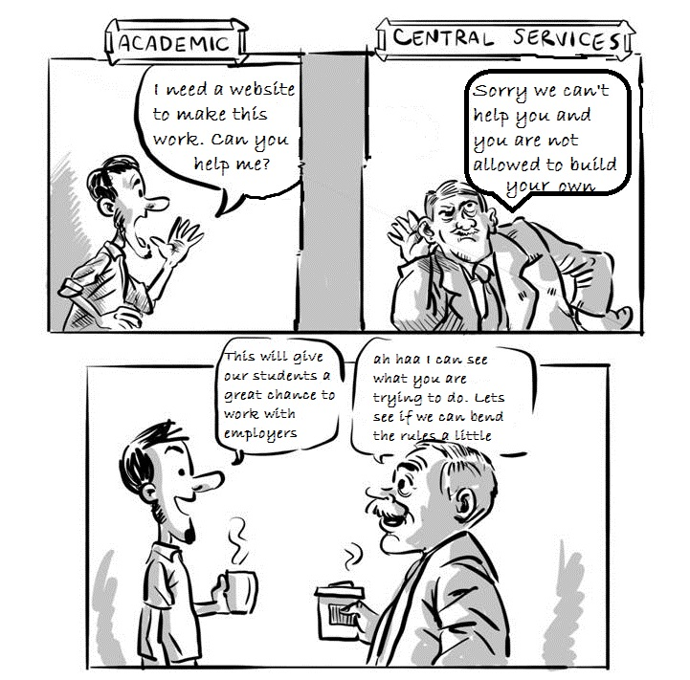
8 A culture that recognises and supports
resolution of local contentious practice
Notes:
Tensions and conflicts often arise when bottom-up innovation meets existing procedures and systems. An organisation involved in strategic change needs the awareness, will and capability to facilitate the resolution of local contentious practice.
People working in an organisation (persons in practice) historically constitute their everyday world as they help to make it through their participation in it while being shaped by the world in which they are a part (Holland and Lave 2009). Local contentious practice, and its resolution, lies at the heart of bringing about innovation in an organisation that is full of systems, procedures and traditions. Local practice comes about in the encounters between people as they address and respond to each other while enacting cultural activities under conditions of political-economic and cultural historical conjuncture. Elements of the SDP narrative reveal that when working within their cultural domain (eg their school) innovators have control over what they do. But once they have to relate their innovations to existing business systems there is often conflict between the new practices they were trying to create and practices that already existed within the institutions established systems and processes.
Relationships and communication between innovators and system owners are crucial to resolving these troublesome areas.
One of the really crucial factors in enabling local contentious practice to be resolved, is for the people who are trying to make change happen to be able to find people who will help them overcome the procedural and decision making barriers between different parts of the organisation. These are the brokers and boundary spanners, that hierarchical and silo'd organisations need in order to unblock things that seem to be frozen.

Slide 21
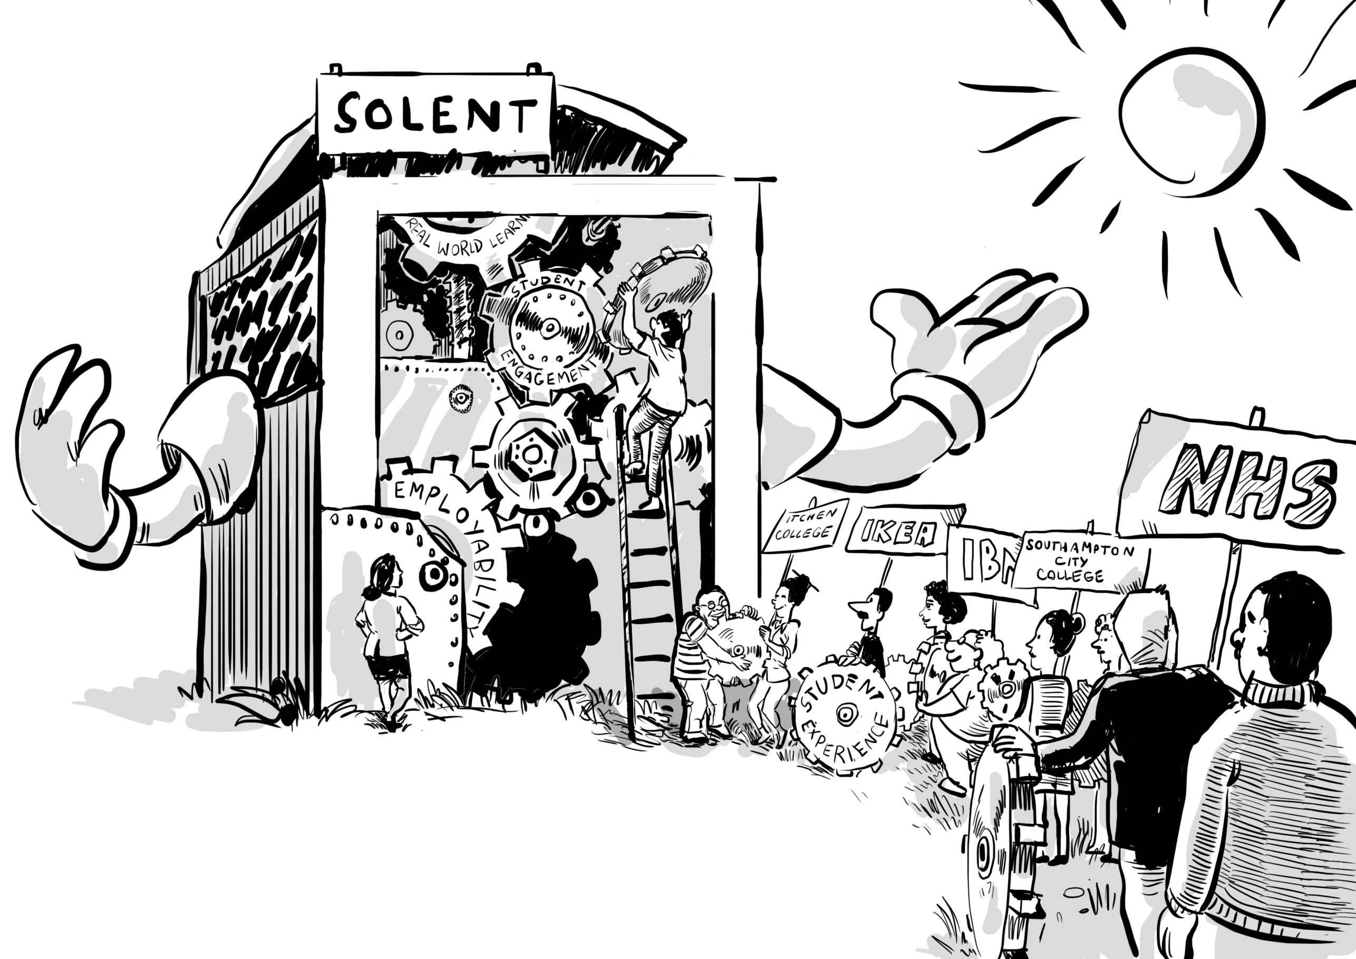
9 A culture that encourages new relationships and collaborations
Notes:
Organisational change is accomplished through the deepening of existing relationships and the forging of new collaborative partnerships that generate ideas and new opportunities, and which provide encouragement, practical help and support.
Forming productive, co-creative and emotionally supportive collaborative working relationships with members of their School or colleagues in central university departments - particularly the Flexible Delivery Team (e-Development and Educational Technology Unit) and Partnerships Office was an important strategy for innovators. Extending existing relationships or building new relationships in the external environment was also a priority in the strategic change process. Relationship building with employers was crucial to the success of several of the innovations. In the case of the Foundation Degree in Health and Social Care the relationship was underpinned by a formal strategic alliance but ultimately it is the interpersonal relationships between the people who are directly involved in change that really matter.
Such relationships helped innovators to appreciate the value of their own work and efforts, encouraged them to 'go the extra mile' and enabled them to persist especially at the most frustrating and challenging moments.

Slide 22
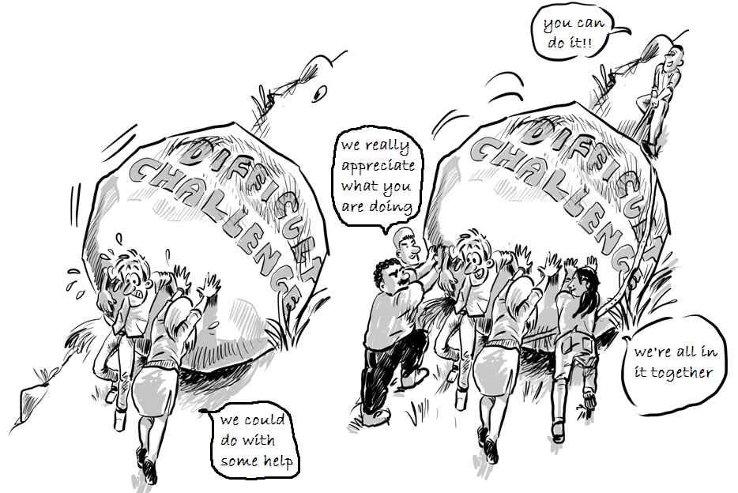
10 A culture that provides emotional support
Nourishers in the work environment
(Amabile and Kramer 2011)
1 Respect, 2 Encouragement,
3 Emotional Support
and 4 Affiliation
Notes:
An emotionally nourishing environment helps people deal with the challenges, stresses, anxieties and frustrations of trying to bring about significant change and helps them to remain positive in the face of setbacks. Such an environment recognises the efforts and celebrates the achievements of those who are involved in change.
Stress, anxiety and frustration are often associated with significant organisational change as people encounter problems and setbacks, things do not work out as intended or other situations. Sources of stress, anxiety and frustration encountered in this study included: 1) the competing demands of developing new practices while continuing to teach 2) inadequacy of resources for some projects where the amount of resource was underestimated or could not be estimated in advance, or when there was a lack of transparency as to how resources were being allocated 3) insufficient support when dealing with difficult problems 4) seeming inability of some institutional systems, procedures and infrastructures to adapt to the changes that they were creating. Such adverse psychological impacts could have been reduced if participants had more time particularly at critical moments in the change process, had more resources - not only money but practical help at certain stages of their project and had more support and empathy in resolving difficult problems that blocked progress.
Amabile and Kramer's study of the socio-cultural work environment identified four categories of nourishers (Amabile and Kramer 2011: 131- 33) and all seemed to be important to the innovators. They have a significant impact on the way they feel and on their creativity and productivity. These are:
1 Respect - managerial actions determine whether people feel respected or disrespected and recognition is the most important of these actions.
2 Encouragement - for example when managers or colleagues are enthusiastic about an individual's work and when managers express confidence in the capabilities of people doing the work increases their sense of self-efficacy. Simply by sharing a belief that someone can do something challenging and trusting them to get on with greatly increases the self-belief of the people who are engaging with the challenge.
3 Emotional support - People feel more connected to others at work when their emotions are validated. This goes for events at work, like frustrations when things are not going smoothly and little progress is being made, and for significant events in someone's personal life. Recognition of emotion and empathy can do much to alleviate negative and amplify positive feelings with beneficial results for all concerned.
4 Affiliation - people want to feel connected to their colleagues so actions that develop bonds of mutual trust, appreciation and affection are essential in nourishing the spirit of participation. One of the challenges for innovators is that they often feel alone because they are moving into new territory by themselves - where there is no-one they can affiliate with! The role of the SDP team was important here in giving people an affiliation that was purpose- as well as culturally-based.
It is clear from the case studies that innovators thrive and innovation is more likely to happen when the environment is emotionally nourishing in the manner described above. An environment that is respectful, positive, encouraging and emotionally as well as practically supportive. SDP was an important additional element in the institutional climate that contributed to a climate of positivity.

Slide 23
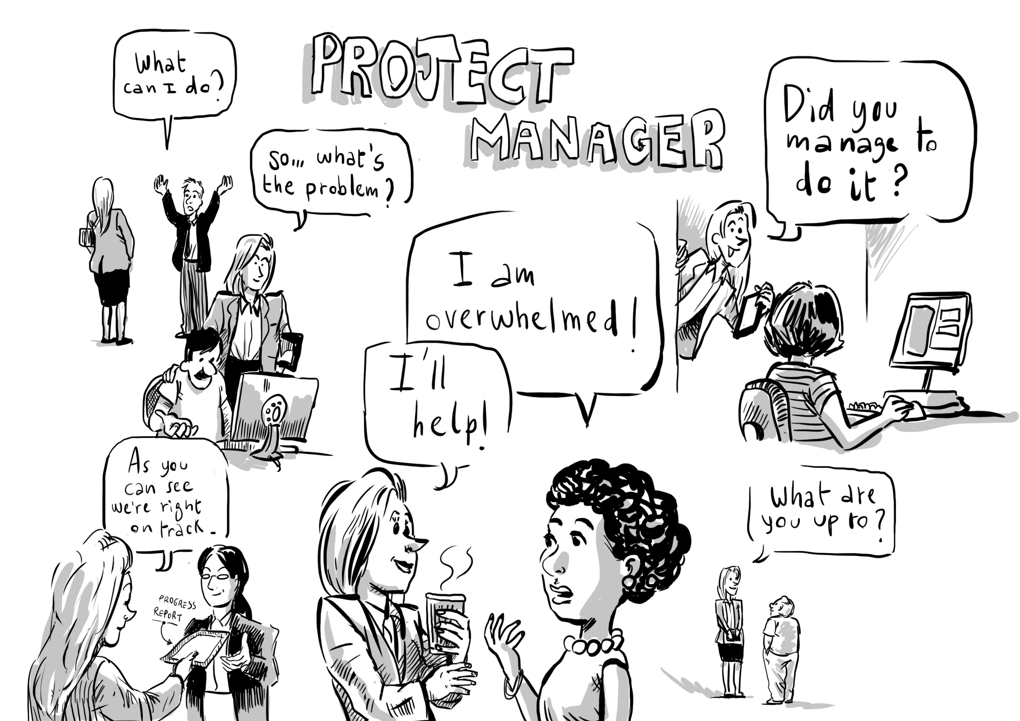
Being able to find help
when you need it

Slide 24
We really appreciate
what you have done

Slide 25
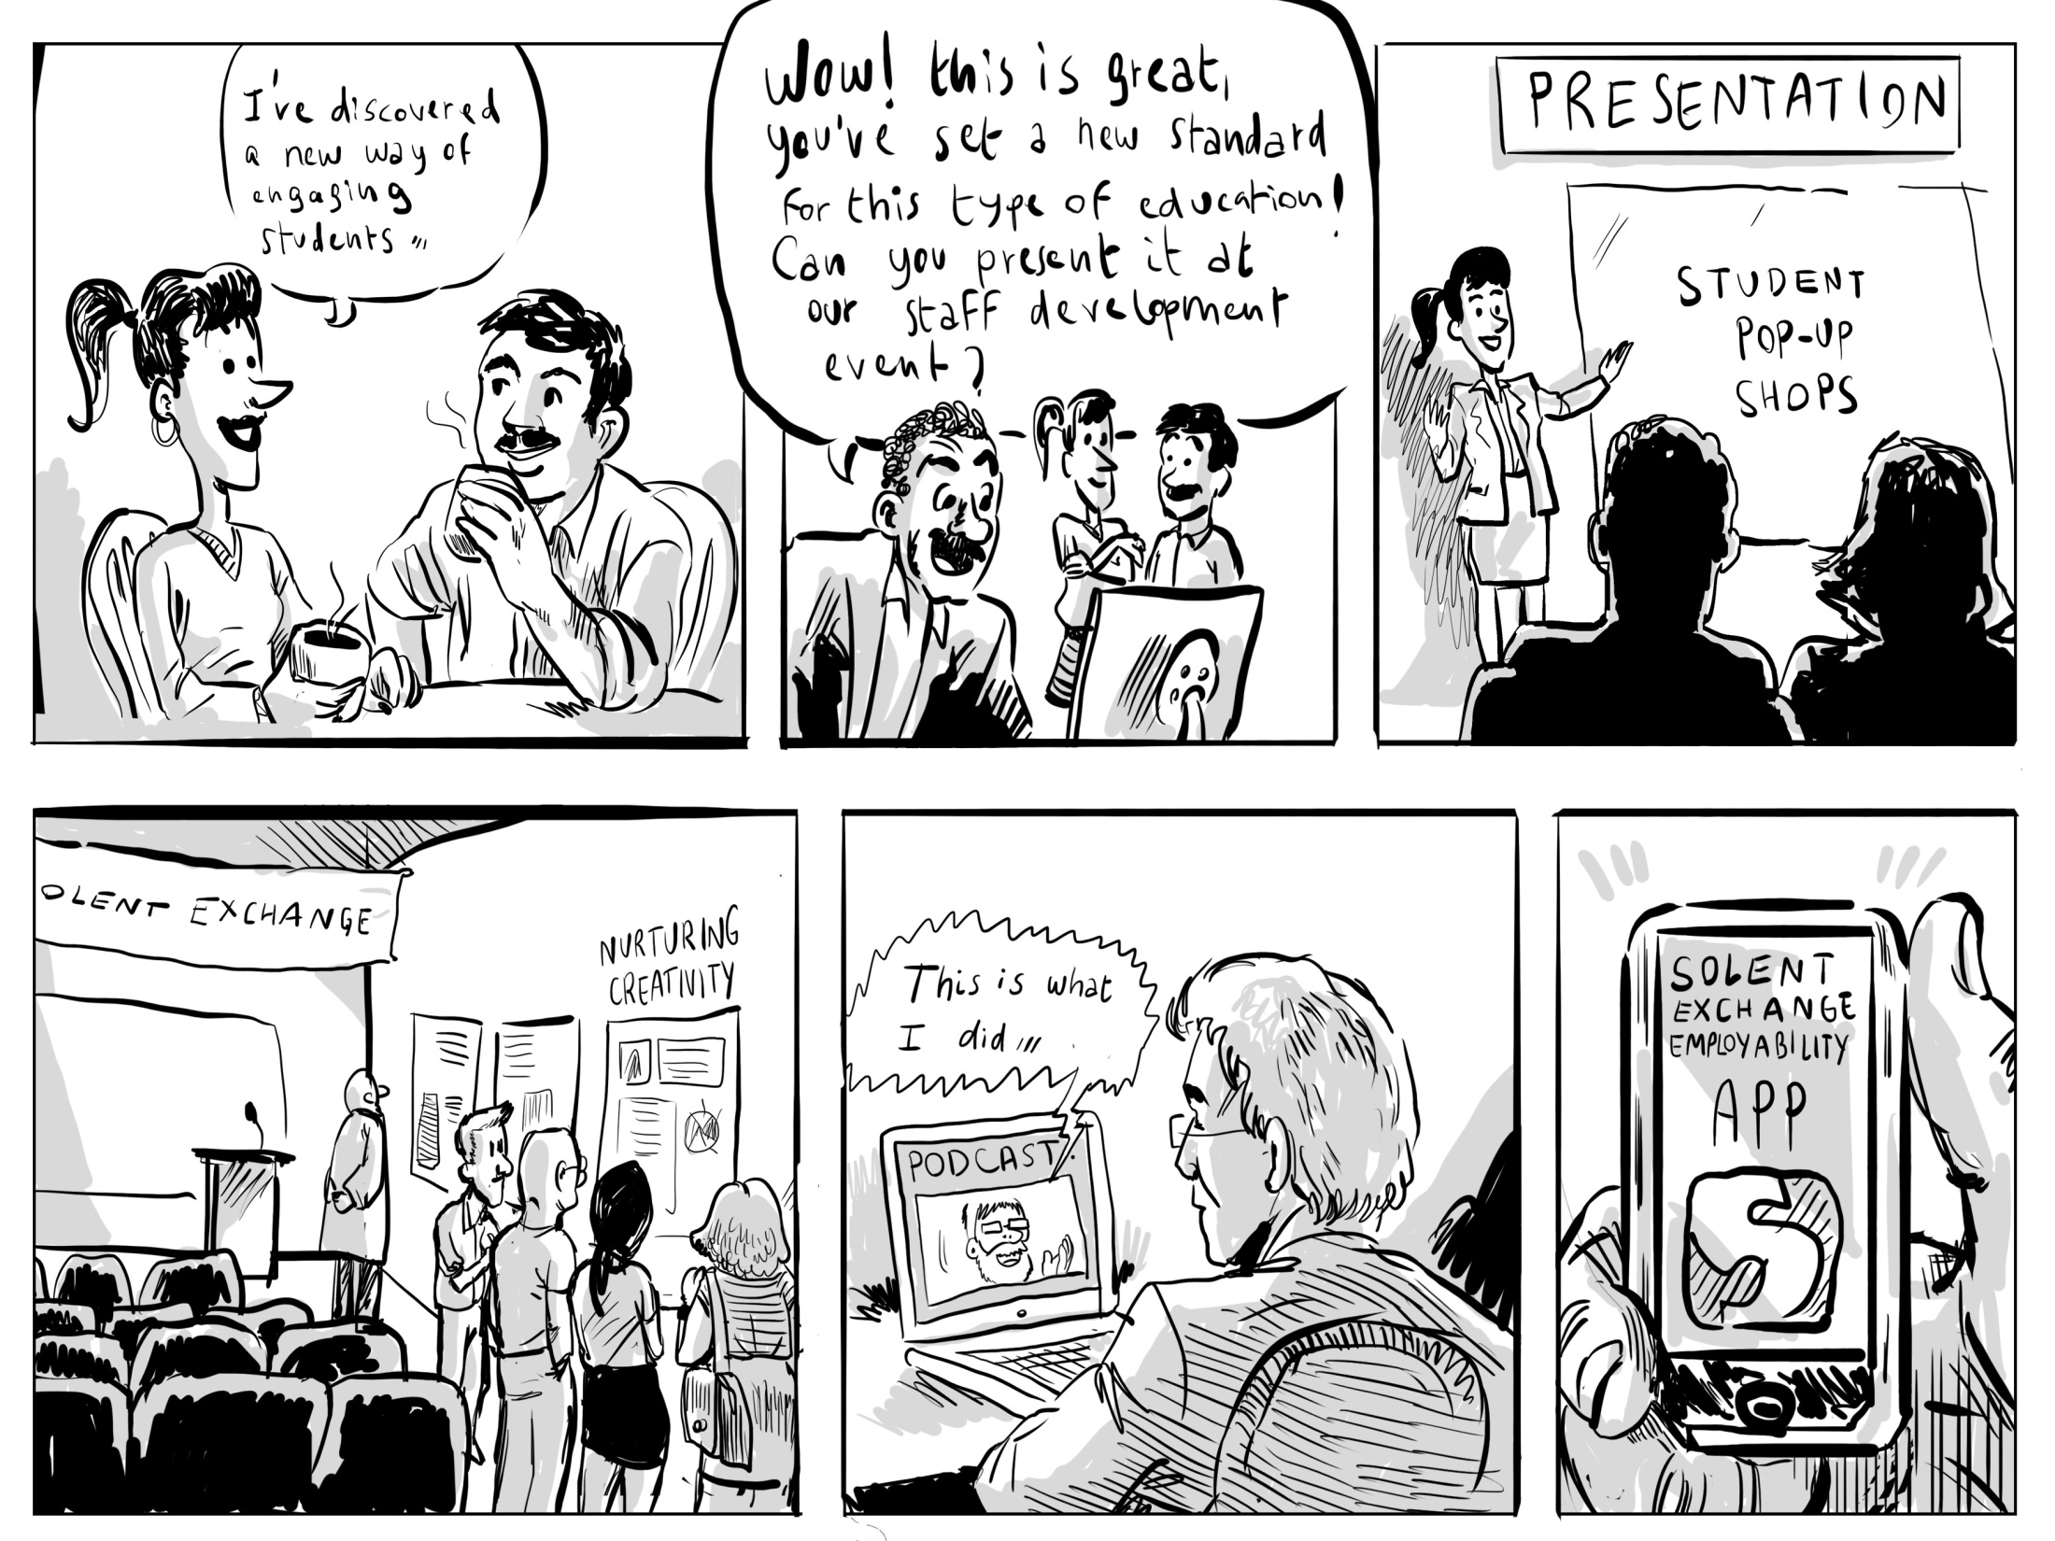
11 a culture that values learning and encourages and enables people to share what
has been learnt so that it can be used and adapted to other contexts
Notes:
If learning to do new and better things is the core enterprise in strategic change it is vital that new knowledge and understanding grown through the change process, is consolidated, made visible and distributed to other members of the organisation in ways that are appropriate and meaningful to them. Only then can what has been learnt be applied in other situations and contexts.
Creating opportunity for meaningful communication is as important after change has been accomplished as it is before and during the change process, remembering that to change an organisation you need to change a majority of conversations in the organisation (Seel 2004).

Slide 26
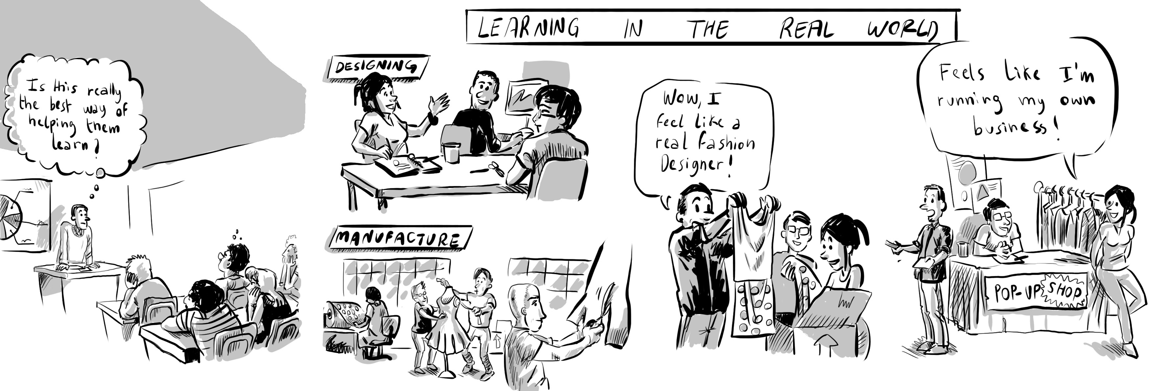
12 a culture that encourages people to take risks to put themselves into unfamiliar
situations where they need to harness their creativity to realise their ideas and
achieve their ambitions
Notes:
Accomplishing change - involves new ideas, new ways of thinking, new practices and new ways of being - it's an inherently creative process and ultimately it involves people becoming different and taking risks to challenge themselves and put themselves into new situations in order to achieve their goals.
Innovators viewed creation in terms of the invention of practice that was entirely new to them or existing practice that was significantly modified. They also recognised creation in new relationships and infrastructures to support new practice, and new policies and procedures to guide future practice. The real value of strategic change initiatives is in enabling people to realise their creative potential to actualise themselves to become who they want to become. Innovators and early adopters thrive in such a culture.
Higher education teachers are motivated to innovate by the ideas of helping their students learn more and better, and through this to improve their chances in life. By creating a more imaginative and more effective curriculum they are helping their learners to actualise themselves. In the process of designing and implementing and new curriculum they are actualising themselves. In actualising themselves they are helping to enable the university to realise its strategic ambition.

Slide 27
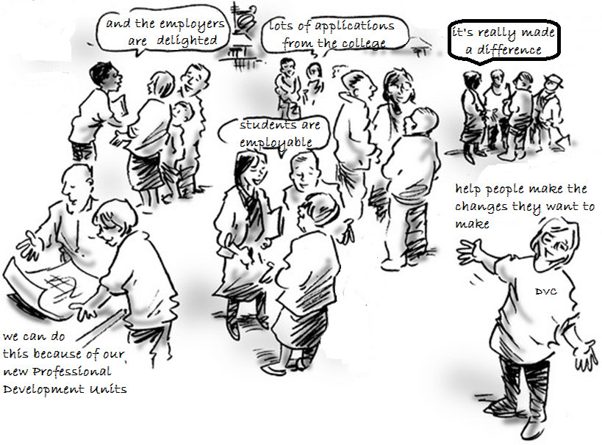
A self-actualising university!
A self-actualising university:
Notes:
The secret of accomplishing significant organisational change is to connect the people who want to actualise themselves through their innovations with the strategic changes the organisation wants to make
In trying to answer the question how does a university accomplish strategic change in which a large part of the change is brought about through the educational innovations of teachers (faculty) we discover that an organisation's strategic ambition and the will and creativity of the individuals who bring about change are intertwined.
In its mission and vision statements a university sets out where it believes its destiny and future identity lie but it is only through the concerted and deliberate actions of individuals and groups of individuals in its community, each of whom is striving to actualise their own vision and destiny, that the university achieves its ambition.
People leading and enacting change appear to be a particular type of person with the will to get involved in something and stay involved until the job is done. Not only do they generate ideas, they also like to actualise these ideas and they do not want to fail so they persist until they are satisfied. The will to complete something is a strong as the will to begin it.
It is the will to be and become a certain sort of person (like a better teacher) or to help others (like enabling students to learn better), or to develop a better system (to improve the support given to students, teachers or perhaps external employers and businesses), that provides the deep motivational force for many of the people who contributed to the Southampton Solent change project. The combination of challenge, personal autonomy, the desire for doing something new and the invention and mastery of new practice, and the belief that people are making a valuable contribution to the educational enterprise of students, were the most important factors that caused deep and sustained engagement in SDP projects.
What comes out of this process is not something that can easily be codified or quantified on a piece of paper. What comes out of it are new relationships and new sorts of conversation within and outside the university, new forms of practice and models or approaches that can be re-used and adapted to other contexts, and new ways of seeing and understanding things - in other words culture that is different to what existed before.

Slide 28
Validating and using this knowledge
Do these factors resonate with your experiences of
trying to innovate in your university?
I welcome your involvement in testing these ideas in your institutional context
Background paper/slides at http://www.normanjackson.co.uk/ifiut.html Thank you
Shukran
Notes:
I would like to determine whether these factors and conditions are valid in other cultural settings. If you would like to share your thoughts or collaborate in a study please contact me..
normanjjackson@btinternet.com.

