Slide 1
Creativity in Practice : An Ecological Phenomenon Norman Jackson
‘A properly ecological approach … is one that would take, as its point of departure, the whole-organism-in-its-environment. In other words, ‘organism plus environment’ should denote not a compound of two things, but one indivisible totality’ (Ingold 2000 :16).
My proposition: In the practice environment the motivator for creativity is the intrinsic desire to create value by solving domain specific problems, developing new situated knowledge and creating new cultural artefacts. The process involves ‘the emergence in action of a novel relational product growing out of the uniqueness of the individual on the one hand, and the materials, events, or circumstances of their life’ (Rogers 1961: 350).
From Learning Ecologies to Ecologies for Creative Practice, Chapter 12 in R. Barnett & N J Jackson Ecologies for Learning and Practice: Emerging Ideas, Sightings and Possibilities
http://www.normanjackson.co.uk/crc.html

Slide 2
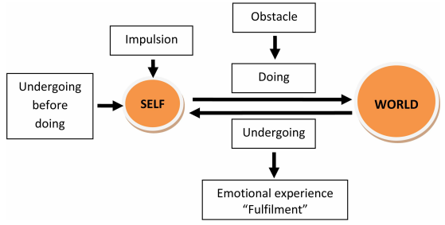
John Dewey’s interactionist model of experience
Glaveanu et al (2013) Creativity as action: findings from five creative domains Frontiers in Psychology 4, 176
Notes:
“For Dewey, what brings action and creativity together is human experience, defined precisely by the interaction between person and environment and intrinsically related to human activity in and with the world. …Action starts….with an impulsion and is directed toward fulfillment. In order for action to constitute experience though, obstacles or constraints are needed. Faced with these challenges, the person experiences emotion and gains awareness (of self, of the aim, and path of action). Most importantly, action is structured as a continuous cycle of “doing” (actions directed at the environment) and “undergoing” (taking in the reaction of the environment). Undergoing always precedes doing and, at the same time, is continued by it. It is through these interconnected processes that action can be taken forward and become a “full” experience.”²⁴ ²⁻³
Glaveanu Vlad, Lubart Todd, Bonnardel Nathalie, Botella Marion, de Biaisi Pierre-Marc, Desainte-Catherine Myriam, Georgsdottir Asta, Guillou Katell, Kurtag Gyorgy, Mouchiroud Christophe, Storme Martin, Wojtczuk Alicija, Zenasni Franck (2013) Creativity as action: findings from five creative domains , Frontiers in Psychology 4 , 176 Available at: https://www.frontiersin.org/article/10.3389/fpsyg.2013.00176

Slide 3
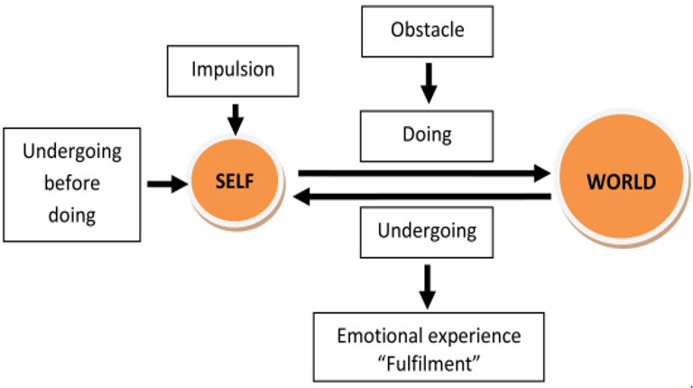
Learning Ecology Conceptual Framework
3 RESOURCES
information, knowledge, people, tools, technologies
& other artefacts (anything that can be used)
4 SPACES
physical, social, virtual, intellectual, psychological, liminal
WHOLE PERSON
with their mind and body, purposes and motivations, sensing, perceiving, feeling, imagining, relating to, interacting with, interpreting & making sense of their environment & emerging situations
ENVIRONMENT
2 AFFORDANCES
possibilities that can be perceived or imagined for thinking and action
PAST
FUTURE?
5 PLACES
some things can
only be learned in a
particular place.
1 CONTEXTS
situations, circumstances, culture, ourselves familiar or unfamiliar, simple –complicated - complex or chaotic
6 RELATIONSHIPS
with people, communities, places, ideas, objects, work, hobbies, problems, anything!
7 PROCESSES/ACTIVITIES/EXPERIENCES
sg study, work, making, research, inquiry,
problem solving and much more….
Jackson, N. J. (2016) Exploring Learning Ecologies. Chalk Mountain/Lulu.
Notes:
Summary of the components of a learning ecology
Learning ecologies (Jackson 2013a:14) 'the process(es) we create in a particular context for a particular purpose that provides us with opportunities, relationships and resources for learning, development and achievement'.
This definition represents the integration and interdependence of the elements of learning and achievement which include the contexts and spaces we inhabit, including our history, relationships and resources, (the most important being knowledge and tools to aid thinking), and our will and capability to create a learning process or learning ecology for a particular purpose.
Such actions may be directed explicitly to learning or mastering something but more likely they will be primarily concerned with performing a task, resolving an issue, solving a problem, or making the most of a new opportunity.
Learning ecologies have temporal dimensions as well as spatial and contextual dimensions: they have the capability to connect different spaces and contexts existing simultaneously across a person's life-course, as well as different spaces and contexts existing in different time periods throughout their life-course.
HYPOTHESIS : ECOLOGIES FOR ACHIEVING OUR PURPOSES
ARE OUR VEHICLES FOR DISCOVERING & CREATING MEANING
Our beliefs shape what we value and what we value shape our beliefs
Our beliefs & values shape our purposes – purposes emerge from the circumstances of our life and what we value they give our life meaning
Purposes create intentions (will/desire/ambition) to act on purpose (to reinforce the meaning that is our life) eg the desire to make a positive contribution/to make a difference to create a better version of oneself and to create new value in the world we are attending
Intentions cause us to search our life/world (contexts) for affordance (perceptions of possibility for action – eg to make a difference)
Affordance enables us to formulate goals to drive specific actions and behaviours in the particular contexts and situations of our life/world
These actions and behaviours result in an ‘ecology for achieving our goals’. Our ecology is the way we interpret, relate to, connect and interact with our world of which we are a part not a separate entity. Our ecology involves relationships, activities, experiences, use of resources (knowledge/tools and other artefacts) through which we learn and develop in order to accomplish something we value and create new and deeper meanings in the process.
New meaning grows from the experiences and reflections on experience grown through our ecology when it is integrated with our previous understandings, values and beliefs. Our unfolding experiences contain things which are currently meaningful and also things that do not make sense to us. It is in striving to make sense or better sense of such things that new meaning grows in relation to all of the above. Its an ecological process.

Slide 4
Learning Ecology Conceptual Framework
3 RESOURCES
information, knowledge, people, tools, technologies
& other artefacts (anything that can be used)
4 SPACES
physical, social, virtual, intellectual, psychological, liminal
WHOLE PERSON
with their mind and body, purposes and motivations, sensing, perceiving, feeling, imagining, relating to, interacting with, interpreting & making sense of their environment & emerging situations
ENVIRONMENT
2 AFFORDANCES
possibilities that can be perceived or imagined for thinking and action
PAST
FUTURE?
5 PLACES
some things can
only be learned in a
particular place.
1 CONTEXTS
situations, circumstances, culture, ourselves familiar or unfamiliar, simple –complicated - complex or chaotic
6 RELATIONSHIPS
with people, communities, places, ideas, objects, work, hobbies, problems, anything!
7 PROCESSES/ACTIVITIES/EXPERIENCES
sg study, work, making, research, inquiry,
problem solving and much more….
Jackson, N. J. (2016) Exploring Learning Ecologies. Chalk Mountain/Lulu.
Notes:
Summary of the components of a learning ecology
Learning ecologies (Jackson 2013a:14) 'the process(es) we create in a particular context for a particular purpose that provides us with opportunities, relationships and resources for learning, development and achievement'.
This definition represents the integration and interdependence of the elements of learning and achievement which include the contexts and spaces we inhabit, including our history, relationships and resources, (the most important being knowledge and tools to aid thinking), and our will and capability to create a learning process or learning ecology for a particular purpose.
Such actions may be directed explicitly to learning or mastering something but more likely they will be primarily concerned with performing a task, resolving an issue, solving a problem, or making the most of a new opportunity.
Learning ecologies have temporal dimensions as well as spatial and contextual dimensions: they have the capability to connect different spaces and contexts existing simultaneously across a person's life-course, as well as different spaces and contexts existing in different time periods throughout their life-course.
HYPOTHESIS : ECOLOGIES FOR ACHIEVING OUR PURPOSES
ARE OUR VEHICLES FOR DISCOVERING & CREATING MEANING
Our beliefs shape what we value and what we value shape our beliefs
Our beliefs & values shape our purposes – purposes emerge from the circumstances of our life and what we value they give our life meaning
Purposes create intentions (will/desire/ambition) to act on purpose (to reinforce the meaning that is our life) eg the desire to make a positive contribution/to make a difference to create a better version of oneself and to create new value in the world we are attending
Intentions cause us to search our life/world (contexts) for affordance (perceptions of possibility for action – eg to make a difference)
Affordance enables us to formulate goals to drive specific actions and behaviours in the particular contexts and situations of our life/world
These actions and behaviours result in an ‘ecology for achieving our goals’. Our ecology is the way we interpret, relate to, connect and interact with our world of which we are a part not a separate entity. Our ecology involves relationships, activities, experiences, use of resources (knowledge/tools and other artefacts) through which we learn and develop in order to accomplish something we value and create new and deeper meanings in the process.
New meaning grows from the experiences and reflections on experience grown through our ecology when it is integrated with our previous understandings, values and beliefs. Our unfolding experiences contain things which are currently meaningful and also things that do not make sense to us. It is in striving to make sense or better sense of such things that new meaning grows in relation to all of the above. Its an ecological process.

Slide 5
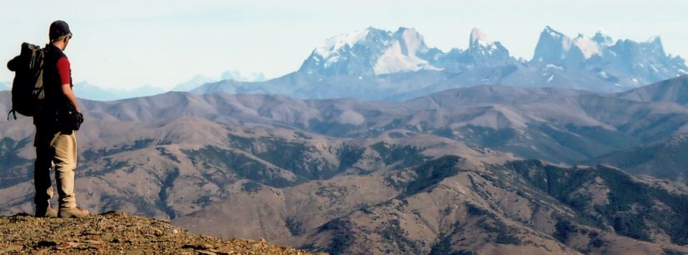
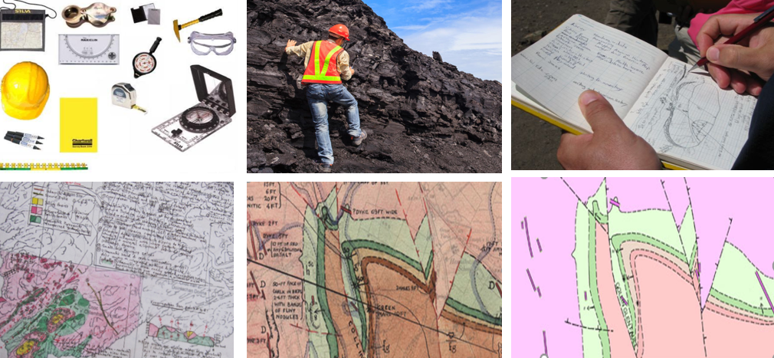
The work, tools & artefacts of a field geologist

Slide 6
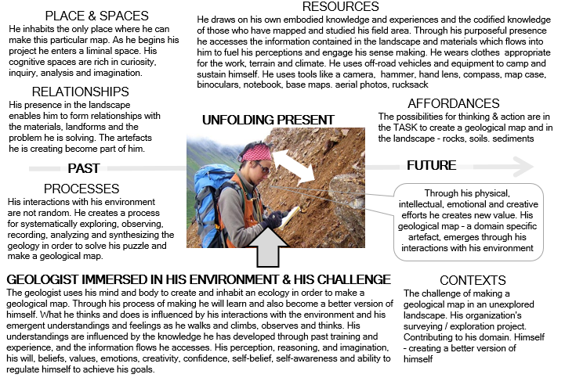
A field geologist’s ecology of practice

Slide 7
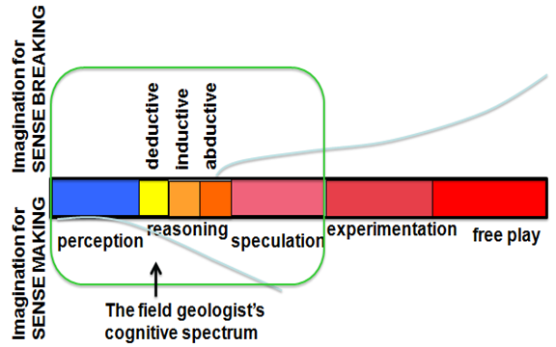
Pragmatic Imagination and the cognitive spectrum
Pendleton-Jullian and Brown (2016:73) http://www.pragmaticimagination.com/

Slide 8
Applying Dewey’s interactionist model to the field geologist’s experience
[after Glaveanu et al. 2013, Table 3 p.12]
TRANSFORMATION |  | FIELD GEOLOGIST
 | Impulsion | To solve a geological problem/task
 | Obstacle(s) | Not knowing/understanding Physical terrain/accessibility Weather Budget
 | Doing | Skilled map making using methods/tools/means of the geologist
 | Undergoing (material) | CREATION OF NEW VALUE Production of artefacts eg. geological map, notebook, reports
 | Undergoing (personal) | CREATION OF NEW VALUE Learning and developing - becoming a better version of self
 | Undergoing (social) | CREATION OF NEW VALUE For company / colleagues/ clients
 | Emotions | (Dis)satisfaction, frustration, anxiety, joy, pride and many more feelings as the geological map is made and work progresses towards feelings of fulfillment

