Slide 1
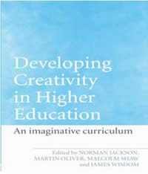
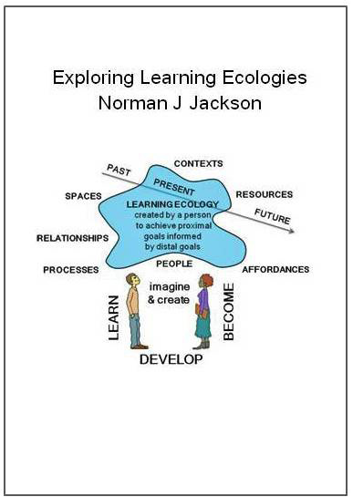
MAIN THEME : Continuous process
of exploration and social learning
Background paper/slides & video clip
http://www.normanjackson.co.uk/bera.html
University of Surrey
QUALITY ASSURANCE
AGENCY
LTSN & HIGHER
EDUCATION ACADEMY
SCEPTrE CETL
Lifewide Education
Creative Academic
Policy/Regulation Research Development Innovation Social Learning Networks
AWARENESS
OF PROBLEM
MAKE SENSE
OF PROBLEM
REFRAME
PROBLEM
EMERGENT
PERCEPTIONS
APPLYING NEW
PERSPECTIVES
Collaborative
Creative
Pedagogies
& Learning
Ecologies
Project
Programme
Specifications
Imaginative
Curriculum
Network
SCEPTrE CETL
Lifewide Education
Community
Creative Academic
Community
1998-2000
2000-05
2006-11
2011----------- 2017
Notes:
1 Key themes of research in HE sector.
I cannot give an overview of creativity research across the HE sector. Rather I can give an account of my own perspectives and how I encourage the sector to explore creativity for itself.
My involvement in creativity in HE spans nearly 2 decades and six organisations.
1) My interest in creativity in higher education began about 17 years ago when I was working at QAA developing policy on programme specifications and became AWARE that the outcomes model of learning we were promoting through our policies was neglecting important developmental outcomes – like creativity.
2) Moved to LTSN/HEA 2000 and was given freehand to develop a programme of work aimed at enhancing higher education I chose ‘curriculum’ and ‘creativity’ to work with and established and facilitated network of higher education practitioners who were interested in creativity. We called it the imaginative curriculum network. Over 5 years we explored the nature of the problem of creativity in higher education, shared experiences understandings through numerous events, undertook surveys and interview-based research. We studied creativity in 8 different disciplines. The results of this work were published in Creativity in Higher Education.
3) I moved to the University of Surrey in 2005 led a Centre for Excellence in Teaching and Learning which focused on informal learning as a way of supporting students’ professional development began to develop and apply the idea of lifewide learning… I used the opportunity to explore further how and where students were being creative in different parts of their lives and the idea of personal creativity being used in and across the domains of our life became important to my understanding of what it means to be creative. The work was published in Learning for a Complex World.
4) I left the University of Surrey in 2011 and set up my own social enterprise to promote and carry on developing the idea of lifewide learning and support people and institutions wanting to develop their own practices in lifewide education. Over the last 3 years I have been developing the idea of learning ecologies which I believe are important vehicles for personal creativity which I will include in this story.
5) In Jan 2015 I cofounded Creative Academic – a resources and networking social enterprise to support the exchange and development o ideas and practices. As a network we are currently exploring the idea and value of an ecological perspective on creativity.
Two additional studies –
Between 2011 – 13 I conducted an interview based study of how educational innovation emerged through a strategic change programme in a university. This enabled me to gain insights into the factors and conditions which encouraged and enabled academics to use their creativity. This work was published by the University in ‘The Wicked Challenge of Changing a University’ Authorhouse
2) I have also also worked on trying to understand the relationship between ‘Creativity in development’ – one project I have worked with educational developers to try to understand the role of creativity in their developmental processes.

Slide 2
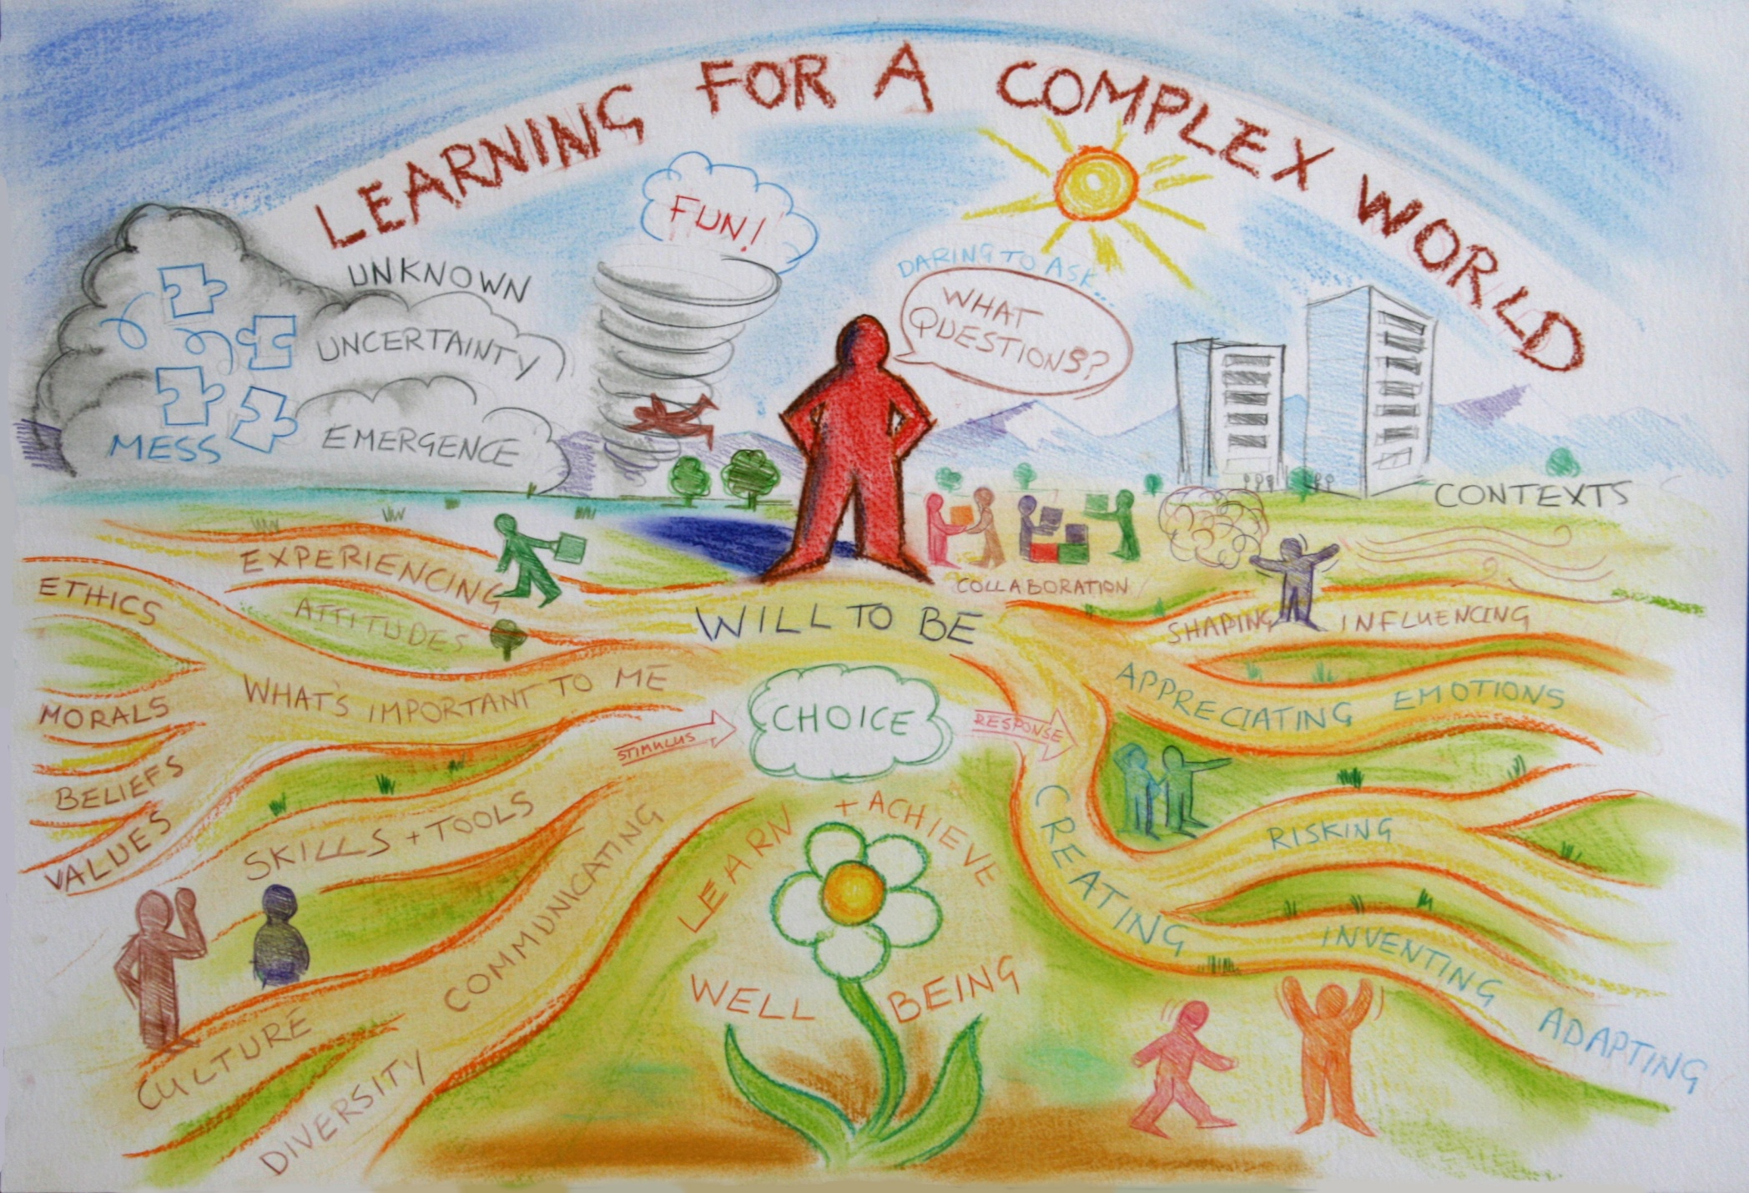
PROBLEM OF CREATIVITY
me 1978
D
I
T
Notes:
Why is the idea of learning ecologies important? Its important because the simple truth in life is that we advance our understandings not because we know certain things but because we are able to come to know and understand new things. And fundamentally the process of coming to know is ecological.
The fundamental challenge facing higher education institutions all over the world. People working and studying in higher education are confronted every day by essentially the same wicked challenge.
For teachers it is associated with a question like ‘ how do we prepare people for an ever more complex world?’… I don’t just mean preparing students for their first job when they leave university I mean how do we prepare them so that they can face and adapt to the many challenges they will encounter over a lifetime of working, learning and living.
From the students’ perspective the same challenge is expressed in the question ‘ How do I prepare myself for the rest of my life?’… what sorts of things do I need to learn, what sorts of skills, qualities, dispositions and values do I need to develop, and what sorts of experiences do I need to have.. Personal and professional development needs to be so much more than simply studying and learning an academic curriculum.
This picture, which we drew on the wall of our Centre at the University of Surrey, symbolically represents some of the complexity embedded in this wicked problem – which is a problem that is very difficult to define, is nested in other problems and has many perspectives on it, has no right or wrong answers, and no clear resolving actions.
The picture also suggests that the whole world is our ‘oyster’ for learning not just the institutions we inhabit.

Slide 3
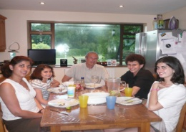
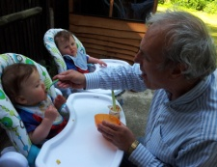
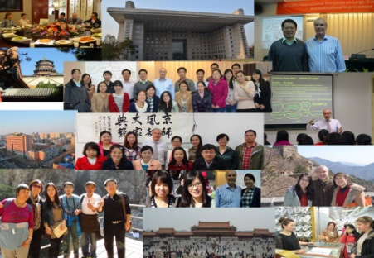
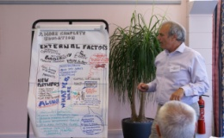
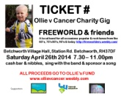
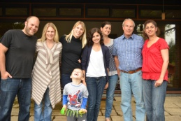
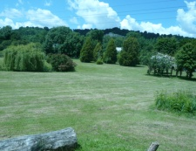
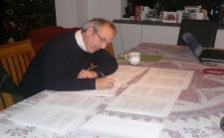
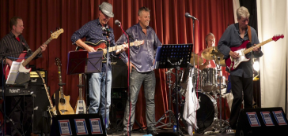
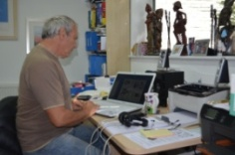
CONCEPT 1 LIFEWIDE PERSPECTIVE ON LEARNING & CREATIVITY :
Our creativity is bound up with our learning, development &
achievement in all aspects of our life
o
t
h
e
r
travel
family & home
work
hobbies
virtual
Now, All, Personal & Significant
Formal AND
Intended
Need
Directed
Planned
Informal
Unanticipated
Interest
Self-directed
Emergent
Learning, Creativity & Achievement are Contextualised
Notes:
Because we are the integration of all of our experiences past and present, I believe that the concept of lifewide is the most comprehensive and inclusive framework within which we can understand learning and therefore personal development.
Our planning and aspirations for personal and professional development and our reflections on how we have developed lie in the lifelong dimension but our actual personal and professional development lies in our day to day, thinking, activities and experiences -
The lifewide dimension contains all the circumstances of our current life and determine who we are. But because we can influence them we can change or add to these circumstances in this way it is the lifewide dimension that enables us to be who we are and become who we would like to be. The lifelong dimension merely shows us who we became.

Slide 4
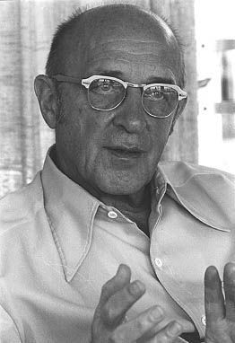
CONCEPT 2 ECOLOGICAL PERSPECTIVE ON PERSONAL CREATIVITY
Personal creativity is
'the emergence in action of a novel relational product growing out of the uniqueness of the individual on the one hand, and the materials, events, people, or circumstances of his life'
Carl Rogers (1960)
NOTES
product = ideas, material or virtual objects, practices, performances, relationships, processes and more……
originality emerges from our uniqueness as individuals, caring and thinking about things in our contexts, in the ways that only we can
creativity is often the result of making a third ‘thing’ from two existing things or ideas, rather than making something from nothing 1+1=3!
McWilliam and Taylor (2016)
Notes:
There are many definitions of creativity and most seem to have the ideas of bringing something new and original into existence as their core conception without providing any sort of context. It’s as if creativity and invention happen in isolation from the world of their creator. Because of this I have come increasingly to appreciate and respect the way Carl Rogers framed the idea of personal creativity as, 'the emergence in action of a novel relational product growing out of the uniqueness of the individual on the one hand, and the materials, events, people, or circumstances of his life' ^{27:350}
The bottom line is that creativity is an ecological phenomenon. It’s about human beings having thoughts that are stimulated by their relationship and interactions with the world around them. A creative thought is the result of a person interacting cognitively, physically, emotionally, virtually with something in their world ideas, people, things, problems, situations and experiences, and a multitude of other things and this interaction triggering a novel thought. These thoughts are often the result of connecting/combining two or more things to create something that is different to the things that were connected. McWilliam and Taylor⁶ catch this beautifully in their idea that creativity is often the result of making a third ‘thing’ from two existing things or ideas, rather than making something from nothing. Perhaps we might capture the idea in 1+1=3!
Rogers' view of personal creativity and how it emerges from the circumstances of our life, is an ecological concept. The ecological metaphor affords us the most freedom and flexibility to explore and appreciate the ways in which we and our purposes are connected to our experiences and the physical, social and psychological world we inhabit. I believe that our creativity lies in seeing affordance in an idea, thing or situation and then acting on this
affordance by doing something useful and novel (at least to ourselves) with what is afforded²⁹. If we translate this way of thinking to the formal teaching and learning environment then the most important things a teacher does through their pedagogic practice is to create affordance for learning, enable learners to appreciate that affordance, and equip them with the means and motivation to make use of it. If the object of affordance has a creative dimension then their pedagogic task is to encourage and enable learners to make use of it.
A learning ecology contains not only the physical, virtual and social spaces that form the circumstances of our lives, but also the mental / psychological spaces that enable us to think about ideas and situations in a variety of ways. If we translate this way of thinking to the formal teaching and learning environment then the most important things a teacher does through their pedagogic practice is to create affordance for learning, enable

Slide 5
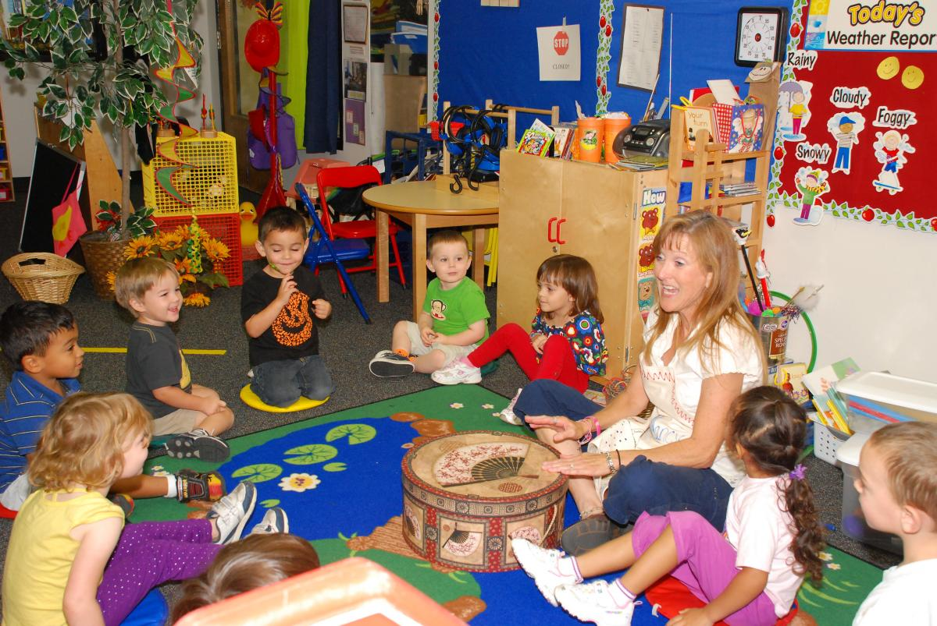
CONCEPT 3 ECOLOGICAL CONCEPT OF LEARNING: Our creativity emerges
through the ecologies we create for learning, developing & achieving
CONTEXT – early years education/school
PEOPLE - teacher, pupils,
TA’s and pupils parents
PURPOSE – learning about things/
learning how to learn/values & social stuff
SPACES (many)
Physical –
classroom/ school
Emotional
Intellectual
Creative
AFFORDANCES
teacher enables
pupils to see and
use opportunities
for learning
RELATIONSHIPS
teacher/TA’s – pupils
pupils-pupils
teacher – parents
parents- children
with subject,
environment &
materials
CONTENT
teacher determines what is to be learnt
PROCESS
teacher determines
how content is learnt
ACHIEVEMENT
teacher determines
what has been achieved
RESOURCES (knowledge, tools, materials, technologies) teacher’s/ TA’s knowledge, pupils’ experiences, books, learning aids, posters/pictures, musical instruments, writing materials, pupils’ work, internet
Notes:
An ecological perspective on learning, requires us to also think about the ecosystem within which learning takes place. A traditional university course taught face to face is designed, organised and implemented by one or more academic teachers who have both disciplinary and pedagogic expertise, within an institutional socio-cultural environment that is full of support and resources to aid learning. There is a structure (timetable/lecture schedule/credit structure) and procedural framework (rules and regulations) within which learning takes place. Programmes are organised into units or modules with explicit objectives, content, resources and processes that engage learners in activities through which they learn, and some of their learning is assessed using one or more methods determined by teachers. The institutional ecosystem for learning includes people - learners, teachers and other professionals who help learners, a physical environment including classroom spaces, social spaces, resources centre and virtual spaces where learners and teachers interact for the purpose of learning..
Affordance for learning within the context of an academic programme is everywhere. It is contained in the course, programme or module content, in the activities that teachers organise and facilitate for learners, in the physical and virtual spaces that are provided which support particular activities (both academics and social) and in the intellectual spaces that the pedagogic activities promote.
Affordance for learning and development is also found in the resources including books, journals, computers, software and other tools and mediating artefacts that are used, and in the teaching and learning processes and practices that are used to engage learners and encourage them to form relationships for learning with these resources. Affordance for learning and personal development is also found in the additional support and advisory services the university provides, and in the relationships and interactions between teacher and students, and student peers, and in learner’s own responses to all of these things. Furthermore, some academic programmes also contain affordances for learning in contexts and environments that lie outside the institution for example through work placements and internships, community-based projects, fieldwork and study visits and more.
Beyond the academic programme the university ecosystem provides affordance for student learning and development (including creative development) in the myriad of activities that populate the co-curriculum, and in the volunteering and paid work opportunities around campus. The university campus is a microcosm of the world and students’ can find and create for themselves affordance in all manner of things. Indeed, the more creative a student is the more likely they will find affordance in the world around them.
Some of the most important spaces for students’ creativity lie outside the academic curriculum. While this is to be celebrated, the question is why can’t the academic curriculum also be suffused with such affordance?

Slide 6
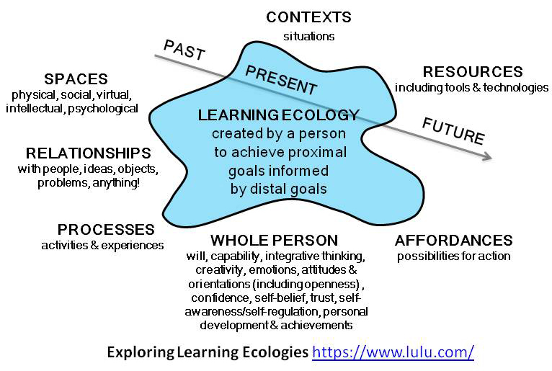
CONCEPTUAL MODEL - an individual’s learning ecology
BELIEF : this model can be applied any level or context
creativity
emerges
Having imagination to see
affordance in a situation &
being willing/able to act on it
Notes:
Concept of a Learning Ecology
In nature an ecosystem comprises the complex set of relationships and interactions among the resources, habitats, and residents of an area for the purpose of living. Each organism within an ecosystem has its own unique ecology within the ecosystem through which it lives its daily life, so the whole ecosystem is made up of many individual ecologies competing or collaborating for resources and contributing to the system as a whole so that the whole system is maintained and sustained.
A similar conceptualisation can be applied to human ecological systems or ecosocial systems - the set of relationships and interactions among the people, resources, habitats, and other residents of an area for the purpose of living³. While all ecosystems are complex adaptive systems that learn to live with, and when necessary adapt to, their environment, the making of meanings and sharing of understandings (learning) are a primary interest and purpose of human ecosocial systems together with their continuous development and improvement⁷.
Every organism has an environment: the organism shapes its environment and the environment shapes the organism. So it helps to think of an indivisible totality of ‘organism plus environment' - best seen as an ongoing process of growth and development⁸. From an environmental perspective it does not make sense to talk about the environment in which we are learning without reference to ourselves as the organism that is perceiving and interacting with the environment we inhabit in order to learn.
Model of a Learning Ecology
To help explore, apply and evaluate the idea of a learning ecology I developed a model to explain the elements it contains
Applying the idea of ecology to learning, personal development and achievement, including our creative achievements, is an attempt to view a person their purposes, ambitions, goals, interests, needs and circumstances, and the social and physical relationships with the world they inhabit, as inseparable and interdependent. The idea of ecology encourages us to think more holistically and more dynamically about the way we inhabit and relate to the world. It encourages us to think in a more holistic way about our life: how we connect up the moments in our lives to form experiences and achievements that mean something to us.
Growing out of the exploration of this idea is a belief that our ecologies for learning embrace all the physical and virtual places and spaces we inhabit in our everyday lives and the learning and the meaning we gain from the contexts and situations that constitute our lives. They are the product of both imagination and reason and they are enacted using all our capability and ingenuity. They are therefore one of our most important sites for our creativity and they enable us to develop ourselves personally and professionally in all aspects of our lives. If this belief is well founded then surely, our ability to create our own ecologies for learning and development must be one of the most important capabilities we need for sustaining ourselves, achieving our purposes and maintaining our sense of wellbeing in a complex, ever changing and often challenging and disruptive world. Yet to date, there has been little consideration of these ideas in the higher education curriculum or pedagogic practices.

Slide 7
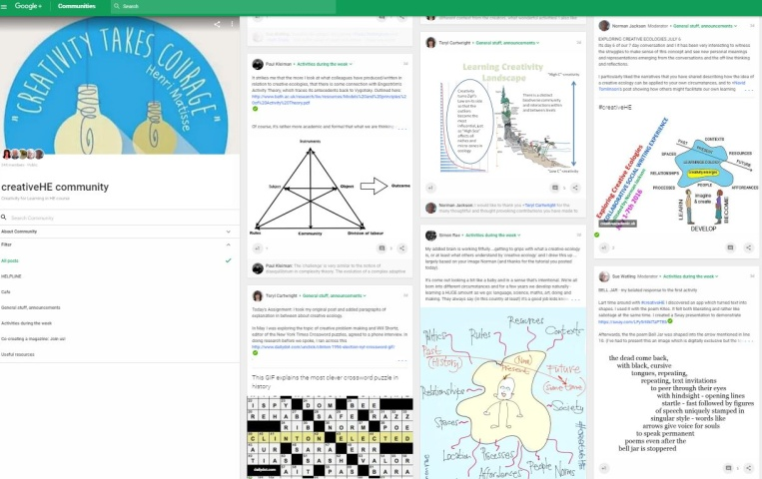
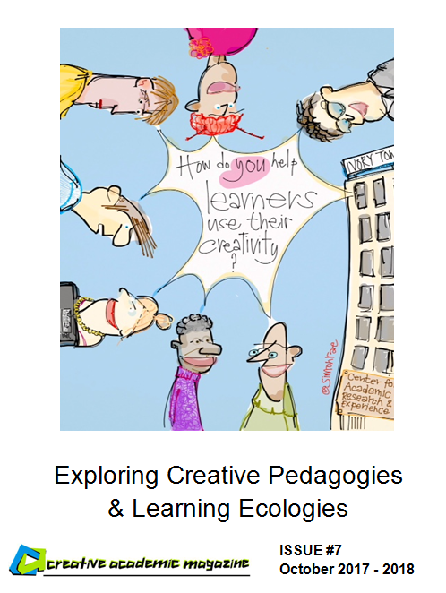
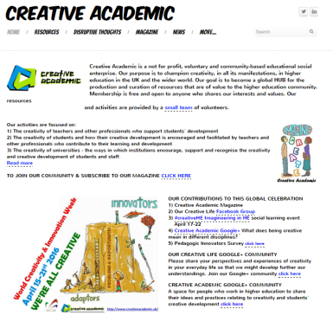
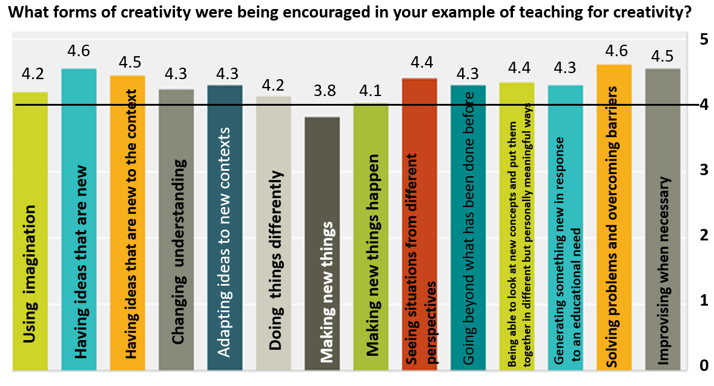
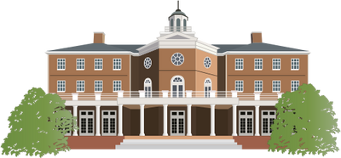
EXPLORING THE VALUE IN THE IDEA : Open learning
Creative Pedagogies for Creative Learning Ecologies
Sept 2016 –
Sept -2017
2 Discursive process #creativeHE Goggle+ platform conversations
OCT 30
NOV 4
1 Formation
of global
Network
of Interest
(currently
50 people)
use of social
media to
Promote
OPEN
INVITATION
TO BERA!
3 Encouragement to share
and evaluate practice through emergent magazine
4 Process for student engagement – what enables them to be creative?
5 On-line surveys –
open, institutions
& disciplines
Resources HUB
7 Book - synthesis
6 Institutional
prof. devt. events
8 Conference
Late 2017?
http://www.creativeacademic.uk/2016-17-programme.html
Notes:
Exploring creativity is a continuous process of social learning.
Through Creative Academic, we are building and facilitating an inclusive social structure for exploring, applying and evaluating these ideas. Specifically to explore the pedagogies that teachers create in order to encourage students to use and develop their creativity. An important value underlying this is to connect practitioners and researchers.
We welcome the participation of BERA researchers in this process.
http://www.creativeacademic.uk/2016-17-programme.html

Slide 8
BERA Creativity SIG seminar
Advancing Creativities Research: Making connections across diverse settings.
Exploring creativity in higher education through lifewide learning and learning ecologies
Norman Jackson
Background paper/slides & video clip
http://www.normanjackson.co.uk/bera.html
Invitation to join our open collaborative exploration
Creative Pedagogies & Learning Ecologies
Oct 30 – Nov 4th #creativeHE Google+
http:// www.creativeacademic.uk/creativehe.html
Notes:
Creative Pedagogies & Learning Ecologies
Invitation to BERA researchers to join #creativeHE conversation Oct 30th – Nov 4th
Dear friends
This is to let you know that the next creativity in higher education conversation will explore the value of an ecological perspective on teaching and learning practices. In particularly, we want to explore the ways in which different pedagogic practices lead to different sorts of learning ecologies within which students are encouraged to use and develop their creativity.
The asynchronous on-line conversation will begin on October 30th. To join the conversation please visit and register on the #creative community website​
https://plus.google.com/communities/110898703741307769041
I have prepared a background paper containing ideas for discussion on the forum which can be downloaded from
http://www.creativeacademic.uk/creativehe.html
To test the learning ecologies idea we are inviting participants to prepare and share a pedagogic narrative of an experience in which they have either created a learning situation within which learners could use and develop their creativity, or they have experienced such a situation as a learner. We are encouraging authors to evaluate their pedagogic/learning narratives using the learning ecology framework provided in the background paper. In this way we can test and develop the idea of a pedagogy for creative learning ecologies.
We will publish a selection of creative pedagogy narratives in Creative Academic Magazine #7 which will be our vehicle for sharing what we have learnt with the wider community.
The conversation is open and inclusive- there is space for everyone. While we are focused on higher education we can learn much from other parts of our educational systems and from developers and trainers working outside formal education. We are also interested in the results of research in this area. Please share the invitation with colleagues and friends who you feel would be interested.
I look forward to meeting you on the #creativeHE platform
warm regards
norman jackson
lead facilitator

