Slide 3
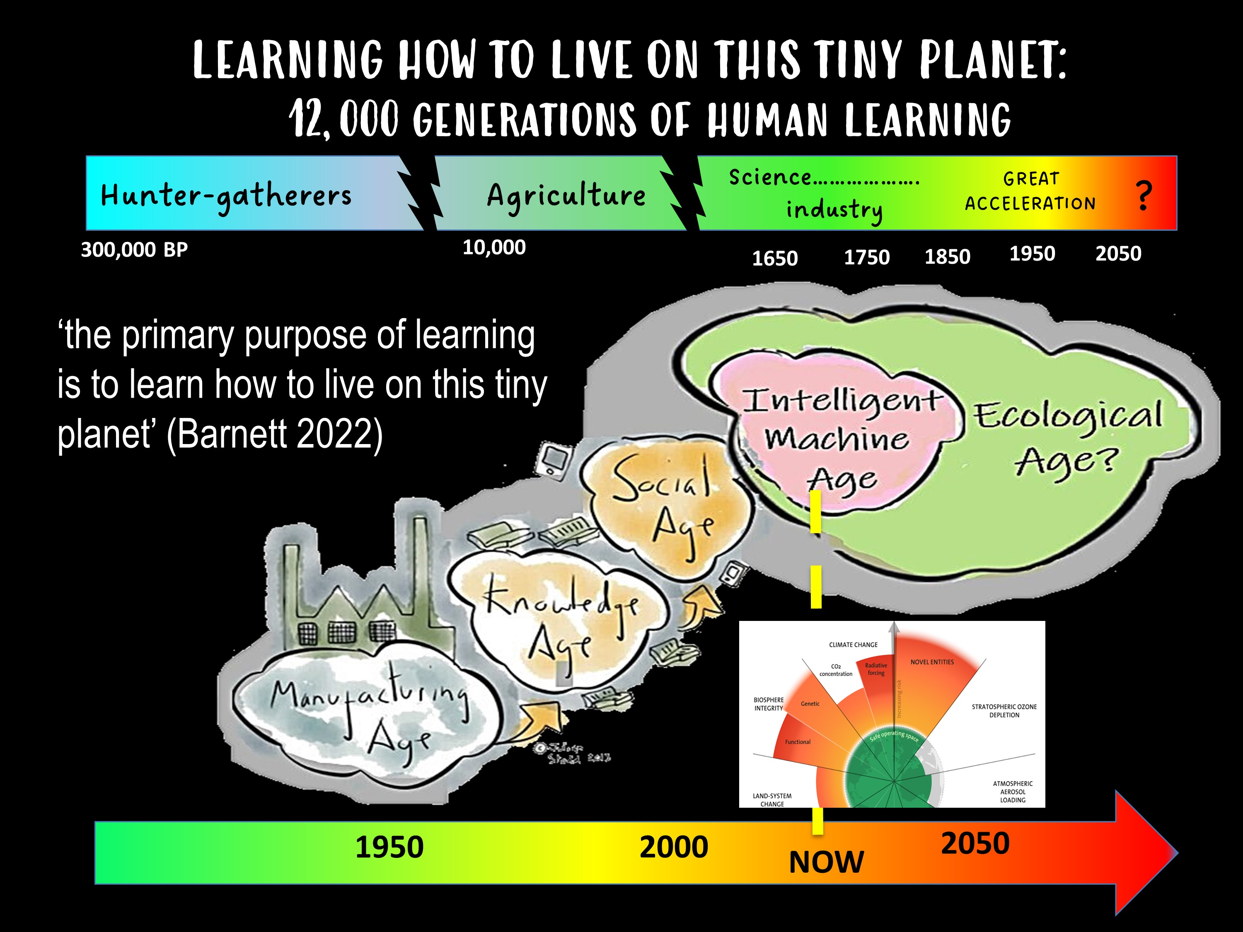

Slide 5
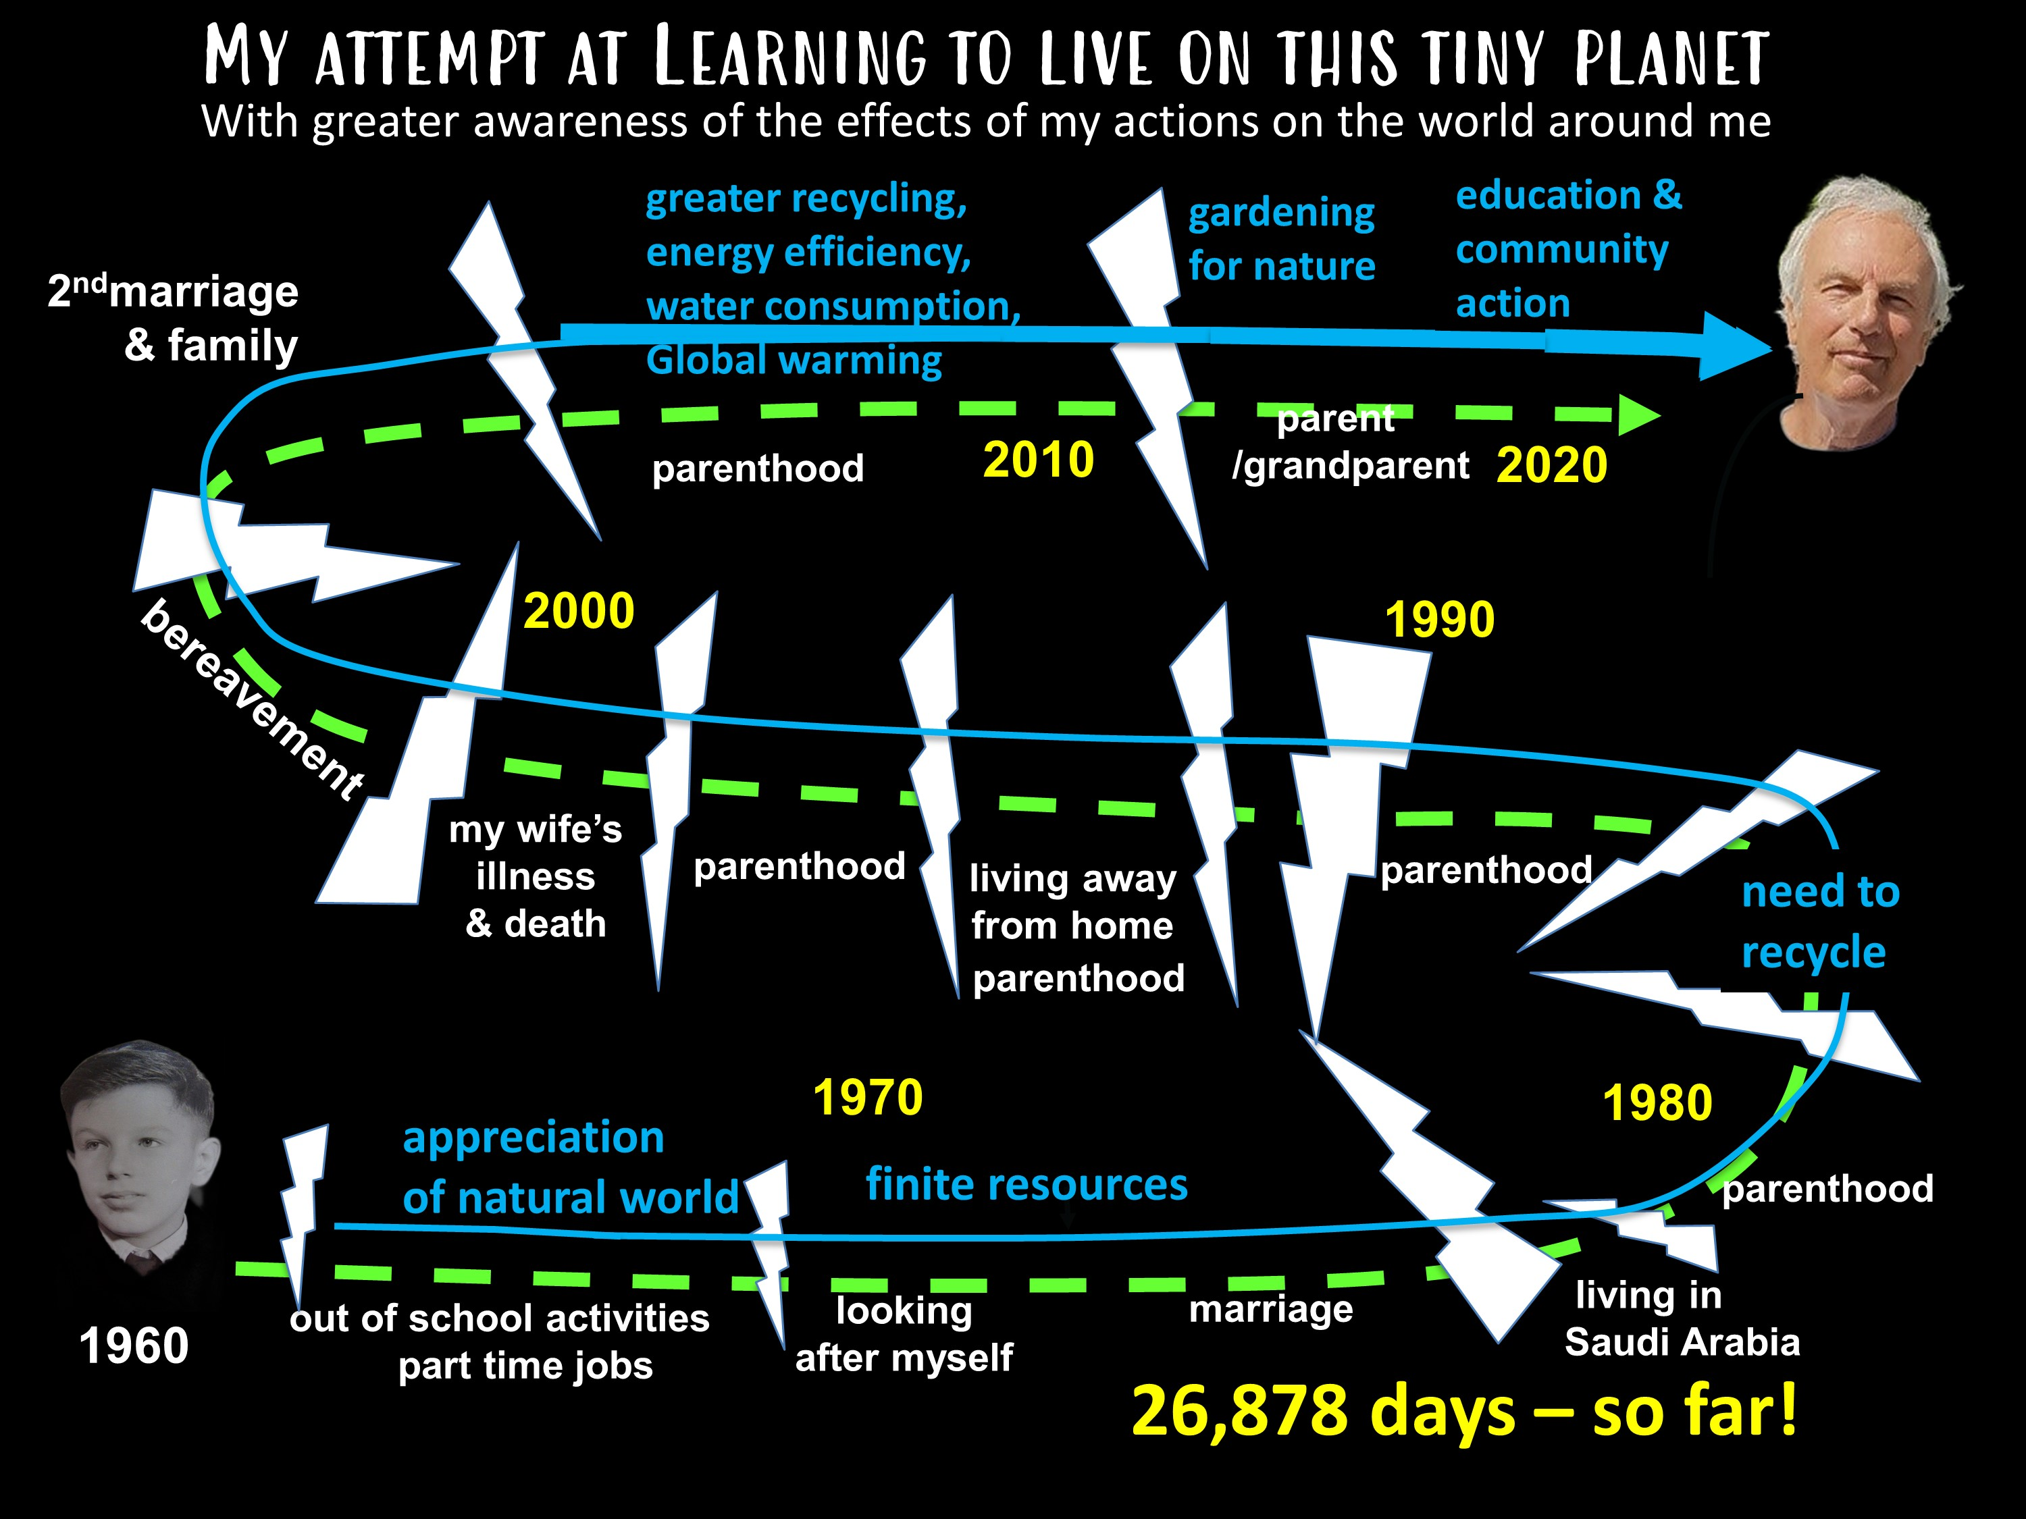

Slide 12
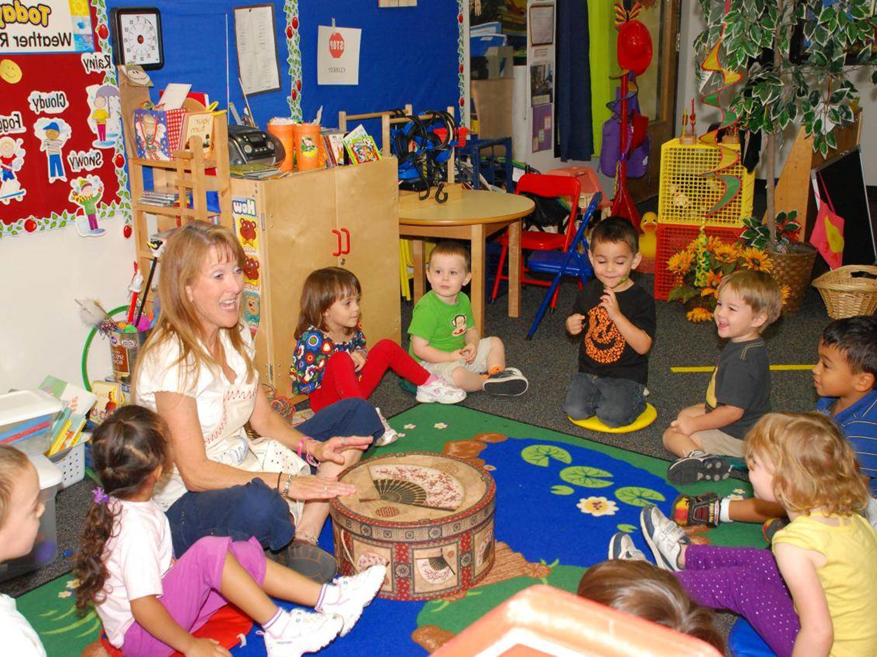

Slide 13
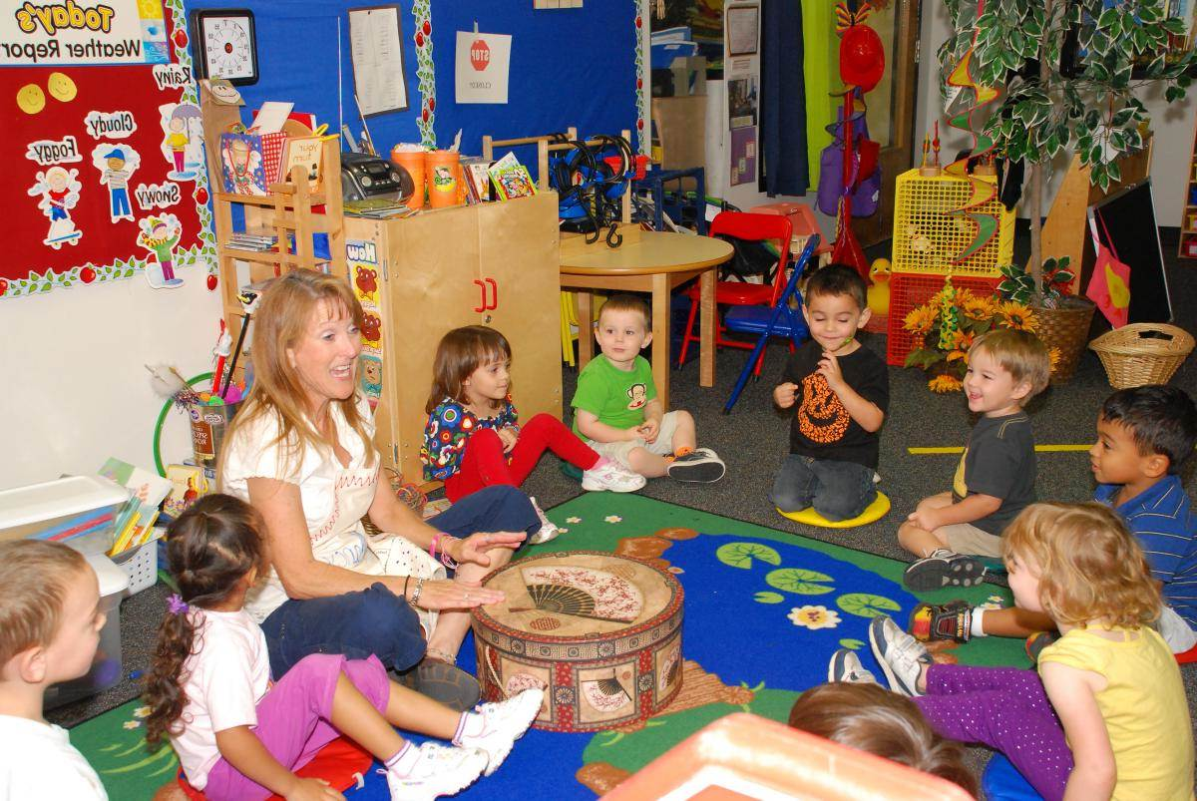
ecologies of practice & learning
4 PLACES
The classroom is the place for situational learning through the experience of doing & co-creating meaning
3 RESOURCES teacher’s pedagogical knowledge & skill, her knowledge of each child and the world, the children’s own experiences, learning aids, posters/ pictures, musical instruments, writing materials, pupils’ work, internet and more
2 AFFORDANCE
Teacher’s ability to read
situation & respond
The classroom environment
The children’s responses
PAST
PRESENT
FUTURE
5 SPACES
Physical, Social, Emotional
Intellectual, Imaginative, Playful, Liminal
1 CONTEXT(S)
State educational policies. The school ethos & culture. Planned curriculum. Teacher’s intentions, values, beliefs, motivations…
6 RELATIONSHIPS
Teacher – children,
Between children
Teacher – parents,
Parents- children
Relationships with subject, environment, materials,
tools & activities
The teacher skilfully weaves together aspects of herself, the students & the environment. She senses the effects of her actions and adjusts them : learning & meaning emerge and all participants undergo through the experience.
7 ACTIVITIES which create EXPERIENCES for learning e.g. discussing, listening, showing, sharing stories, singing, dancing, reading, painting and much more

Slide 15
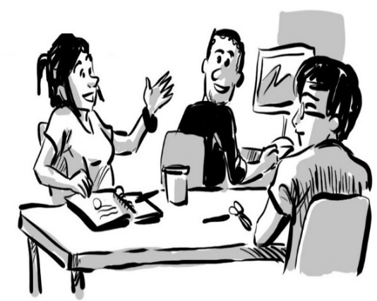
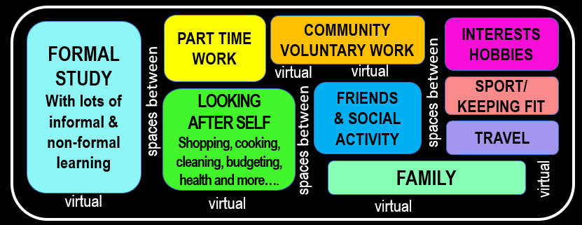
Learning for an ecological civilisation:
educational implications of these ideas
Developing self while contributing to
a future that is more sustainable
LIFEWIDE EXPERIENCES

